Slide 1
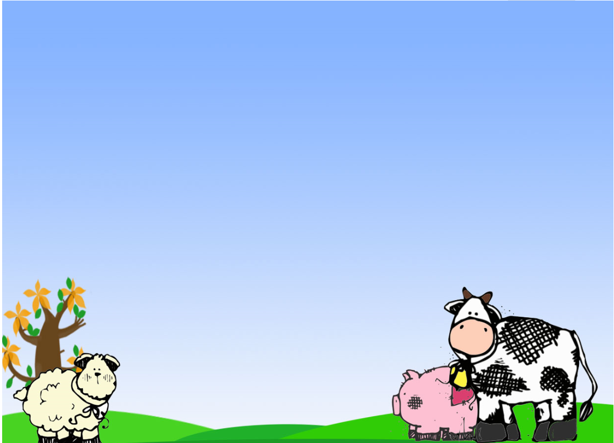
Title Layout
I AM THE SHEPHERD AND THE GATE…..
Children’s Liturgy -Fourth Sunday of Easter
3rd May 2020
Subtitle
Gospel: John 10:1-10

Slide 2
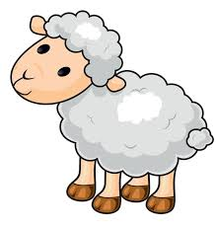
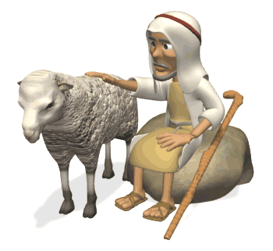
Have you seen Sheep ? You might have for sure. But, have you seen Shepherds?

Slide 3
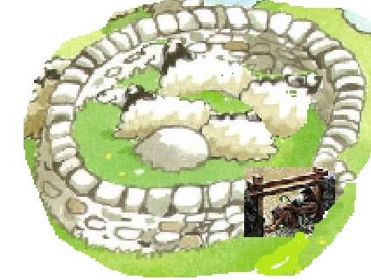
Title Layout
In Jesus’ times, the Sheepfold was made of a circle of rocks with an opening in one end. The Shepherd would lie across this opening serving himself as the Gate, guarding the sheep.
Subtitle

Slide 4
NO OTHER CALLS PLEASE…
The sheep listen and learn the voice of the shepherd. When the shepherd calls, the sheep follow him. The sheep is sure that he will guide them to green fields for grazing.

Slide 5
Add a Slide Title - 1
Jesus says, “whoever enters through the gate is the shepherd of the sheep.
The gatekeeper opens it for him, and
the sheep hear his voice, as the shepherd calls his own sheep by name and leads them out.
He walks ahead of them, and the sheep follow him,
because they recognize his voice.
But they will not follow a stranger; they will run away from him, because they do not recognize the voice of strangers.”

Slide 6
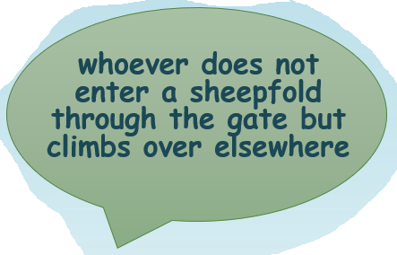
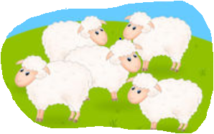
Who are the strangers? How do they come?
Yes, that’s right!
They are thieves and robbers. They come only to steal, slaughter and destroy the sheep.

Slide 7
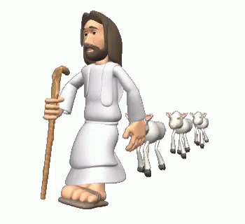
JESUS IS THE SHEPHERD AND WE ARE HIS SHEEP.
All who came before the Shepherd are thieves and robbers, but the sheep did not listen to them
because they do not recognize the voice of strangers.”
Jesus tells us that, he is OUR SHEPHERD who guides and takes care of us (the sheep) and THE GATE who protects us.
SO, WHAT MUST WE, THE SHEEP, DO??

Slide 8
Title Layout
FOLLOW HIM …. THAT’S RIGHT!
WE MUST FOLLOW ONLY JESUS .
WHY??
Because HE is our SHEPHERD. He knows what is good for us.
JESUS says, ‘I am the gate. Whoever enters through me will be saved and will come in and go out and find pasture.’
TO BE SAVED
TO FIND GREEN PASTURES OF LIFE..
FOLLOW THE SHEPHERD ‘JESUS’
Subtitle

Slide 9
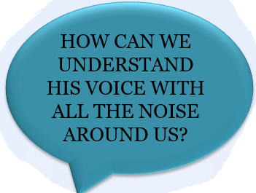
Add a Slide Title - 1
WE MUST not FOLLOW any other VOICES
GIVE NO EAR TO STRANGE VOICES PLEASE!!
WHY??
BECAUSE STRANGERS ARE THIEVES AND ROBBERS.
THEY COME only to steal and slaughter and destroy.
To follow Him, we must understand His voice
TO UNDERSTAND HIS VOICE WE MUST LISTEN AND LEARN HIS VOICE CALLING OUT OUR NAME.
HOW CAN WE FOLLOW JESUS IF WE DON’T HEAR JESUS?

Slide 10
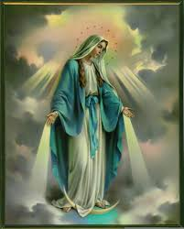
How can we understand the voice of Jesus? How can we hear him?
THE LIVING WORD of the BIBLE
THE VOICE OF JESUS.
THAT LEADS US TO LIFE.
HOLY SPIRIT
‘COME HOLY SPIRIT
MOTHER MARY
She intercedes for us to
‘DO WHATEVER JESUS TELLS’
ANGELS Brings messages from God, guides us..
SAINTS:
Their life shows us how to follow Jesus.
PRIEST:
THE REPRESENTATIVE OF JESUS - THE SHEPHERD.
HE SHOWS US HOW TO FOLLOW HIS VOICE.
OUR PARENTS
THEY ARE ENTRUSTED BY GOD TO HELP US GROW LIKE JESUS. LET US OBEY THEM

Slide 11
Jesus says, ‘I came so that they might have life and have it more abundantly.’ - John 10:10
JESUS LEADS US TO LIFE AS WE FOLLOW HIM
LET US REFLECT ON THE LIFE OF JESUS FROM THE GOSPEL.
Christ LIVED, leaving us an example that we should follow in His footsteps.(1 Peter 2:)
What all aspects can you remember in Jesus’s life?
PERSEVERANCE
LOVING
OBEDIENT
FORGIVING
PRAYERFUL
FIND OUT MORE ABOUT HIM…
KNOWING JESUS IS ETERNAL LIFE.(JOHN 17:3)

Slide 12
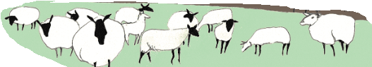
Jesus says, “Come follow me….”
Let us pray Psalms 23 together,
The Lord is my shepherd, I shall not want. He makes me lie down in green pastures; he leads me beside still waters; he restores my soul. He leads me in right paths for his name’s sake.
Even though I walk through the darkest valley, I fear no evil; for you are with me; your rod and your staff— they comfort me.
You prepare a table before me in the presence of my enemies; you anoint my head with oil; my cup overflows. Surely goodness and mercy shall follow me all the days of my life, and I shall dwell in the house of the Lord my whole life long.
LET US SING ALONG

Slide 13
DEAR JESUS, TRAIN US TO LISTEN TO YOU AND FOLLOW YOU BY LIVING IN THE HOLY SPIRIT GIVEN TO US. AMEN
For more ideas and activities
Please visit: http://littleevangelist.com/childrens_liturgy.php
https://www.youtube.com/channel/UCndM2GK0dnpWg5ECUscdDcA
VERSES:
I am the gate. Whoever enters through me will be saved, and will come in and go out and find pasture.
– John 10:9
THANK YOU

