Slide 1
HE IS ALIVE
EASTER SUNDAY
- THE RESURRECTION
HALLELUJAH !!

Slide 2
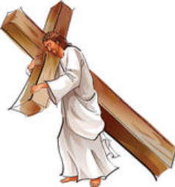
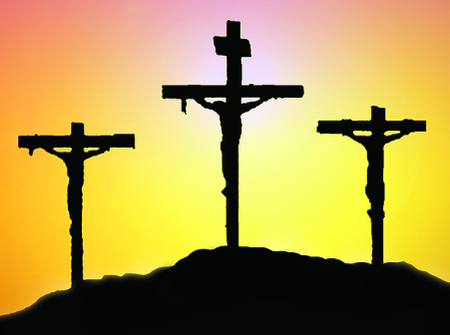
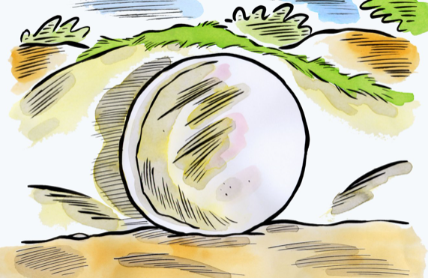
Do you remember what happened on Good Friday?
What happened to Jesus?
What happened to Jesus’ friends?

Slide 3
Let’s find out what were Jesus’ friends up to…
Take your Bible
Can you read or ask your parents to read for you;
Mark 14:50 and John 19:20
So, what do you think?
What were Jesus’ friends’ reactions?
Sad and scared

Slide 4
But there was someone who was so eager to see the tomb where they kept Jesus…
Can you guess who?
This person came to the tomb early in the morning.....
Crack this code: DMDADRDY HMHAHGHDHAHLHEHNHE
(Clue: remove all D from the first word and all H from the second word)
Yes, she was so passionate to see Jesus because of the love and forgiveness she received from Him.

Slide 5
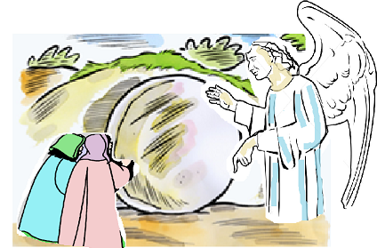
Do you know what she saw?
SHE SAW THE STONE REMOVED FROM THE TOMB.
So she ran and went to Simon Peter and to the other disciple whom Jesus loved, and told them, “They have taken the Lord from the tomb, and we don’t know where they put him.”

Slide 6
Peter and the other disciple ran to the tomb….
Who reached the tomb first?
Who entered the tomb first?
Can you find out?
Read John 20:1-9 from your Bible

Slide 7
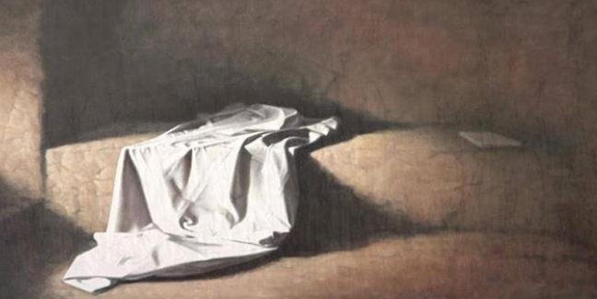
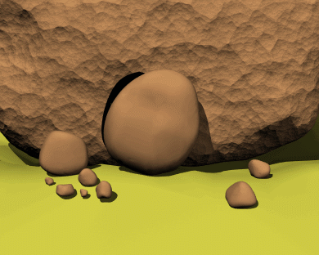
What did they see inside the tomb?
Was it really empty?
Just have a peep into the tomb for yourself

Slide 8
Then Peter and the other disciple set out and went toward the tomb. The two were running together, but the other disciple outran Peter and reached the tomb first.
He bent down to look in and saw the linen wrappings lying there, but he did not go in. Then Simon Peter came, following him, and went into the tomb. He saw the linen wrappings lying there, and the cloth that had been on Jesus’ head, not lying with the linen wrappings but rolled up in a place by itself.
Then the other disciple, who reached the tomb first, also went in…
CAN A DEAD PERSON DO THIS?

Slide 9
Then they saw and believed…
Do you believe?
JESUS IS ALIVE
LET US SING HALLELUJAH!!!

Slide 10
SO ON THIS DAY OF EASTER, JESUS IS ASKING US,
ARE WE STANDING SCARED OR DOUBTFUL BEFORE EMPTY TOMBS OF OUR HOPELESSNESS, BECAUSE OF OUR WEAK FAITH IN THE LIVING JESUS?
THEN TURN AROUND! THE ANGEL OF THE LORD IS ASKING US “Why do you look for the living among the dead? He is not here but has risen.
OUR JESUS IS LIVING. HE IS BRINGING THE LIGHT OF LIFE INTO OUR WEAK FAITH, DOUBTS AND HOPELESSNESS.
HE IS SAYING TO US THAT “YOU ARE NOT ALONE; I WILL BE WITH YOU FOREVER”
ASK YOUR PARENTS TO READ MORE ABOUT THE RESURRECTED JESUS VISTING HIS FRIENDS SHOWING HIMSELF THAT HE IS LIVING IN THE BIBLE. READ THE FOLLOWING:
- LUKE 24, MATTHEW 28, JOHN 20 & 21

Slide 11
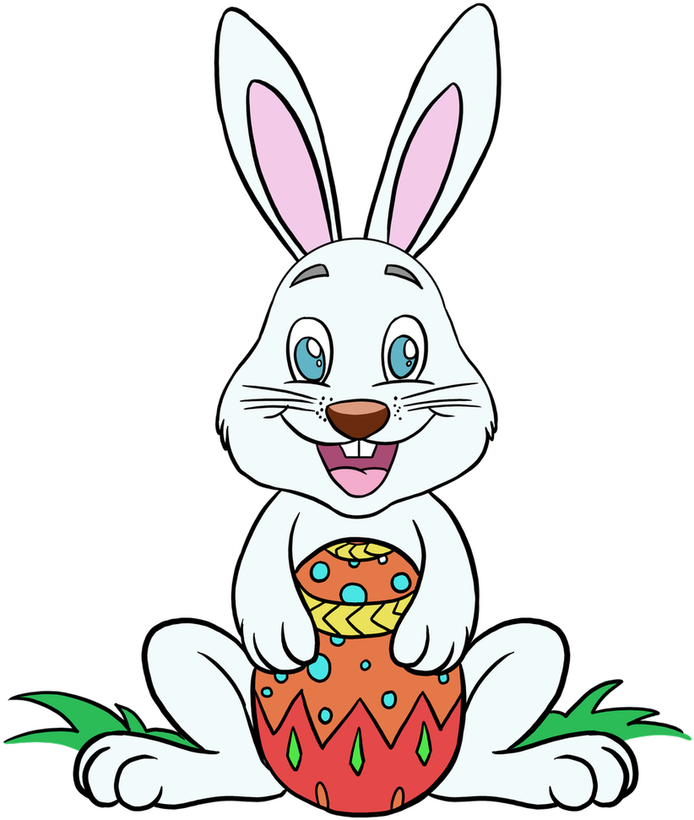
HAPPY EASTER TO YOU ALL!
INVITE JESUS TO LIVE WITH YOU ALWAYS
SPREAD THE GOOD NEWS:
“that Christ died for our sins in
accordance with the scriptures,
and that he was buried, and that he was
raised on the third day in
accordance with the scriptures” (1 Corinthians 15:4)

Slide 12
Try making your own Easter Garden!
Have an Easter verse hunt!
Play the Egg hunt!
FOR MORE IDEAS VISIT : https://www.youtube.com/channel/UCndM2GK0dnpWg5ECUscdDcA/featured
DOWLOAD THE ACTIVITY SHEETS FROM:
http://littleevangelist.com/childrens_liturgy.php

Slide 13
HAPPY EASTER TO YOU ALL!
JESUS IS ALIVE IN YOU

