Slide 1
Second Sunday of Easter - The Sunday of Divine Mercy
FAITH
BIBLE
BIBLE
’Blessed are those who have not seen and have believed.”- Matthew 20:29

Slide 2
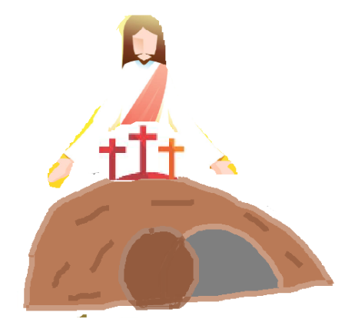
Do you remember what did we celebrate last Sunday?
EASTER
It is the time.
And we are in
JESUS ROSE BACK TO LIFE!
YES IT WAS THE RESURRECTION OF OUR LORD.
LOCKDOWN
DO YOU KNOW THAT A FEW OTHERS WERE IN LOCKDOWN TOO DURING THIS TIME. CAN YOU GUESS WHO?
Notes:
NOTE: To change images on this slide, select a picture and delete it. Then click the Insert Picture icon in the placeholder to insert your own image.
2

Slide 3
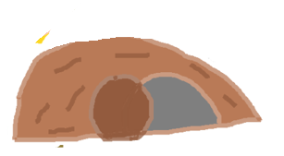
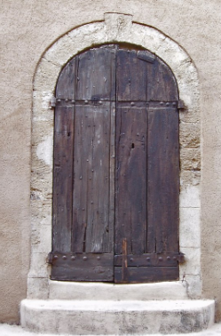
On the evening of the first day of the week, the DISCIPLES too were LOCKED DOWN INSIDE for THEY feared the Jews. The doors were locked from inside.
Jesus’ tomb is
open and
empty
but the disciples were closed and locked inside.
CLOSED
FEAR LOCKED THE DOORS… CAN YOU GUESS WHAT DO DOORS POINT TO US?
Notes:
NOTE: To change images on this slide, select a picture and delete it. Then click the Insert Picture icon in the placeholder to insert your own image.
3

Slide 4
BUT, THROUGH THE LOCKED DOORS, SOMEONE CAME THROUGH.
DID YOU GUESS WHO?
YIPEEE!
Locked Doors Are Not A Block For His Coming…
nor A Blocked Stone.
He came amidst them and said
‘PEACE BE WITH YOU’
YEAH
ITS JESUS!
LOCKDOWNS ARE NOT BLOCKS FOR JESUS

Slide 5
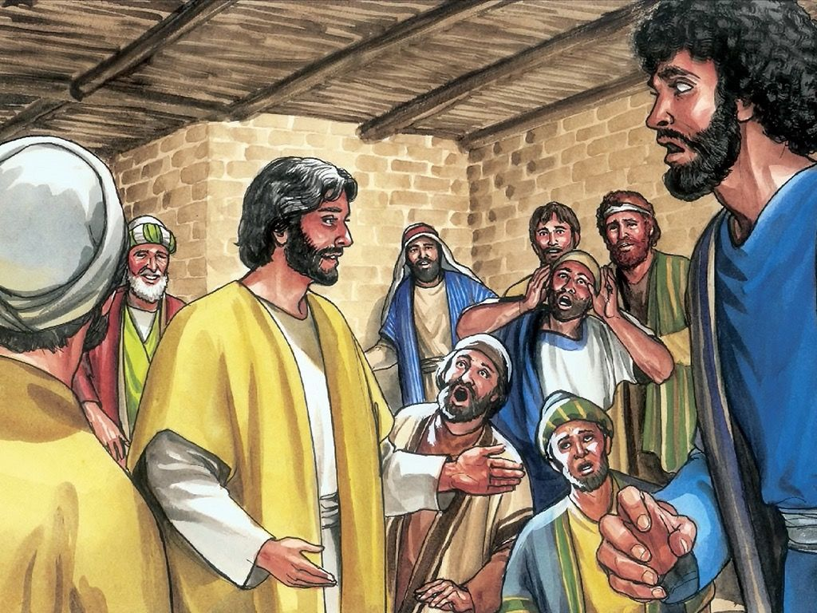
EVEN THEN THE DISCIPLES WERE IN A DOUBT AND SURPRISE.
JESUS showed his wounds and they BELIEVED and REJOICED
As they believed, Jesus again said ‘Peace be with you.’
He assigned them the mission in their faith in him by breathing on them and said to them, “Receive the holy Spirit. Whose sins you forgive are forgiven them, and whose sins you retain are retained.”
SO THE FIRST MISSION THROUGH HOLY SPIRIT, BY OUR FAITH IN JESUS IS TO FORGIVE OTHERS.

Slide 6
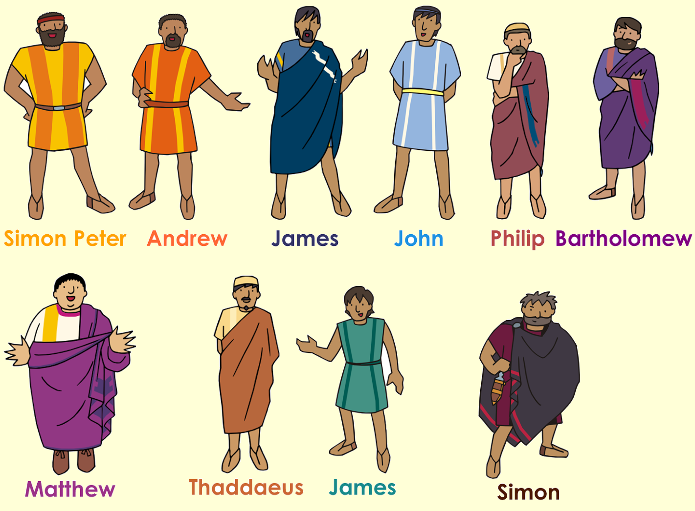
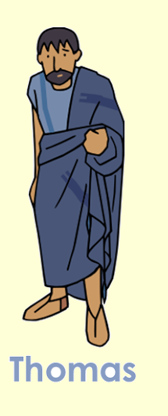
Not ALL were there, One was missing. Can you guess who?
DEFINITELTY NOT JUDAS !!
CLUE: READ John 20:24

Slide 7
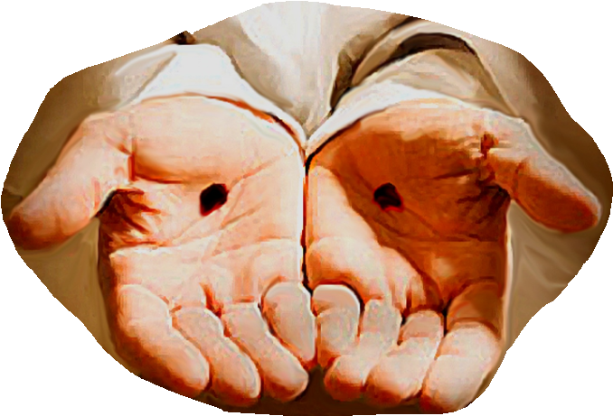
Just imagine, when someone says something that you haven’t actually seen, does it increase your curiosity?
Thomas too was so. When disciples said to him, “We have seen the Lord.”
Thomas said, “Unless I see the mark of the nails in his hands and put my finger into the nail-marks and put my hand into his side, I will not believe.”
DO WE HAVE THIS DESIRE?

Slide 8
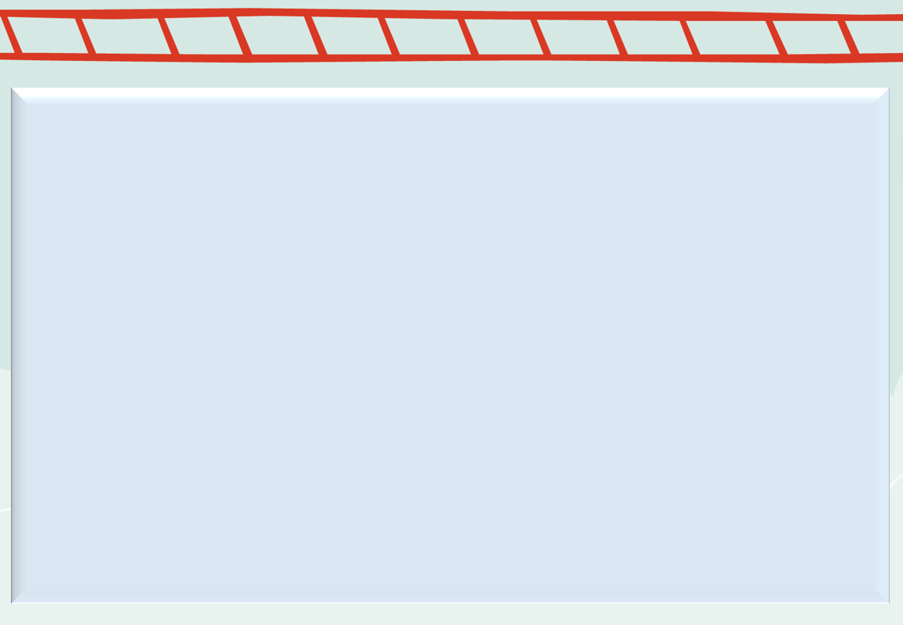
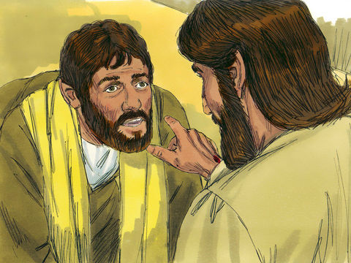
1 WEEK LATER, JESUS CAME AGAIN TO HIS FRIENDS. THIS TIME THOMAS WAS PRESENT TOO..
AGAIN HIS FRIENDS WERE INSIDE,THE DOORS WERE LOCKED..JESUS CAME THROUGH THE LOCKED DOORS…
HE STOOD IN THEIR MIDDLE AND SAID “Peace be with you”
He said to Thomas, “Put your finger here and see my hands, and bring your hand and put it into my side, and do not be unbelieving, but believe.”
Thomas answered and said to him, “MY LORD AND MY GOD!”
Jesus said to him,
“Have you come to believe because you have seen me? Blessed are those who have not seen and have believed.”
TO WHOM DO YOU THINK IS POINTING TO?

Slide 9
BLESSED ARE THOSE WHO HAVE NOT SEEN AND HAVE BELIEVED.
‘these are written that you may [come to] believe that Jesus is the Messiah, the Son of God, and that THROUGH THIS BELIEF YOU MAY HAVE LIFE IN HIS NAME.’
- John 20:31
WE LIVE BY FAITH NOT BY SIGHT.
THAT’S WHY BIBLE IS GIVEN TO US.TO UNDERSTAND MORE ABOUT JESUS
HE POINTS TO EACH OF US
NOT ALL CAN SEE HIM WITH NAKED EYES

Slide 10
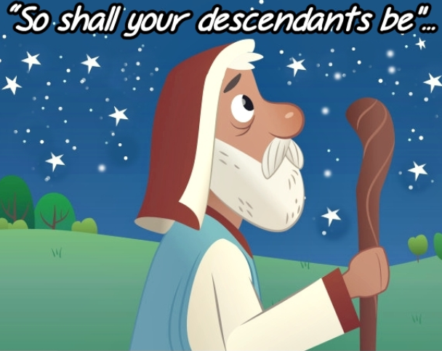
Do YOU KNOW WHO IS THE FATHER OF FAITH?
ABRAHAM
ABRAHAM WAS CHILDLESS BUT HE GOT GODS PROMISE WHEN HE WAS VERY.. VERY OLD (FIND HIS AGE )
BUT HE NEVER LOST HOPE
BUT INCREASED IN HIS FAITH..

Slide 11
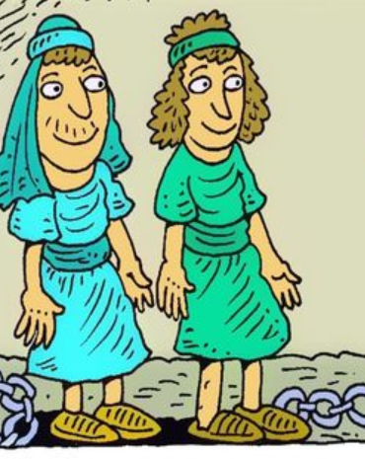
HOW DID ABRAHAM INCREASE IN HIS FAITH?
No distrust made him waver concerning the promise of God, but he grew strong in his faith as he gave glory to God, being fully convinced that God was able to do what he had promised -(Romans 4:20-21)
‘he grew strong in his faith as he gave glory to God’
THERE IS A LOCK OUT STORY !
DO YOU KNOW PAUL AND SILAS WHO WAS LOCKED OUT IN PRISON? WHAT DID THEY DO?
HOW DID THEY GET OUT?
Seek help from parents to read Acts of Apostles 16:25

Slide 12
FAITH IS THE KEY THAT PLEASES GOD
FAITH IN GOD HELPS HIM TO WORK THROUGH US AND FOR US
OUR FAITH IN JESUS IS WHAT CONQUERS THE WORLD(1 John 5:5)
SO HOW CAN WE GROW IN FAITH?
LET’S PRAY AS JESUS’s DISCIPLES PRAYED
‘JESUS INCREASE OUR FAITH’
LET’S GROWN IN FAITH BY PRAISING OUR LORD FOR EVERYTHING.

Slide 13
‘he grew strong in his faith as he gave glory to God’
LET’S PRAISE GO AMIDST HAPPINESS
LET’S PRAISE GOD AMIDST LOCK DOORS OF CORONA
PRAISE GOD ALL THE TIME…
LET’S PRAISE GOD TO OPEN OUR DOORS OF FAITH
INSIDE LOCKED DOORS OF OUR HOUSES
So,Wanna know the definition of faith?
JESUS IS PRESENT AMIDST US ..HE EVEN COMES THROUGH LOCKED DOORS….NOTHING CAN BLOCK HIS COMING TO US…

Slide 14
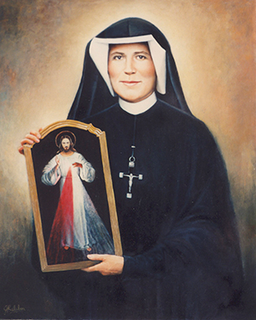
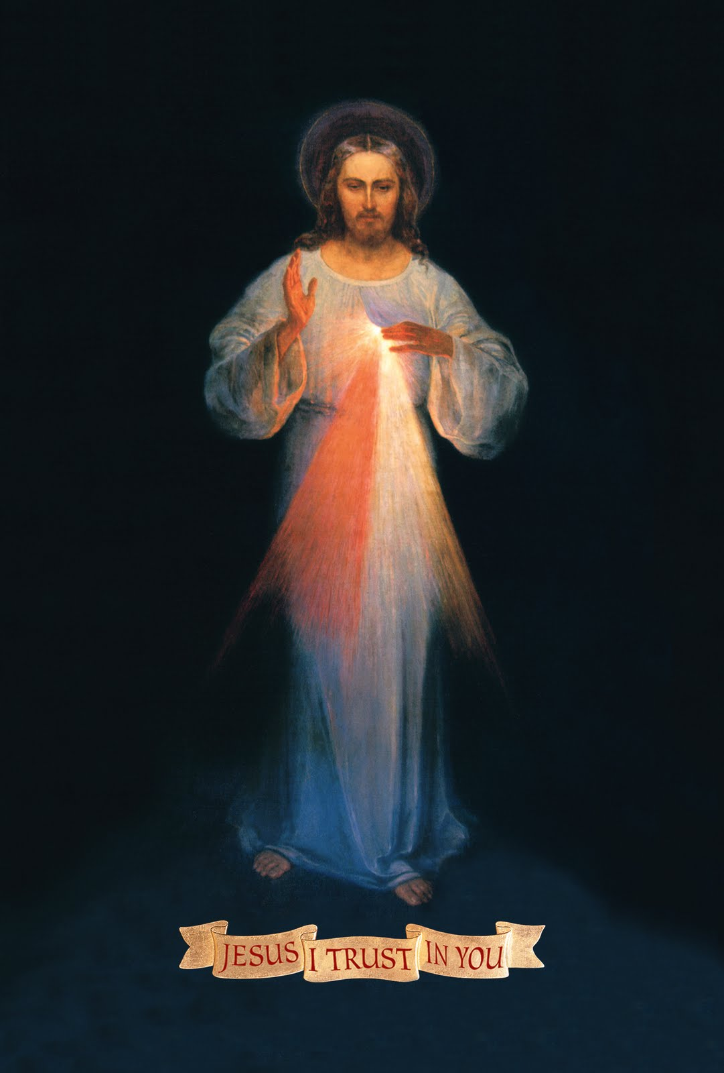
TODAY IS DIVINE MERCY SUNDAY
Jesus told her to have a Feast of Divine Mercy so that all people will turn to His unfathomable Mercy
Jesus appeared to St. Faustina, a Polish nun.
THE FIRST SUNDAY AFTER EASTER IS OBSERVED AS
DIVINE MERCY SUNDAY
Jesus in one of his vision to St. Faustina asked Sister Faustina to paint the image of Divine Mercy pouring forth from his heart. With words written’ JESUS, I TRUST IN YOU
ON THE DIVINE MERCY SUNDAY, THE DIVINE MERCY
CHAPLET WILL BE PRAYED , THE DIVINE MERCY IMAGE
WILL BE VENERATED ON THIS DAY

Slide 15
JESUS GIVES THE MESSAGE TO THE WHOLE WORLD TO TRUST IN HIS MERCY AND COME TO HIM IN FAITH
HE SAID TO ST.FAUSTINA’ “I demand from you deeds of mercy, which are to arise out of love for Me.”’

Slide 16
MANKIND WILL NOT HAVE PEACE UNTIL IT TURNS WITH TRUST TO MY MERCY-JESUS (Diary 300 St.Faustina)
LET US OPEN UP THE LOCKED DOORS OF FAITH PRAISING THE MERCY OF OUR LORD JESUS WHO GAVE HIMSELF FOR US. JESUS COMES AMIDST US AND SAYS
‘PEACE BE WITH YOU’
LET HIS PEACE BE WITH US AMIDST ALL LOCKEDOWN AS WE PRAY,
LORD,”INCREASE OUR FAITH” (Luke 17:5).JESUS,I TRUST IN YOU.
Who is it that conquers the world but the one who believes that Jesus is the Son of God? -1 John 5:5

Slide 17
TODAYS VERSES:
’Blessed are those who have not seen and have believed.”- Matthew 20:29
For more ideas and activites
Please visit: http://littleevangelist.com/childrens_liturgy.php
https://www.youtube.com/channel/UCndM2GK0dnpWg5ECUscdDcA
FIND MORE ABOUT FAITH – READ HEBREWS 11
THE GOAL OF YOUR FAITH- THE SALVATION OF YOUR SOULS. -1 Peter 1:9

