Slide 1
‘GIVE TO GOD WHAT BELONGS TO GOD’
CHILDREN’S LITURGY OCTOBER 18th, 2020
GOSPEL: MATTHEW 22:15-21

Slide 2
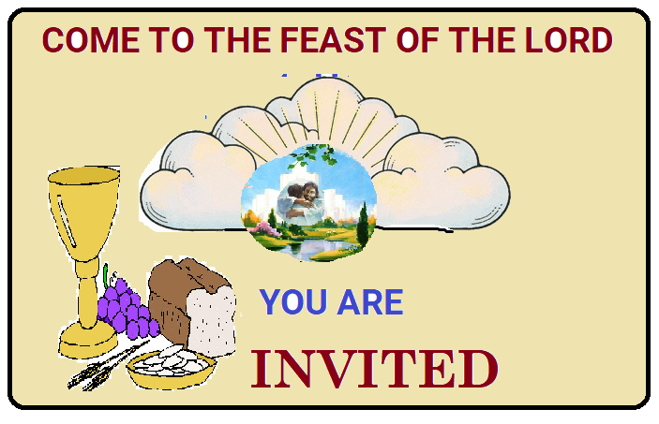
LAST WEEK IN THE GOSPEL
"HAPPY ARE THOSE WHO ARE CALLED TO HIS SUPPER” - LUKE 14:15
JESUS TOLD US
THE PARABLE OF THE WEDDING BANQUET
“MANY ARE INVITED, BUT FEW ARE CHOSEN."
JESUS REVEALED TO US THAT,
THE WEDDING FEAST IS THE KINGDOM OF HEAVEN.
WE ARE INVITED TO THE FEAST THROUGH OUR BAPTISM.
LET US PREPARE AND GET READY FOR THE FEAST.

Slide 3
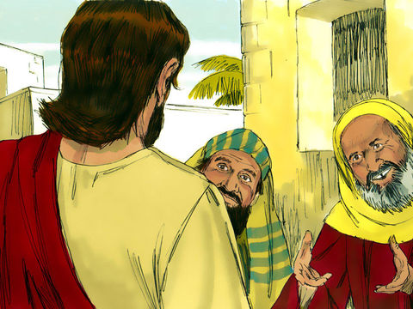
IN TODAY’S GOSPEL, WE SEE THE PHARISEES PLOTTING PLANS TO TRAP JESUS.
THEY SEND THEIR DISCIPLES AND HEROD’S SUPPORTERS TO TRAP JESUS IN SPEECH.
“Teacher, You are a very true man, who teaches the way of God in truth.
And You never take opinions to please people, for You do not regard people with partiality. Can You tell us, what is your opinion; IS IT LAWFUL TO PAY TAXES TO THE ROMAN EMPEROR OR NOT?”
JEWS DIDN’T LIKE TO PAY TAX TO ROMANS. THEY GAVE TEMPLE TAX TO GOD ACCORDING TO THE LAW OF MOSES.
THEIR TRAP WAS TO CATCH JESUS IN WORDS SPOKEN AGAINST
THE ROMANS.

Slide 4
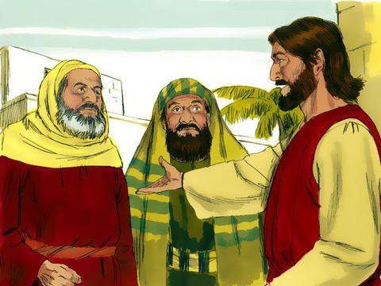
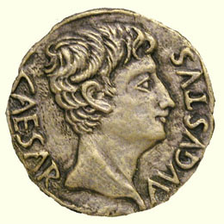
Knowing their malice, Jesus said,
“Why are you testing me, you hypocrites? Show me the coin that pays the tax.”
“The Emperor's!”
“Whose head is ON THE COIN, and whose title?”
“Give therefore to the emperor the things that are the emperor’s, and to God the things that are God’s.”
WHEN THEY HEARD THE REPLY OF JESUS , THEY WERE AMAZED; AND THEY LEFT HIM AND WENT AWAY.

Slide 5
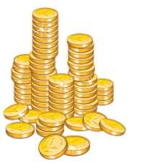
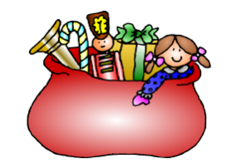
WHAT WAS JESUS’ ANSWER ?
GIVE TO THE WORLD WHAT BELONGS TO THE WORLD.
WHAT ARE THE THINGS THAT BELONG TO THE WORLD?
MATERIALS
HOUSE
MONEY
CLOTHING
POSITIONS
WHOSE IMAGE IS IMPRINTED ON IT?
THE WORLD’S OR GOD’S??

Slide 6
EVERYTHING OF THE WORLD BELONGS TO GOD AND IS GIVEN TO US BY OUR GOD.
ARE WE USING IT IN GREED , PRIDE, SELFISHNESS , ENVY, HYPOCRISY ….??
THEN YOU ARE IMPRINTING IT WITH THE IMAGE OF THE
LORD OF THIS WORLD.
THANKSGIVING IMPRINTS GOD’S IMAGE IN EVERYTHING WE HAVE AND IN ALL WE DO
BY ACKNOWLEDGING THE REAL PROVIDER
WE MUST BE THANKFUL TO GOD AND
USE IT FOR THE RIGHT PURPOSE FOR WHICH IT IS GIVEN TO US.

Slide 7
2. GIVE TO GOD WHAT BELONGS TO GOD
WHAT BELONGS TO GOD?
OUR SOUL, OUR DEEDS, OUR LIFE MUST BE FOR GOD.
JESUS CAME TO GATHER US WHO BELONGED TO GOD.
HE REDEEMED US BY PAYING HIS LIFE AS RANSOM, SEALING US WITH HOLY SPIRIT.
Let us live wisely led by Holy Spirit, filling in wisdom of God.

Slide 8
JESUS ANSWERED IN WISDOM .
JESUS DEALT WITH THE ISSUE OF TAX IN THE WISDOM OF GOD.
HAVE YOU EVER BEEN TRICKED?
BE WISE AS JESUS IS
FOLLOW JESUS….
THE WISDOM OF THE LORD HELPS US TO USE THE THINGS OF THIS WORLD WISELY AND TO LIVE AS CHILDREN OF GOD.

Slide 9
LIVE IN THE WISDOM OF GOD
* ACKNOWLEDGE THAT WE BELONG TO GOD.
* IN EVERYTHING, GIVE GOD THE GLORY.
USE THE THINGS OF THE WORLD IN WISDOM OF GOD AS
HIS GOOD STEWARDS WITH A THANKFUL HEART.
* ABIDE TO THE RULES AND LAWS SET BY THE GOVERNMENTS AND AUTHORITIES IN WISDOM OF GOD.
PRAY FOR OUR GOVERNMENT AND AUTHORITIES THAT WE ARE SUBJECT TO; LIKE SCHOOLS , UNIVERSITIES ETC. FOR FILLING IN WISDOM OF LORD TO RULE AND GUIDE ACCORDING TO HIS PLAN.

Slide 10
Today is world mission Sunday
Let us thank God for all His blessing and
Use everything in the wisdom of God for good of all around us.
CAN YOU THINK OF WAYS TO HELP SOMEONE AROUND YOU?
BY HELPING OTHERS, WE HONOR GOD AND GLORIFY HIS NAME..

Slide 11
LET US PRAY,
DEAR LORD JESUS, THANK YOU FOR REDEEMING US BY GIVING YOUR LIFE AS RANSOM AND SEALING US WITH THE
HOLY SPIRIT. DELIVER US BY YOUR GRACE FROM THE TRAPS AND TRICKS OF THE WORLD. FILL US WITH WISDOM THROUGH HOLY SPIRIT, TO LIVE WISELY AS YOU LIVED IN THIS WORLD, GLORIFYING THE LORD BY OUR LIVES.
IN JESUS’ NAME WE PRAY, AMEN

Slide 12
VERSE FOR THE DAY

Slide 13
THANK YOU AND GOD BLESS YOU ALL
PLEASE KEEP LITTLE EVANGELISTS IN YOUR SPECIAL PRAYERS
FOR MORE IDEAS , PLEASE VISIT:
WEBSITE: http://littleevangelist.com/childrens_liturgy.php
YOUTUBE CHANNEL:
https://www.youtube.com/channel/UCndM2GK0dnpWg5ECUscdDcA

