Slide 1
CHILDREN’S LITURGY JULY 5TH, 2020
GOSPEL: MATTHEW 11:25-30
COME TO ME... LEARN FROM ME… I WILL GIVE YOU REST

Slide 2
This was what the Lord spoke to us last week
FIND YOUR LIFE IN JESUS AND BE WORTHY FOR HIM
BY LOVING HIM MORE THAN ANYTHING
BY TAKING UP OUR CROSS AND FOLLOWING HIM
WE RECEIVE JESUS AND HEAVENLY FATHER, WHEN WE RECEIVE JESUS AND THOSE WHO SERVE JESUS
* WE ARE REWARDED WHEN WE HELP THEM
REWARDED
ARE WE THERE YET?
LET US SEE WHAT THE LORD TELLS US TODAY…

Slide 3
LET US CLOSE OUR EYES TAKE 3 DEEP BREATHS IN EACH BREATH YOU TAKE, SAY TO YOURSELF: ‘JESUS, I LOVE YOU’
DID YOU FIND PEACE WHEN YOU DID THIS?
THIS IS WHAT OUR GOSPEL IS TODAY
‘COME TO ME… FIND REST IN ME.’

Slide 4
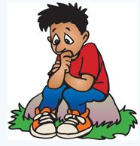
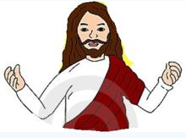
ARE WE WORRIED ABOUT ANYTHING?
ARE WE WORKING HARD FOR SOMETHING?
THEN THE GOSPEL IS FOR YOU
JESUS SAYS,
“Come to me, all you who labour and are burdened, and I will give you rest. Take my yoke upon you and learn from me, for I am meek and humble of heart; and you will find rest for yourselves. For my yoke is easy, and my burden light.”- Matthew 11:28-30
SO WHAT IS JESUS ASKING US TO DO?

Slide 5
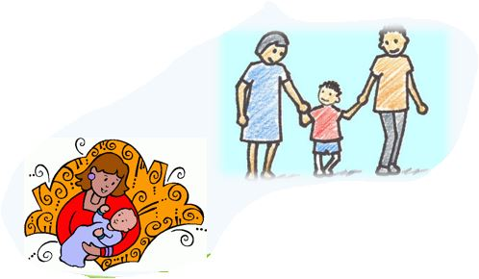
BE HUMBLE
GOD REVEALS HIS WAY TO THE HUMBLE
EVEN THOUGH HE IS THE SON OF GOD, JESUS HUMBLED HIMSELF AND OBEYED GOD IN ALL THINGS
JESUS ASKS US TO BE LIKE HIM - HUMBLE AND GENTLE
JUST LIKE A LITTLE CHILD WHO TRUSTS AND DEPENDS ON THEIR PARENTS FOR EVERYTHING, WE HAVE TO SURRENDER OURSELVES TO THE LORD AND ALLOW JESUS
TO WORK FOR US…

Slide 6
‘THE FATHER REVEALS TO THE SON AND THE SON REVEALS TO THOSE WHOM HE CHOOSES’
BE THE CHOSEN ONE
How can we be the chosen one?
Jesus says, COME TO ME
& LEARN FROM ME

Slide 7
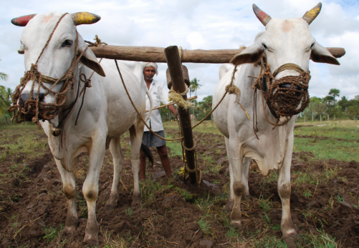
JESUS SAYS, TO TAKE HIS YOKE AND TO LEARN FROM HIM
HAVE YOU SEEN A YOKE?
Take my yoke upon you, and learn from me; for I am gentle and humble in heart, and you will find rest for your souls - Matthew 11:29
A YOKE IS WOODEN BEAM USED FOR AN OXEN OR OTHER ANIMALS TO HELP THEM TO PULL A HEAVY LOAD

Slide 8
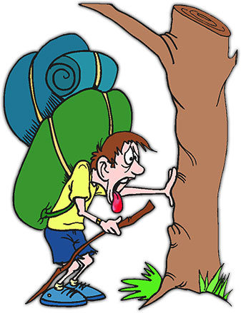
WHAT IS THE YOKE OF JESUS?
WHAT ARE OUR BURDENS?
BURDENS OF SINS, PAINS, DISEASES…
WHAT IS THE YOKE PUT UPON US?
THE YOKE OF THE WORLD - LAWS
JESUS ASKS US TO TAKE HIS YOKE
THE YOKE OF LOVE
JESUS FREED US FROM THE SLAVERY OF SIN AND FLESH. HE ALSO FREED US FROM THE YOKE OF THE WORLD, FULFILLED THE LAW AND GAVE US LOVE AND FORGIVENESS.

Slide 9
JESUS SAYS, “you will find rest for yourselves. For my yoke is easy, and my burden light.”- MATTHEW 11:29-30
WHY IS IT EASY TO CARRY THE YOKE OF JESUS?
Because JESUS CARRIED IT FOR US AND it is not by our efforts. WE JUST WANT TO FOLLOW HIM IN FAITH.
The HOLY SPIRIT whom we received through faith in Jesus, helps us to fulfill all God’s wish.
LOVED , REDEEMED AND FORGIVEN

Slide 10
WE FIND REST IN JESUS…
HOW WILL OUR SOULS FIND REST IN JESUS?
BY SURRENDERING EVERYTHING TO JESUS AND DOING WHAT HE SAYS,
Jesus reveals and leads our way to the Father..
JESUS IS THE WAY, THE TRUTH AND THE LIFE

Slide 11
PRAYER, LORD JESUS, IN EVERY MOMENT OF OUR LIVES, HELP US TO DEPEND ON YOU. TRAIN US BY YOUR HOLY SPIRIT, TO COME TO YOUR GRACE AND ALLOW YOU TO WORK FOR US. HELP US TO SEEK, LISTEN AND OBEY YOUR WORDS ALWAYS. YOU ARE THE WAY, THE TRUTH AND THE LIFE. IN JESUS NAME WE PRAY, AMEN.

Slide 12
FOR MORE IDEAS AND ACTIVITIES PLEASE VISIT;
THANK YOU ALL.
GOD BLESS
VISIT:* WEBSITE: http://littleevangelist.com/childrens_liturgy.php
* YOUTUBE CHANNEL: https://www.youtube.com/channel/UCndM2GK0dnpWg5ECUscdDcA

