Slide 1
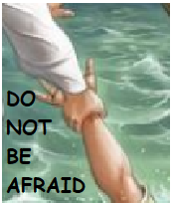
TRUST IN JESUS
CHILDREN’S LITURGY AUGUST 9TH 2020
GOSPEL:MATTHEW 14:22-33

Slide 2
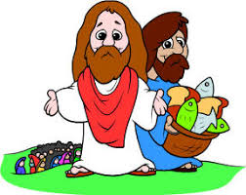
Do you remember what Jesus told us last Sunday?
In last Sunday’s gospel, Jesus asked us to OFFER unto the LORD all that we have, no matter how LITTLE,
to MULTIPLY it and to USE it for the GOOD of many.
In this week’s Gospel, Jesus asks us to
HAVE COURAGE AND TRUST HIM WITHOUT DOUBT.
IT IS ABOUT SOMETHING REALLY GREAT THAT HAPPENED TO JESUS FRIENDS.

Slide 3
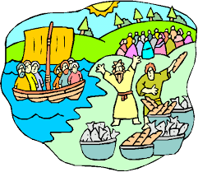
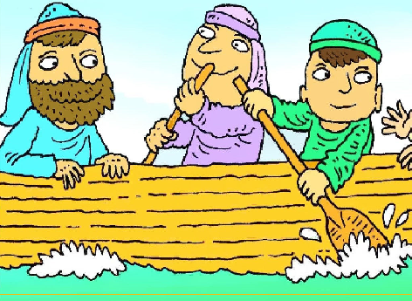
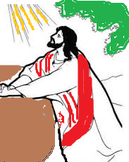
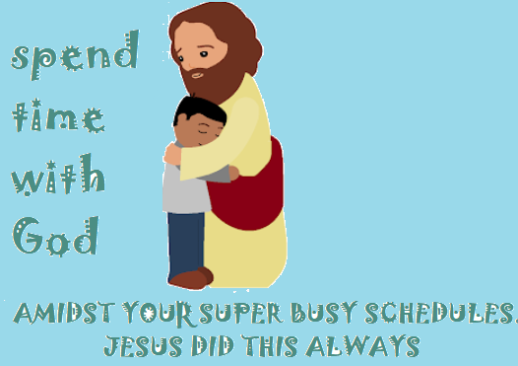
DO WE FIND TIME TO SPEND WITH OUR LORD?
AFTER FEEDING THE 5000
JESUS SEND HIS DISCIPLES IN A BOAT
JESUS HIMSELF WENT TO
PRAY TO FATHER

Slide 4
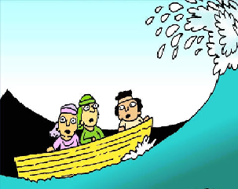
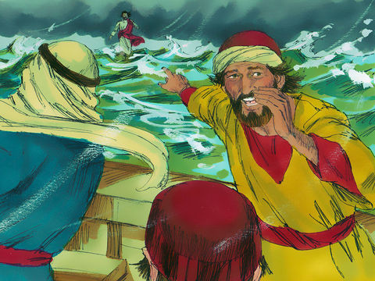
THE BOAT WAS CAUGHT IN A WIND!
SUDDENLY THEY SAW SOMEONE
WALKING ON WATER TOWARDS THEM
IT IS A GHOST!!
A TERRIBLE WIND CAUGHT THE BOAT,
THE DISCIPLES WERE SCARED

Slide 5
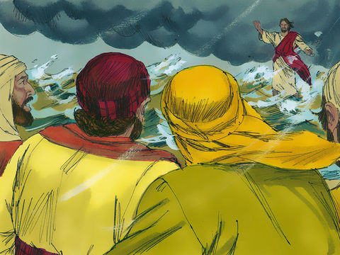
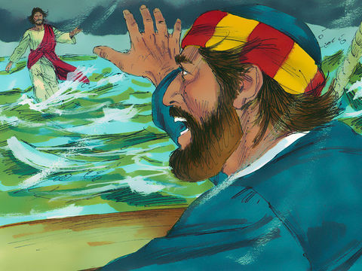
Jesus said, “Take courage, it is I; do not be afraid.”
PETER IS SO COURAGEOUS. HE TRUSTED IN JESUS.
IF YOU WERE IN PETER’S PLACE, WILL YOU TRY THIS OUT?
COME !!
Peter said, "Lord, if it is you, command me to come to you on the water.”

Slide 6
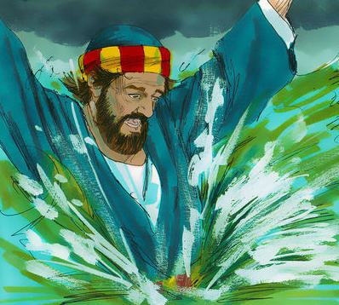
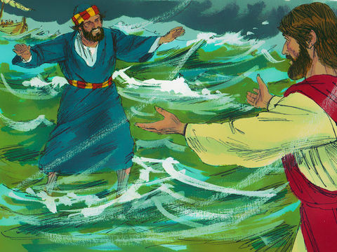
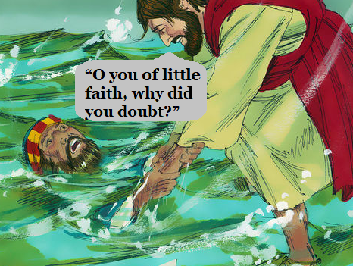
Peter got out of the boat and began to walk on the water toward Jesus.
LORD SAVE ME !
I AM SINKING !
But when he saw how strong the wind was, he became frightened; HE LOST FOCUS ON JESUS and began to sink.
OUT OF FEAR AND DOUBT, WE ALSO SOMETIMES LOSE FOCUS ON JESUS.
Jesus stretched out his hand and caught Peter.
WHY DID PETER LOSE HIS FOCUS FROM JESUS?

Slide 7
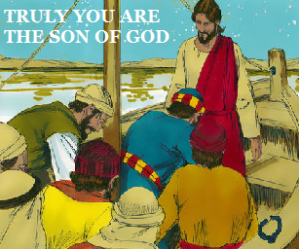
“Truly, you are the Son of God.
Jesus and Peter got into the boat; the wind died down.
Those who were in the boat did him homage, saying,
“TRULY, YOU ARE THE SON OF GOD.”
Let our troubles and challenges be transformed into times that reveal Jesus as son of God.

Slide 8
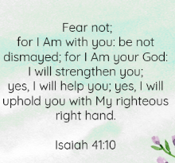
SO WHAT DOES JESUS TELL US THROUGH THE GOSPEL?
FIND TIME TO SPEND WITH THE LORD.
DURING STORMS OF TROUBLES OR CHALLENGES, SEE JESUS AND TRUST IN HIS POWER AND AUTHORITY.
STEP OUT IN COURAGE, WALK OVER THE TROUBLES FOCUSING ON JESUS
NEVER LET FEAR OVERPOWER YOU.
EVEN IF YOU FEEL LOST, CALL UPON JESUS WHO IS NEAR YOU AND WITH YOU IN TROUBLE.
USE THE CHALLENGES AS TIMES OF REVELATION OF JESUS

Slide 9
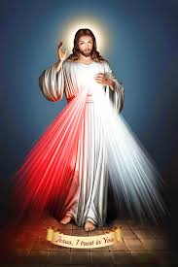
TAKE COURAGE! IT IS I….DO NOT BE AFRAID….DO NOT DOUBT
-> SO, BRING TO MIND EVERYTHING THAT CAUSES YOU FEAR OR THAT YOU FEEL IS CHALLENGING
-> WRITE THEM DOWN
-> AND AGAINST IT WRITE
‘JESUS, I TRUST IN YOU’

Slide 10
PRAYER
DEAR LORD JESUS, THANK YOU FOR BEING WITH US ALWAYS. INCREASE OUR FAITH IN YOU TO OVERCOME FEARS AND CHALLENGES AND TO STEP OUT AND WALK OVER IT, FIXING OUR FOCUS ON YOU ALWAYS. IN JESUS NAME WE PRAY, AMEN

Slide 11
VERSES
LORD, LET US SEE YOUR KINDNESS, AND GRANT US YOUR SALVATION.
(PSALMS 84:8)

Slide 12
THANK YOU
GOD BLESS
FOR MORE IDEAS , PLEASE VISIT:
WEBSITE: http://littleevangelist.com/childrens_liturgy.php
YOUTUBE CHANNEL:
https://www.youtube.com/channel/UCndM2GK0dnpWg5ECUscdDcA

