Slide 1
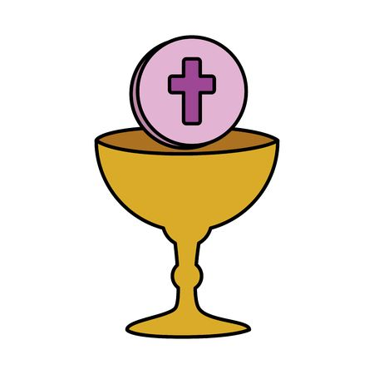
The Solemnity of the Body and Blood of Christ Corpus Christi
CHILDREN’S LITURGY JUNE 14TH, 2020
The cup of blessing that we bless, is it not a participation in the blood of Christ? The bread that we break, is it not a participation in the body of Christ? - 1 CORINTHIANS 10:16-17

Slide 2
Today is the Solemnity of the Body and Blood of Christ
CORPUS CHRISTI (in Latin)
We celebrate the REAL PRESENCE OF JESUS IN THE HOLY EUCHARIST
This is the Centre of Catholic Belief.
The Solemnity is usually celebrated on the Thursday following the Solemnity of the Holy Trinity or on the Sunday after the Holy Trinity Sunday. The feast was instituted in 1264 after the visions of a nun and a Eucharistic miracle in Bolsena, Italy.

Slide 3
Do you sometimes find it hard to believe that Jesus is present in the Holy Eucharist?
You may be doubting too, but don’t worry!!! This Solemnity was the result of one such doubt.
So let us first start with a little prayer:
‘Dear Jesus, let Your Holy Spirit fill us and help us to know more about your amazing presence in the Holy Eucharist.
Mother Mary asked the angel, “How is it possible?”, but she was willing to listen. Lord, help us to pray with this same faith.
Let your Holy Spirit overshadow us, to help us know about Your communion with us through the Holy Eucharist.
We ask this in the name of the Father, the Son and the Holy Spirit. Amen.’

Slide 4
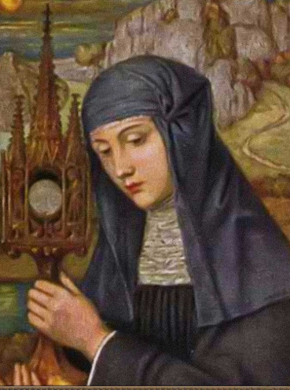
The Story of the Feast
The feast of Corpus Christi was proposed by St Thomas Aquinas, Doctor of the Church to Pope Urban IV, in order to create a feast focused solely on the Holy Eucharist.
St Juliana of Mt Cornillon in Belgium (1193-1258), a nun and mystic who had great devotion to the Holy Eucharist had a series of visions of our Lord, who asked her to establish a liturgical feast for the Holy Eucharist.
She tried to convince a future Pope, Urban IV regarding this. Finally after her death, the Feast was instituted by Pope Urban IV, after he was convinced by a Eucharistic Miracle that took place in Bolsena, Italy on 1263 to a German Priest Peter of Prague.
The Universal Church celebrated it for the first time in Orvieto in 1264, a year after the Eucharistic Miracle in Bolsena.

Slide 5
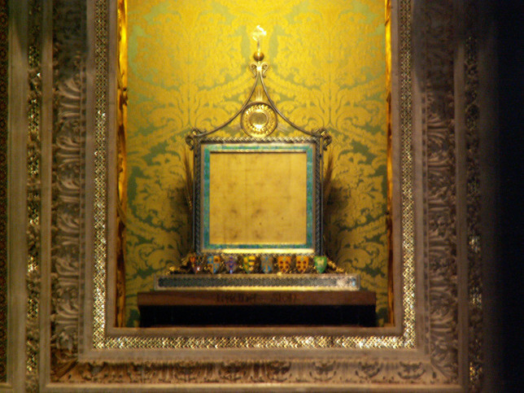
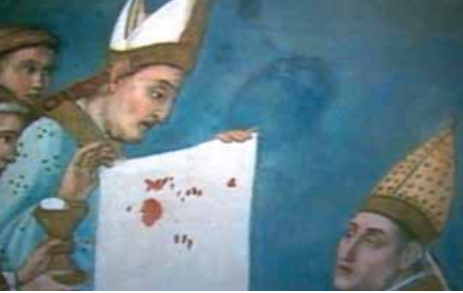
Let us hear about The Eucharistic Miracle of Bolsena, Italy in 1263
THE CORPORAL OF BOLSENA
FR PETER OF PRAGUE

Slide 6
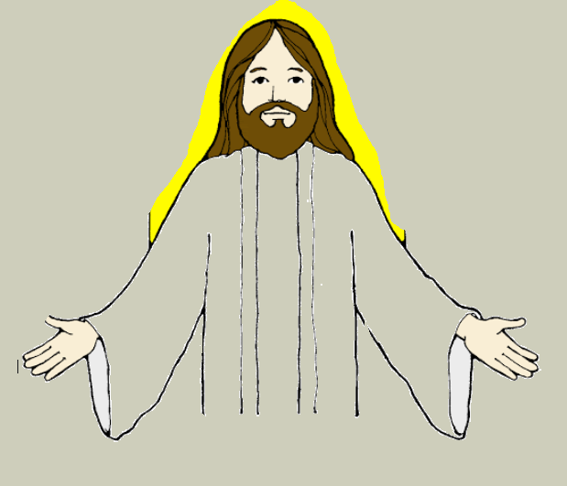
Let’s see what Jesus says in the Gospel today…
Jesus says that, He was sent by the Heavenly Father and HE HAS LIFE BECAUSE OF THE FATHER - the Father is in Him. In the same way, ANYONE WHO HAS JESUS INSIDE HIM WILL LIVE BECAUSE OF THE LIFE THAT JESUS GIVES TO THEM.
Jesus says, ‘My flesh is real food and my blood is real drink. The bread that I will give is my flesh for the life of the world… Whoever eats my flesh and drinks my blood remains in me and I in him. Just as the living Father sent me and I have life because of the Father, so also the one who feeds on me will have life because of me’ (John 6:51-58)

Slide 7
How is Jesus living inside us?
Jesus is living in us by His body and blood that we receive through:
- the Holy Eucharist
- the word of God
- our FAITH in Him
Jesus has given His body and blood for us.

Slide 8
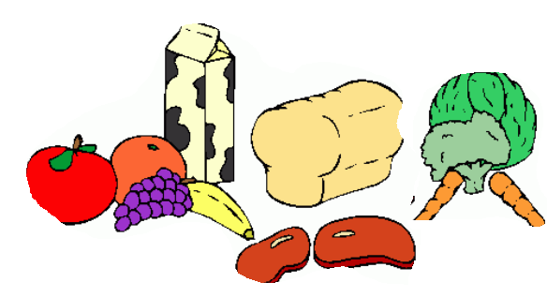
Why in the form of bread and wine?
Why do we eat food?
We eat food to maintain good health and give energy for the body to live.
SO HOW MUCH MORE WILL THE ETERNAL FOOD PROVIDE US WITH LIFE?
Being present under the appearances of bread and wine, Christ gives himself to us in a form that is appropriate for human eating and drinking.
In the same way as the food we eat becomes the part of our body, Jesus, who come into us, joins our soul in close communion.

Slide 9
Can we recall what Jesus said during the Last Supper? Let’s find out: If you need help, ask your parents to read Matthew 26:25-29 Mark 14:22-25 Luke 22:19-23

Slide 10
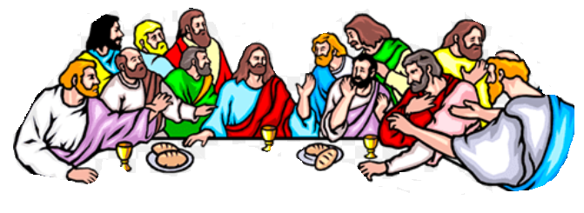
Jesus instituted the Holy Eucharist during His Last Supper.
We see that during the Last supper, Jesus took a LOAF OF BREAD, and after blessing it He broke it, gave it to the disciples, and said, “TAKE, EAT; THIS IS MY BODY.” Then He TOOK A CUP, and after giving thanks He gave it to them, saying, “Drink from it, all of you; for THIS IS MY BLOOD of the covenant, which is poured out for many for the forgiveness of sins. (Mark 14:26-25)
THE LOAF OF BREAD AFTER BLESSING IS MY BODY
THE CUP AFTER BLESSING IS MY BLOOD POURED OUT FOR THE FORGIVENESS OF YOUR SINS

Slide 11
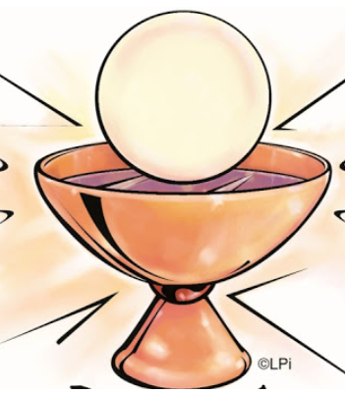
Whoever eats my flesh and drinks my blood remains in me and I in Him. Just as the living Father sent me and I have life because of the Father, so also the one who feeds on me will have life because of me. Whoever eats this bread will live forever. - John 6:56
JESUS PROMISES,

Slide 12
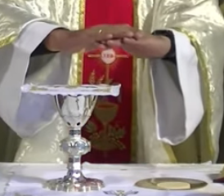
Let us see what the Priest says during the time of Holy Mass: The Eucharistic prayers
In one of the prayer, Priest prays: 'You are indeed Holy, O Lord, the fount of all holiness. Make holy, therefore, these gifts, we pray, by sending down your Spirit upon them like the dew-fall, so that they may become for us the Body and Blood of our Lord Jesus Christ.'
Recalling the words of Jesus, the Catholic Church professes that, in the celebration of the Eucharist, bread and wine become the Body and Blood of Jesus Christ through the power of the Holy Spirit and through the hands of the Priest anointed by God.
Next time, when you attend Holy Mass, seek help of parents and try to listen to this prayer and what the Priest does during this time.

Slide 13
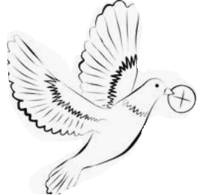
The bread and wine offered is TRANSUBSTANTIATED to the Body and Blood of Jesus during the time of Consecration in Holy Mass
TRANSUBSTANTIATION
It is the work of the Holy Spirit and the mystery of faith.
This is the change brought about in the Eucharistic prayer through the power of the word of Christ and by the action of the Holy Spirit. However, the outward characteristics of bread and wine, remain unaltered, the substance of it changes to Body and Blood of Jesus
The Consecrated Host is the Real Body and Blood of Jesus Christ.

Slide 14
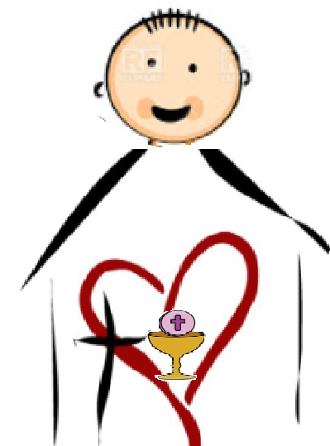
THE LIVING PRESENCE OF JESUS IS IN US
As we go out to the world after receiving Jesus,
we must remind ourselves that:
WE ARE THE HOUSE OF THE LORD bearing the real presence of the living Lord in us.
WE ARE CALLED TO TAKE JESUS THE LIVING WORD AND CHANGE OUR WORLD.
By coming into us each time we receive holy communion, Jesus wants to live through us giving us life to live in the same way as Jesus lived.

Slide 15
During this time we are not able to receive Jesus physically in the Holy Communion - we receive Him Spiritually
Let us pray for all of our priests who are in pain of not being able to celebrate Holy Mass with us.
Let us think of our heavenly Father and Jesus who too is in pain
Let us pray:
Dear Jesus, remain in us spiritually and strengthen us. Make us eligible to receive you soon again. We wait in love and thirst.

Slide 16
THE STORY OF ST.JULIANA

Slide 18
THANK YOU
FOR MORE ACTIVITIES AND IDEAS PLEASE VISIT
1.http://littleevangelist.com/childrens_liturgy.php
2.https://www.youtube.com/channel/UCndM2GK0dnpWg5ECUscdDcA
REFERENCES FROM:
*iBreviery
* http://stjuliana.org/events/st-juliana-book-club-sjbc/item/661-corpus
*http://www.therealpresence.org/eucharst/mir/bolsena.html
*https://en.wikipedia.org/wiki/Corporal_of_Bolsena

