Slide 1
CHILDRENS LITURGY 12TH JULY 2020
BE THE RICH SOIL, BE FRUITFUL
GOSPEL: MATTHEW 13:1-23
Notes:
NOTE: To change images on this slide, select a picture and delete it. Then click the Insert Picture icon
in the placeholder to insert your own image.

Slide 2
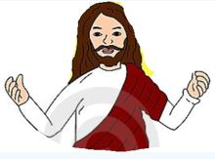
IN THE LITURGY LAST SUNDAY:
JESUS SAID:
* COME TO ME AND LEARN FROM ME
* FIND REST IN ME, WHO ARE BURDENED
* BE HUMBLE AND GENTLE LIKE JESUS
TODAY JESUS IS ASKING US TO LEARN FROM HIM.
HE TEACHES US A PARABLE.

Slide 3
WHAT ARE PARABLES?
PARABLES ARE SHORT STORIES THAT TEACH A MORAL OR SPIRITUAL LESSON.
JESUS OFTEN TAUGHT USING PARABLES
HE USED SIMPLE NARRATIONS TO MAKE HIS FOLLOWERS UNDERSTAND THE LORD’S WISH FOR US.
Notes:
NOTE: To change images on this slide, select a picture and delete it. Then click the Insert Picture icon
in the placeholder to insert your own image.

Slide 4
JESUS SAYS, BLESSED ARE THE EYES THAT SEE WHAT YOU SEE AND HEAR WHAT YOU HEAR
“WHOEVER HAS EARS OUGHT TO HEAR.”
DO WE GIVE OUR EARS FOR
JESUS TO LISTEN TO HIS WORDS?
THEN WE ARE BLESSED!
THE KEYS TO UNDERSTAND HEAVENLY SECRETS ARE GIVEN TO YOU - WHO TRULY DESIRE TO EXPLORE MORE WHAT JESUS IS SAYING
SO, LET US ASK, KNOCK AND SEEK MORE TO JESUS IN TRUTH
Notes:
NOTE: To change images on this slide, select a picture and delete it. Then click the Insert Picture icon
in the placeholder to insert your own image.

Slide 5
THE PARABLE OF THE SOWER
ONE DAY WHEN JESUS WAS SITTING DOWN BY THE SEA, LARGE CROWDS GATHERED AROUND HIM. HE GOT INTO A BOAT AND STARTED TO TEACH THEM IN PARABLES.

Slide 6
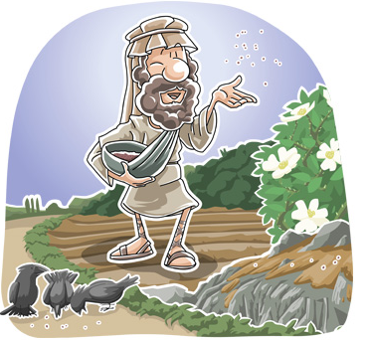
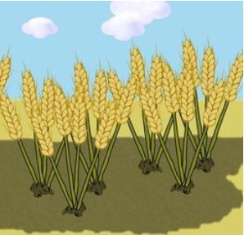
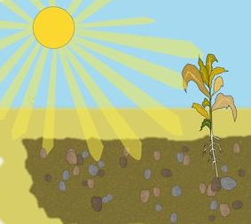
A SOWER WENT TO SOW.
AS HE SOWED THE SEEDS…
SOME FELL
ON RICH SOIL
SOME FELL ON THE PATH
SOME FELL
ON ROCKY GROUND
SOME FELL
ON THORNS
BUT THE BIRDS CAME AND ATE IT UP.
THE SOIL WAS NOT DEEP.
IT CAME UP QUICK.
WHEN THE SUN ROSE, IT DRIED AND WITHERED FOR IT LACKED ROOTS.
THE SEED GREW AND PRODUCED FRUIT, A HUNDRED OR SIXTY OR THIRTYFOLD.
THEY GREW UP
BUT THE THORNS GREW WITH IT AND CHOKED IT.

Slide 7
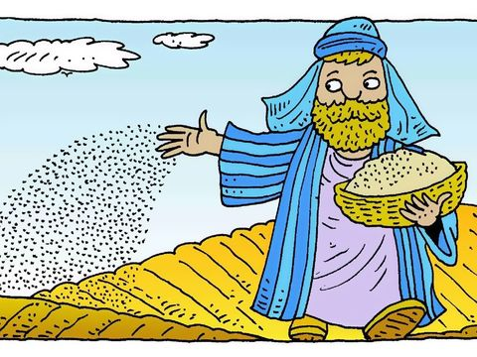
JESUS EXPLAINS THE PARABLE TO HIS FRIENDS WHO DESIRED TO KNOW MORE ABOUT ITS MEANING.
JESUS SAID:
FOUR TYPES OF SOIL ARE
FOUR TYPES OF HUMAN HEARTS
THE SOWER IS
CHRIST
THE SEED IS
THE WORD OF GOD

Slide 8
THE VARIOUS TYPES OF SOIL ON WHICH THE SEED FELL ARE THE DIFFERENT TYPES OF HEARTS OF PEOPLE WHO RECEIVES THE WORD OF GOD IN DIFFERENT WAYS
THE SEED ON
THE PATH
THE SEED ON
ROCKY GROUND
IS THE ONE WHO HEARS THE WORD WITHOUT UNDERSTANDING IT.
THE EVIL ONE COMES AND STEALS AWAY WHAT IS SOWN IN HIS HEART
IS THE ONE WHO HEARS AND RECEIVES THE WORD IN JOY. BUT THIS LASTS ONLY FOR A SHORT TIME AS HE HAS NO ROOTS.
WHEN SUFFERING AND PERSECUTION COMES, HE FALLS AWAY.
THE SEED AMONG THORNS
THE SEED ON
RICH SOIL
IS THE ONE WHO HEARS THE WORD. BUT THE THORNS OF WORLD’S RICHES AND ANXITIES CHOKE THE WORD AND CAUSES THEM TO BEAR NO FRUIT.
IS THE ONE WHO HEARS , UNDERSTANDS AND OBEY THE WORD, BEARS FRUITS AND YIELDS MANIFOLD

Slide 9
WHAT DO YOU THINK JESUS IS TEACHING US THROUGH THIS PARABLE?
TO BE THE RICH SOIL
A HEART THAT RECEIVES THE WORD OF GOD AND ALLOWS THE WORD TO GROW AND BEAR FRUITS, YIELDING A LOT FOR THE SOWER (THE LORD).

Slide 10
HOW CAN WE BE THE RICH SOIL?
WHEN THE WORD OF GOD COMES TO US, WE MUST:
* GIVE TIME TO HEAR THE WORD
RECEIVE THE WORD IN FAITH AND HUMILITY
UNDERSTAND IN FAITH
TRULY DESIRE TO KNOW MORE AND MORE
BEAR FRUITS BY OBEYING THE WORD
ROOT IN LOVE OF GOD
YIELD FOR THE WORD – ALLOW OURSELVES TO CHANGE ACCORDING TO WORD
IN GOD’S GRACE SEEK HELP TO GET RID OFF:
* LAZINESS AND DISINTEREST IN WORD OF GOD
* THE ROCKS THAT STOP US GROWING DEEPER IN JESUS’ LOVE
* THE THORNS OF WORLDLY PLEASURES

Slide 11
VERSES FOR TODAY
‘BLESSED ARE YOUR EYES,
BECAUSE THEY SEE,
AND YOUR EARS,
BECAUSE THEY HEAR’
- MATTHEW 13:16

Slide 12
PRAYER
DO YOU KNOW SOMEONE WHO RECEIVED THE WORD OF GOD AND OBEYED IT?
MOTHER MARY
THE WORD GREW, AS SHE SAID ’LET IT BE DONE ACCORDING TO THY WORD’
THE WORD IS JESUS
DEAR JESUS, MAKE OUR HEARTS HUMBLE AND GENTLE AS YOURS.
HELP US:
TO GIVE TIME FOR YOU TO TALK,
TO LISTEN TO YOU IN PATIENCE,
TO DEISRE YOUR WORD IN TRUTH,
TO RECEIVE YOUR WORD IN LOVE,
TO OBEY YOUR WORD IN HUMILITY,
TO ALLOW THE WORD TO CHANGE US AS YOU WISH,
TO BE THE RICH SOIL,
A HOLY HOUSE FOR YOU TO LIVE IN FOREVER AND EVER.
IN JESUS NAME WE PRAY, AMEN.

Slide 13
THANK YOU
GOD BLESS
FOR MORE IDEAS , PLEASE VISIT:
WEBSITE: http://littleevangelist.com/childrens_liturgy.php
YOUTUBE CHANNEL: https://www.youtube.com/channel/UCndM2GK0dnpWg5ECUscdDcA

