Slide 1
FEAST OF ASCENSION OF THE LORD
Children’s Liturgy, May 24th 2020

Slide 2
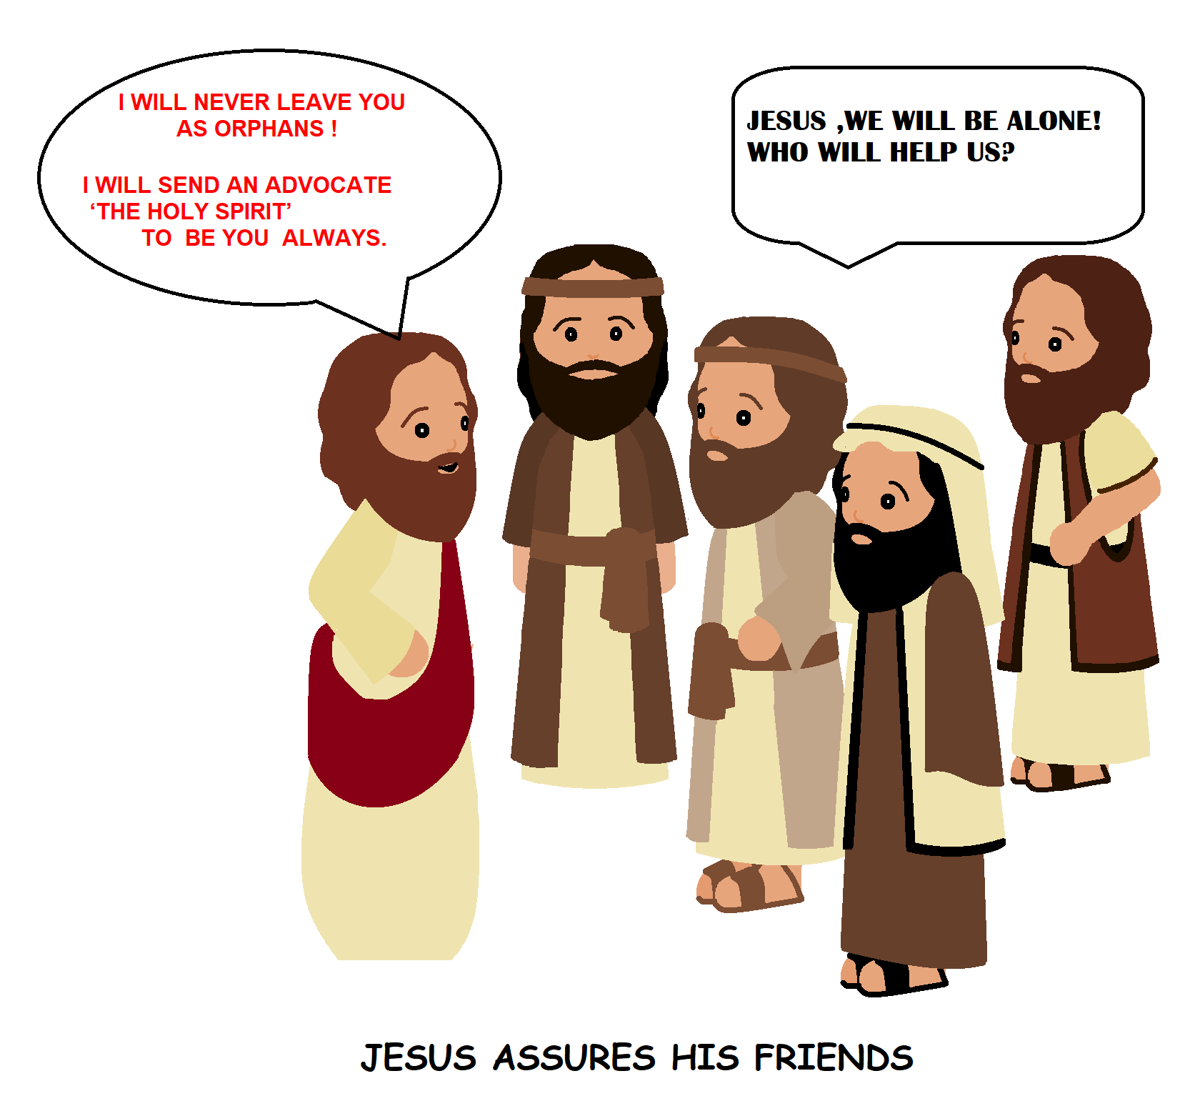
CAN YOU RECOLLECT WHAT JESUS TOLD HIS FRIENDS FROM LAST SUNDAY’S GOSPEL?
JESUS SAID
AFTER SOME TIME HE WILL GO TO THE FATHER
THE WORLD WILL NOT SEE HIM ANY MORE
BUT AFTER SOME TIME ,HE WILL COME BACK AND THOSE WHO LOVE HIM; CAN SEE HIM

Slide 3
THE FEAST OF ASCENSION OF OUR LORD JESUS
IT IS THIS DAY THAT JESUS WENT BACK TO HIS FATHER
AFTER PRESENTING HIMSELF ALIVE FOR FORTY DAYS AND EXPLAINING MORE ABOUT THE KINGDOM OF GOD TO HIS FRIENDS,
JESUS ASCENDED - TO THE RIGHT HAND OF THE FATHER IN HEAVEN

Slide 4
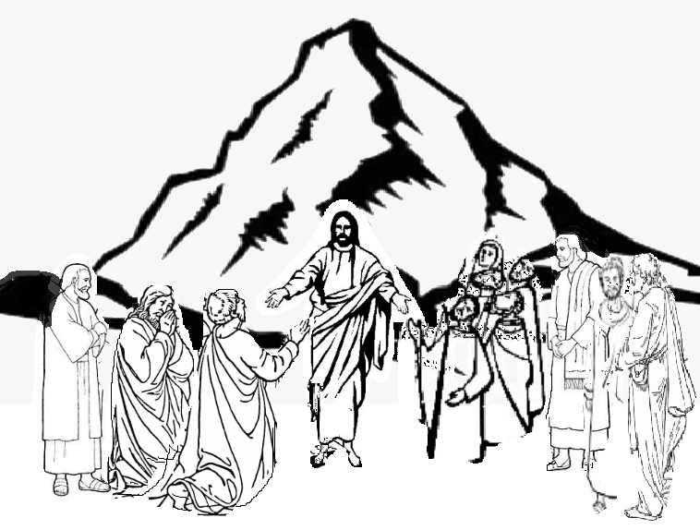
COME TO GALILEE, I WILL MEET YOU THERE
JESUS, HAD ASKED HIS FRIENDS TO COME TO GALILEE
ON REACHING THE MOUNT OLIVES, JESUS TOLD HIS DISCIPLES (WHO STILL WERE IN DOUBT) THAT,
“All power in heaven and on earth has been given to me”

Slide 5
ALL POWER IN HEAVEN AND ON EARTH IS GIVEN TO JESUS
JESUS –THE AUTHORITY : HE ASSIGNS MISSIONS TO HIS FRIENDS
HOW ???
By BAPTIZING them in the name of the Father, and of the Son, and of the Holy Spirit.
How???
1. MAKE DISCIPLES OF ALL NATIONS
2. TEACH THEM TO OBSERVE ALL THAT JESUS HAVE COMMANDED
By proclaiming THE GOSPEL and living THE GOSPEL

Slide 6
JESUS HAD TOLD THEM THAT HE WILL NOT LEAVE THEM AS ORPHANS.
JESUS PROMISED,
“I am with you always, until the end of the age.”
THE DISCIPLES ARE NOT ALONE IN this mission ,
Jesus will be with each of them until the end of the age.

Slide 7
JESUS ORDERED HIS FRIENDS TO DO SOMETHING SPECIAL
DO NOT LEAVE Jerusalem
WAIT for “the PROMISE of the Father -THAT JESUS WAS SPEAKING TO THEM BEFORE.. .THE HOLY SPIRIT
JESUS TOLD: John baptized with water, but in a few days, you will be BAPTIZED WITH THE HOLY SPIRIT.” -Acts of the apostles 1:4-5
WAIT AND PRAY FOR THE PROMISE OF POWER

Slide 8
BAPTIZED WITH HOLY SPIRIT
Jesus told them “you will receive POWER when the HOLY SPIRIT comes upon you , and you will be MY WITNESSES in Jerusalem, throughout Judea and Samaria, and to the ends of the earth.” (Acts 1:8)
Not alone anymore but with POWER OF JESUS INSIDE, which is THE HOLY SPIRIT

Slide 9
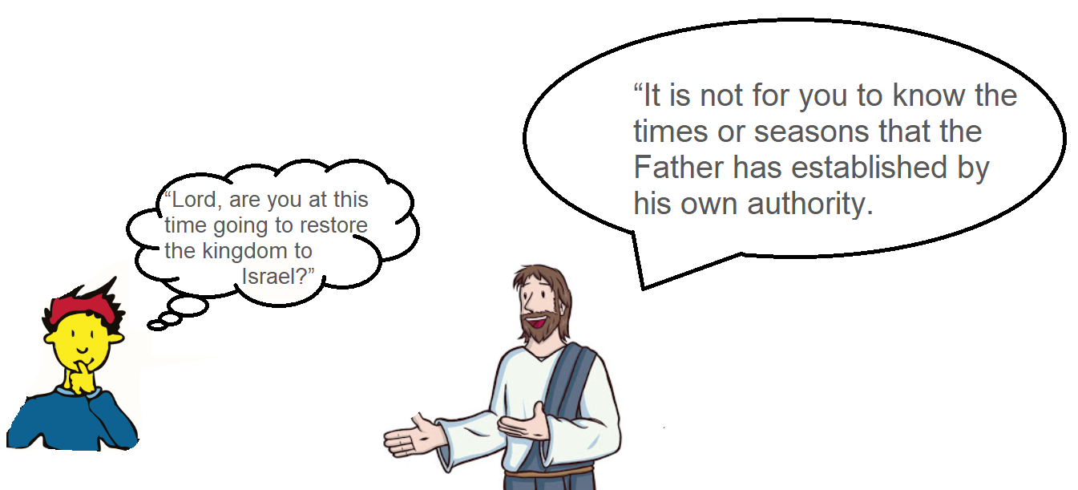
DISCIPLES WERE AGAIN WORRIED ABOUT THE FUTURE AND THE TIMES…….
Receive power when the Holy Spirit comes upon you, and you will be my WITNESSES in Jerusalem,
BE MY WITNESSES BY THE POWER OF HOLY SPIRIT

Slide 10
ASSURING the disciples about THE POWER THAT IS GOING TO COME to them soon….and ASSIGNING MISSIONS JESUS ASCENDS HIMSELF .. He was lifted up, and a cloud took him from their sight.

Slide 11
HE WILL COME BACK IN THE SAME WAY AS HE WENT…
While they were looking AT the sky as JESUS was ASCENDING, suddenly two men dressed in white garments stood beside them and told NOT TO GAZE IN SADNESS,
Jesus who has been taken up from you into heaven WILL RETURN IN THE SAME WAY as you have seen him going into heaven
A GREAT HOPE →HE WILL COME BACK SOON

Slide 12
BEING FRIENDS OF JESUS, * WHAT ARE OUR MISSIONS?
BE THE WITNESS OF LIVING JESUS THROUGHOUT OUR LIFE
* HOW WILL WE ABLE TO ACCOMPLISH IT?
BY THE POWER OF HOLY SPIRIT

Slide 13
CLOTH WITH THE POWER FROM ABOVE -JESUS SAYS TO HIS FRIENDS.
WHY?
TO KNOW
JESUS
TO LIVE AS JESUS SAYS
NOT TO BE AFRAID AND HAVE FAITH
TO WITNESS AND LET KNOW OTHERS WHAT JESUS DID FOR US
TO BE LIKE JESUS EACH MOMENT
HE WILL COME BACK SOON…..

Slide 14
WE ARE NEARING PENTECOST IN 7 DAYS
LET US PREPARE
BY PRAYING TO FILL MORE IN HOLY SPIRIT
BY MEDITATING ON THE ACTS OF APOSTLES AS THEY FILLED BY THE POWER OF HOLY SPIRIT APOSTLES
TO BE A WITNESS FOR RESURRECTED JESUS IN THE POWER OF HOLY SPIRIT

Slide 15
THERE IS 10 DAY PREPARATION FOR PENTECOST VIDEOS ON OUR YOU TUBE CHANNEL. PLEASE DO PRAY ALONG.
VERSES FOR TODAY
All power in heaven and on earth has been given to me. Go, therefore, and make disciples of all nations, baptizing them in the name of the Father, and of the Son, and of the Holy Spirit, teaching them to observe all that I have commanded you. And behold, I am with you always, until the end of the age.”
- Matthew 28:18-20
FOR MORE ACTIVITIES AND IDEAS PLEASE VISIT
http://littleevangelist.com/childrens_liturgy.php

Slide 16
THANK YOU.
REMEMBER
WAIT AND PRAY……….

