Slide 1
THE BAPTISM OF THE LORD
GOSPEL: MARK 1:7-11
CHILDRENS LITURGY JANUARY 10th , 2021

Slide 2
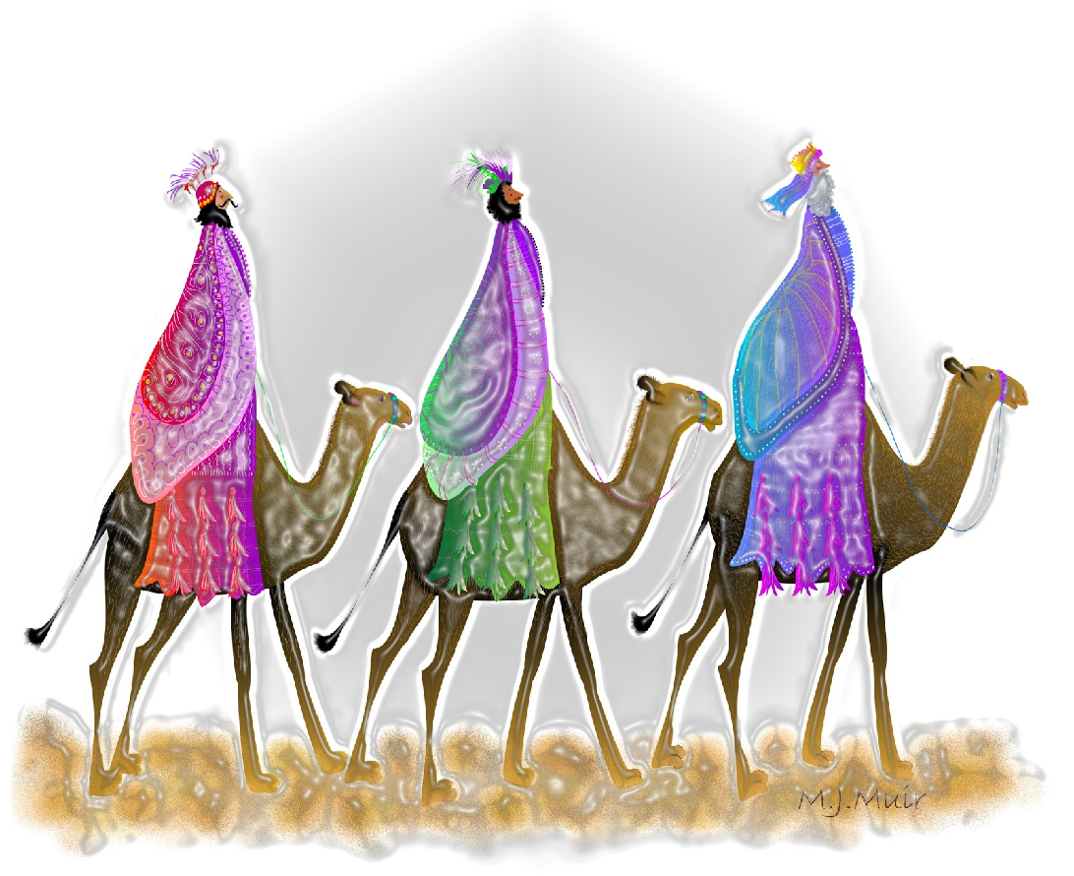
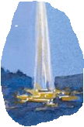
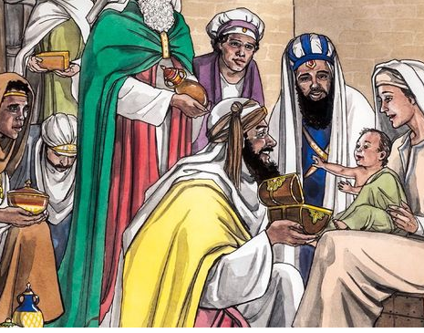
THE THREE WISEMEN BEING LED BY THE STAR TO JESUS.
In the Gospel last week we saw ,
They used their knowledge and wisdom to seek and find the Saviour.
They adored and worshiped him and paid homage to Jesus and offered their precious treasures to Jesus.
Wisdom of God through dream, helped them to escape the traps of King Herod.
Let everything that we are being provided in this world be like the STAR REVEALING AND LEADING US TO JESUS through Holy Spirit.
Let our life be led by Holy spirit and fill in wisdom
to reach Jesus escaping the Herod.

Slide 3
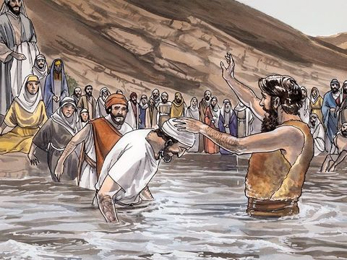
Today in the Gospel we see ,
THE BAPTISM OF THE LORD
John the Baptist was giving baptism of repentance in the river Jordan
to prepare the way for the lord.
John proclaimed,
I have baptized you with water; but he will baptize you with the Holy Spirit.”
“The one who is more powerful than I is coming after me; I am not worthy to stoop down and untie the thong of his sandals.

Slide 4
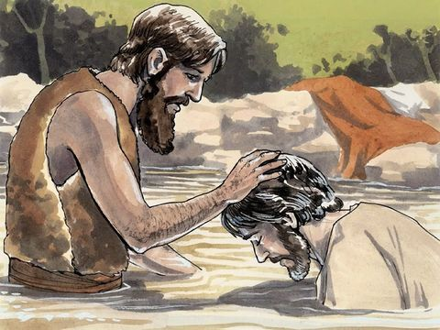
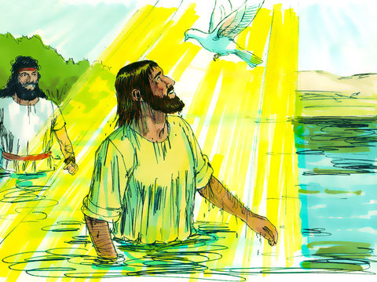
In those days Jesus came from Nazareth of Galilee and was baptized by John in the Jordan.
“You are my Son, the Beloved; with you I am well pleased.”
And just as he was coming up out of the water, he saw the heavens opened and the Spirit descending like
a dove on him.
And a voice came from heaven…

Slide 5
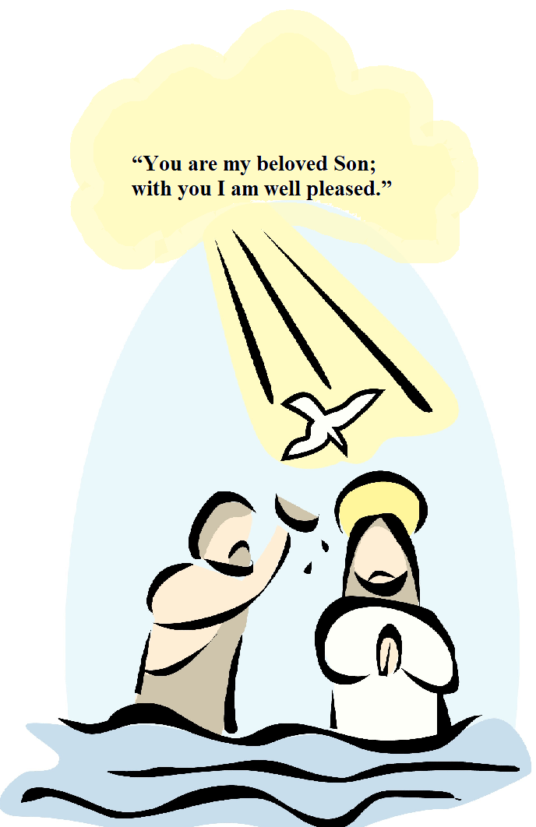
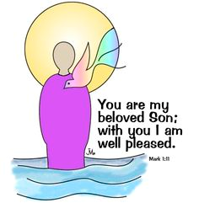
THE BAPTISM OF THE LORD REVEALED THE HOLY TRINITY - THE FATHER, THE SON AND THE HOLY SPIRIT.
THE FATHER
THE HOLY TRINITY
THE HOLY SPIRIT
THE SON
FATHER IN HEAVEN HIMSELF BEAR WITNESS TOJESUS,
HIS CHOSEN ONE, WITH WHOM HE IS PLEASED AND UPON WHOM HE HAVE PUT HIS SPIRIT.

Slide 6
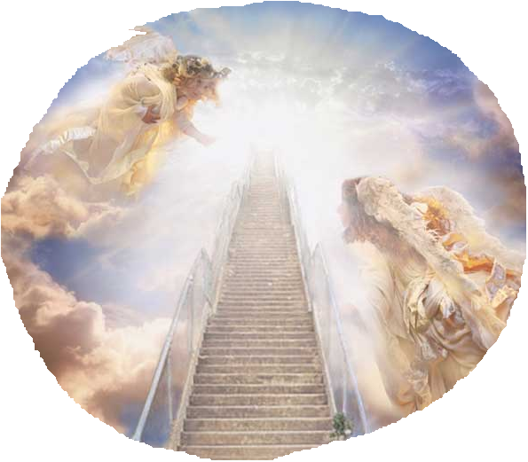
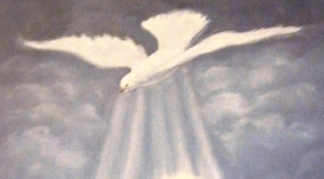
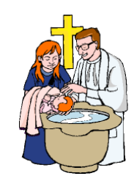
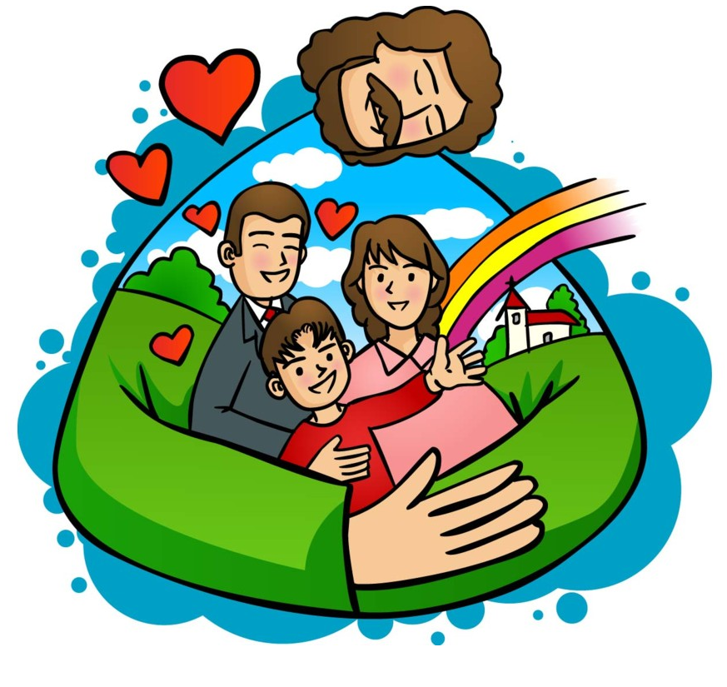
Jesus’ baptism ,
opened Heavens
send down the Holy spirit upon him
THIS IS THE SIGN OF HEAVENLY GRACES TO BE SHOWERED UPON EACH ONE OF US DURING OUR BAPTISM.
THE FATHER REVEALED HIS SON TO THE WORLD BY HIS OWN VOICE FROM HEAVEN.
Each one of us are baptised in the name of the Father, Son and Holy Spirit.
We have received the Holy Spirit.
We are made children of God.
We are baptised into a new life in Christ.
We have received the light of Christ.
We became the part of the body of Christ (church).
Baptism is binding us to God and all his promises by his amazing love.

Slide 7
WE ARE BAPTISED TO CHILDREN OF GOD.
Are we seeing the presence of God above us as heavens opened?
Are we aware of the Holy spirit, the heavenly power upon us?
Are we realising that we are beloved children of God?
Are we loving our Father?

Slide 8
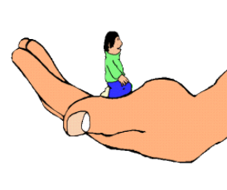
So, What is Our mission through Baptism?
In the baptism, We promised through our God parents, to live a life like the children of God.
TO LIVE AS BELOVED CHILDREN OF GOD. LIVE A LIFE PLEASING TO GOD.
LIVING IN THE PRESENCE OF GOD
ALWAYS
OBEYING
We show Our love to God by obeying Him.
LISTENING
and
TESTIFYING GOD
BY OUR LIFE.
Allowing the Holy spirit to transform us inwardly
as we say yes to His Word ‘Jesus’.

Slide 9
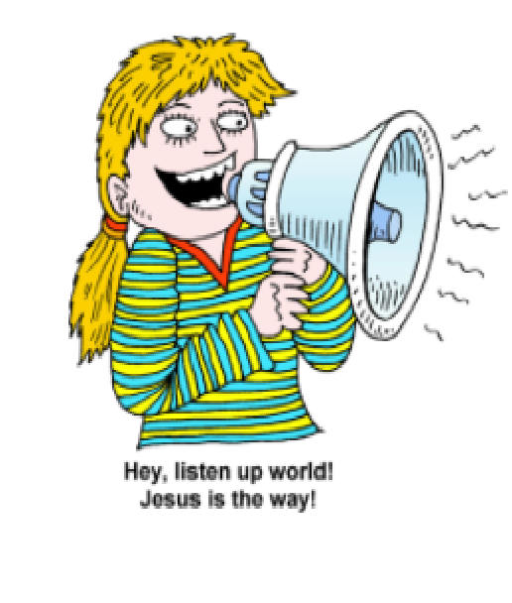
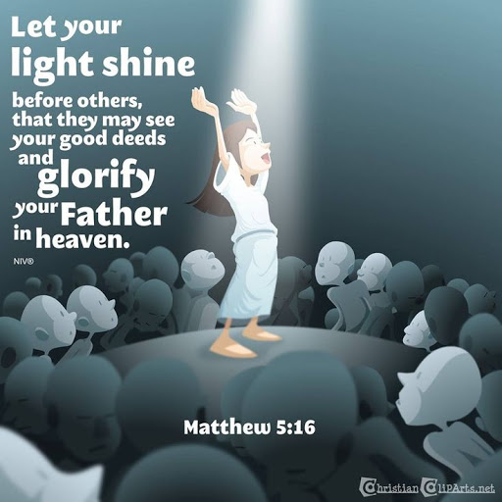
LIVE OUR LIFE IN CHRIST-WAY
FOR THIS, WE ARE GIVEN THE HEAVENLY POWER THROUGH HOLY SPIRIT.
BEING FAITHFUL
FORGIVING EACHOTHER

Slide 10
Let us pray,
Dear Father in Heaven, we thank you for sending us you beloved son Jesus – the living word. We thank you for giving us the Sacrament of Baptism making us your own beloved children in Jesus. Help us to live realizing your presence with us always. Give us your grace and heavenly help ,the holy spirit, to say yes to the living word and to allow ourselves to be changed by word transforming us more like Jesus.
In Jesus name we pray, amen.

Slide 11
VERSE OF THE DAY

Slide 12
Thank you
FOR MORE IDEAS PLEASE VISIT:
WEBSITE:
http://littleevangelist.com/childrens_liturgy.php
YOUTUBE CHANNEL:
https://www.youtube.com/channel/UCndM2GK0dnpWg5ECUscdDcA
GOD BLESS YOU ALL
KEEP LITTLE EVANGELIST IN YOUR SPECIAL PRAYERS

