Slide 1
GIVING CHANCES
CHILDREN’S LITURGY SEPTEMBER 6, 2020
GOSPEL: MATTHEW 18:15-20

Slide 2
IN THE GOSPEL LAST WEEK,
Jesus revealed to us that: following Him is by denying one’s “SELF”
We learned that our little pains can be offered for the salvation of souls.
‘
THIS WEEK,
JESUS TEACHES US THE WAY TO SAVE SOMEONE BY HELPING HIM TO RECONCILE.
JESUS ALSO SHOWS US THE IMPORTANCE OF PRAYING TOGETHER IN JESUS’ NAME.

Slide 3
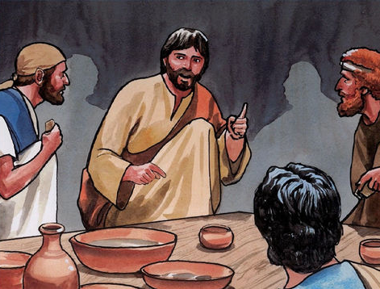
WHAT WILL YOU DO, WHEN YOU SEE ONE OF YOUR FRIEND, DOING WRONG AND IS TEMPTING YOU TO DO IT?
DO WE MAKE A SCENE BY SHOUTING ALOUD?
DO WE KEEP QUIET AND IGNORE HIS FAULT?
OR DO WE JOIN THEM ?
LET US SEE WHAT IS THE ‘JESUS WAY’ OF DEALING WITH THIS SITUATION
JESUS IS TEACHING HIS DISCIPLES TO LIVE
‘THE WAY OF THE GOSPEL’

Slide 4
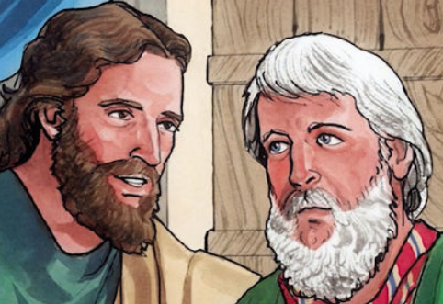
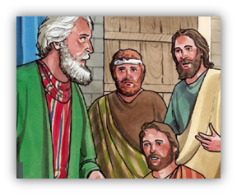
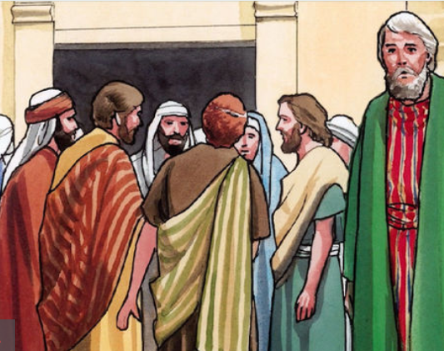
JESUS SAYS, WHEN SOMEONE AMONG YOU DOES ANYTHING WRONG…
1. TALK TO THEM ABOUT THE FAULT WHEN YOU BOTH ARE ALONE.
IF THEY LISTEN,
THEN YOU GAINED YOUR BROTHER OR SISTER.
BUT IF THEY DIDN’T LISTEN,
2. ADVISE THEM BY TAKING ONE OR TWO RIGHT PEOPLE ALONG WITH YOU, SO THAT EVERY WORD THAT YOU TALKED, MAY BE CONFIRMED BY THE EVIDENCE OF TWO OR THREE WITNESSES.
BUT IF STILL THEY DIDN’T LISTEN,
3. TELL IT TO THE AUTHORITIES / THE CHURCH
4. IF STILL THEY REFUSE TO LISTEN EVEN TO THE CHURCH,
LET THAT PERSON BE AS A STRANGER TO YOU.

Slide 5
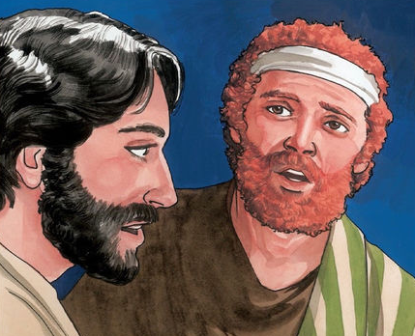
THE CHURCH HAS THE AUTHORITY TO TAKE DECISIONS IN SUCH CASES.
“Truly I tell you, whatever you bind on earth will be bound in heaven, and whatever you loose on earth will be loosed in heaven.” - Matthew 18:18
Jesus reminds us of the authority of the church that He gave through Peter, to “bind” and to “loosen”- to make important decisions with the help of the Holy Spirit.

Slide 6
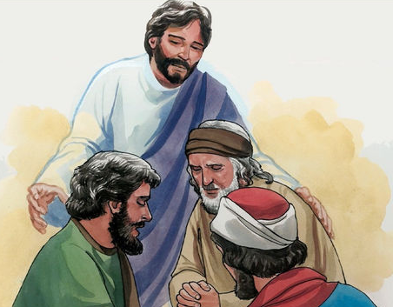
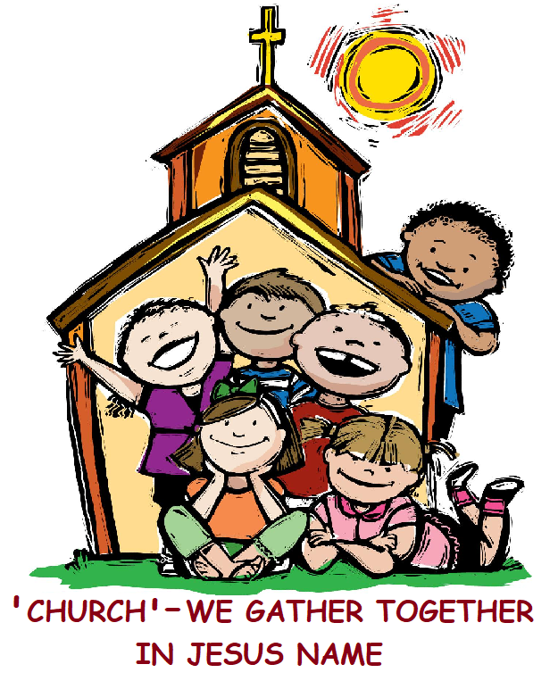
‘MORE POWER’ WHEN PRAYING TOGETHER
JESUS SAYS THAT, ”if two of you agree on earth about anything you ask, it will be done for you by my Father in heaven. For where two or three are gathered in my name, I am there among them.”
- Matthew 18:19-20
TWO OR THREE!
Gather as family
Gather as friends
Gather in the Church
AND PRAY FOR A COMMON THING
A person can pray alone, but Jesus says that praying together in Jesus’ name increases the power of the prayer and that Jesus will be in our midst.

Slide 7
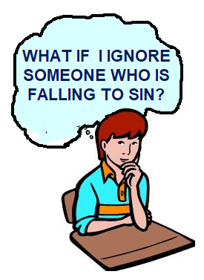
WHEN WE ENCOUNTER SUCH SITUATIONS, RESPOND IN JESUS’ WAY.
THROUGH THIS GOSPEL, JESUS ASKS US THAT IF WE REALLY WANT TO HELP OUR FRIENDS AND SAVE THEM FROM DOING WRONG,
* NEVER DISGRACE THEM IN PUBLIC.
* TALK TO THEM PERSONALLY AND GIVE THEM HELP TO REALISE THEIR MISTAKE.
* IF IT IS NOT POSSIBLE FOR YOU TO DEAL ALONE, SEEK HELP FROM TWO OR THREE RIGHT PEOPLE OR THE AUTHORITIES TO STOP THEM FROM DOING WRONG.
* GIVE CHANCES FOR OUR FRIENDS TO RETURN AND TO RECONCILE.
LET US GATHER TOGETHER UNITEDLY IN JESUS NAME AND PRAY FOR ALL THOSE AMONG US TRAPPED IN SIN.

Slide 8
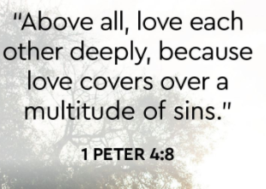
THE LOVE OF JESUS HELPS US TO RESPOND IN THE JESUS WAY
LET US DO IT IN THE LOVE OF JESUS
THE LOVE OF JESUS CAN SAVE MANY FROM DOING WRONG AND DELIVER THEM.
SO, LET US:
- RECONCILE TO GOD AND TO EACH OTHER.
- RESOLVE MISTAKES.
- MAKE WAY TO RESTORE BACK THE LOVE IN JESUS’ NAME.
LET US ALSO MAKE SURE THAT WE BEHAVE AS JESUS EXPECTS US TO LIVE
The one who loves another has fulfilled the law.
------
Romans 13:9

Slide 9
LET US PRAY,
DEAR JESUS, THANK YOU FOR FORGIVING US AND LOVING US. WE ARE SORRY FOR THE TIMES THAT WE DISGRACED, IGNORED OR JUDGED ANYONE AMONG US WHO WERE FOUND DOING WRONG. JESUS, WE TRUST IN YOU AND TRULY BELIEVE THAT YOU ARE AMIDST US AND YOU WILL GRANT US WHAT WE PRAY IN ONE MIND, AS WE GATHER TOGETHER IN JESUS’ NAME. FILL US WITH YOUR LOVE TO LIVE THE JESUS WAY. AMEN

Slide 10
VERSES FOR THE WEEK
“IF TWO OF YOU AGREE ON EARTH ABOUT ANYTHING YOU ASK, IT WILL BE DONE FOR YOU BY MY FATHER IN HEAVEN.
FOR WHERE TWO OR THREE ARE GATHERED IN MY NAME, I AM THERE AMONG THEM.” - MATTHEW 18:19-20

Slide 11
THANK YOU
GOD BLESS YOU ALL
FOR MORE IDEAS, PLEASE VISIT:
WEBSITE: http://littleevangelist.com/childrens_liturgy.php
YOUTUBE CHANNEL:
https://www.youtube.com/channel/UCndM2GK0dnpWg5ECUscdDcA

