Slide 1
COME TO THE FEAST OF THE LORD - Many are invited, but few are chosen.
CHILDREN’S LITURGY OCTOBER 11th 2020
GOSPEL- MATTHEW 22:1-10

Slide 2
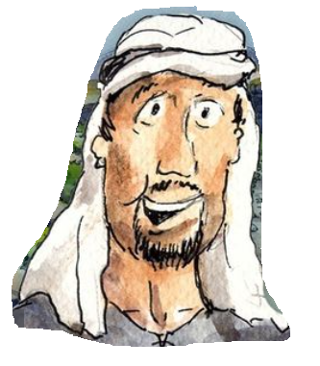
IN THE GOSPEL LAST WEEK,
WE HEARD THE PARABLE ABOUT A LANDOWNER WHO GAVE HIS VINEYARD IN LEASE TO TENANTS
THROUGH THE PARABLE JESUS WAS MAKING US REALISE THAT WE HAVE TO BEAR FRUITS THAT THE LORD DESIRES - THE FRUITS OF THE SPIRIT
ARE WE BEARING FRUITS FOR THE LORD?
OR ARE WE BEING LIKE THE WICKED TENANTS?
WHAT IS OUR RESPONSE?
ABIDE IN JESUS AND BEAR FRUITS FOR THE LORD.

Slide 3
IN TODAY’S GOSPEL JESUS IS REVEALING TO US MORE ABOUT THE KINGDOM OF GOD.
DO YOU REMEMBER WHAT ALL JESUS COMPARED THE KINGDOM OF HEAVEN TO ?
Light up your brain guys!
2. THE PEARL OF GREAT TREASURE
1. HIDDEN TREASURE
3. AS A FAMER WHO SOWS SEEDS
4. THE FARMER WHO PLANTS GOOD SEED BUT WEEDS APPEAR WHICH ARE DESTROYED IN HARVEST
5. LIKE A KING WHO WANTED TO SETTLE ACCOUNTS WITH HIS SERVANTS
7. LIKE A FATHER WHO ASKS HIS TWO SONS TO WORK IN HIS VINEYARD
6. LIKE THE VINEYARD WORKERS
8. TO A LANDOWNER WHO GAVE HIS VINEYARD IN LEASE TO TENANTS

Slide 4
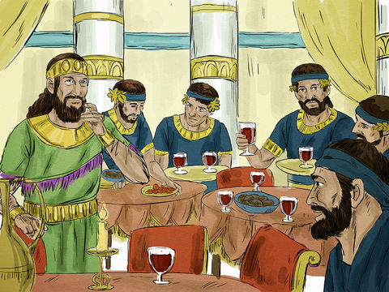
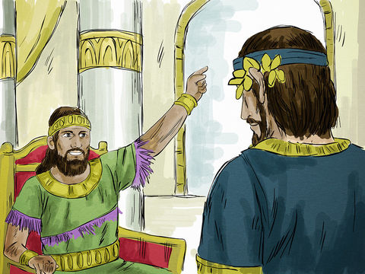
Jesus says that,
The Kingdom of God is like a king who gave a wedding feast for his son.
He sent his servants to summon the invited guests to the feast.
At first, the guests refused.

Slide 5
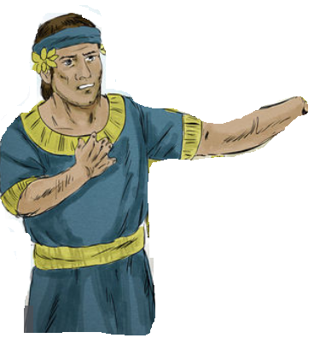
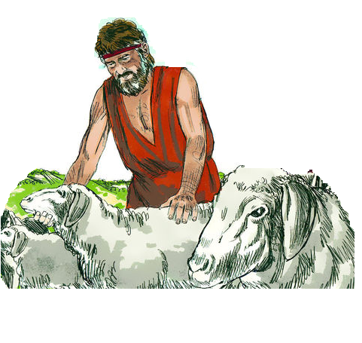
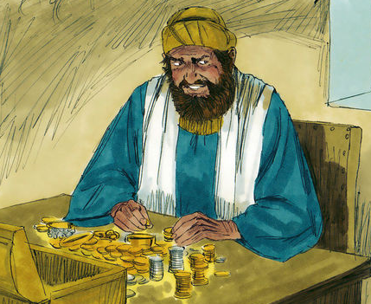
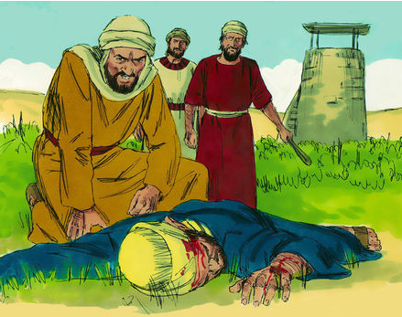
The KING SENT HIS servants to invite THEM A Second time.
‘Everything is ready; come to the feast.’
Some ignored the invitation and went away,
one to his farm,
another to his business.
The rest seized hold of his servants, mistreated them, and killed them.

Slide 6
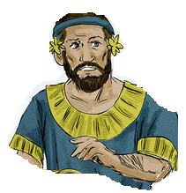
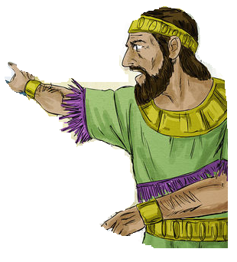
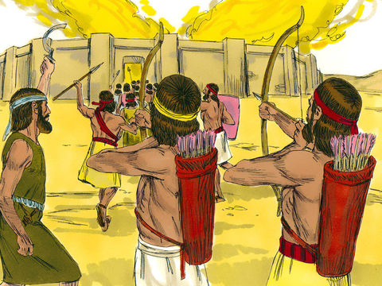
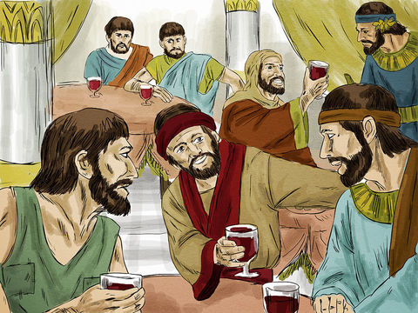
The king was ANGRY
He sent his troops AND destroyed those murderers and burned their city.
Then he said to his servants, 'The feast is ready, but those who were invited were not worthy to come. Go out, therefore, into the main roads and invite to the feast whomever you find.’
The servants went out into the streets and gathered all they found, bad and good alike, and the hall was filled with guests.

Slide 7
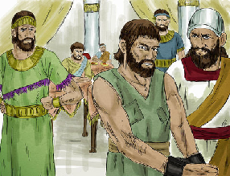
“Many are invited, but few are chosen."
The king came to meet the guests,
My friend, how is it that you came in here without a wedding garment?
He saw a man there not dressed in a wedding garment.
Then the king said to his attendants
He was reduced to silence.
Bind his hands
and feet, and cast him into the darkness outside, where there will be wailing and grinding of teeth.

Slide 8
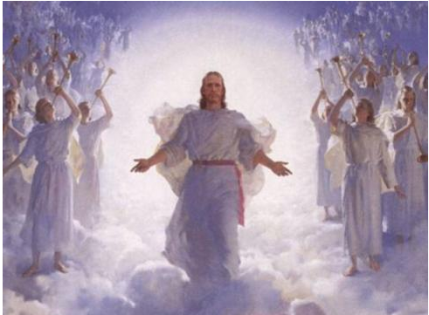
In the parable
HEAVENLY FATHER IS THE KING
THE WEDDING FEAST IS OF HIS SON JESUS in THE KINGDOM OF HEAVEN.
The invited ones are each of us
GOD IS INVITING US FOR THE FEAST THROUGH OUR BAPTISM.
Are we RESPONDING ?
To which group of invitees do we belong to?

Slide 9
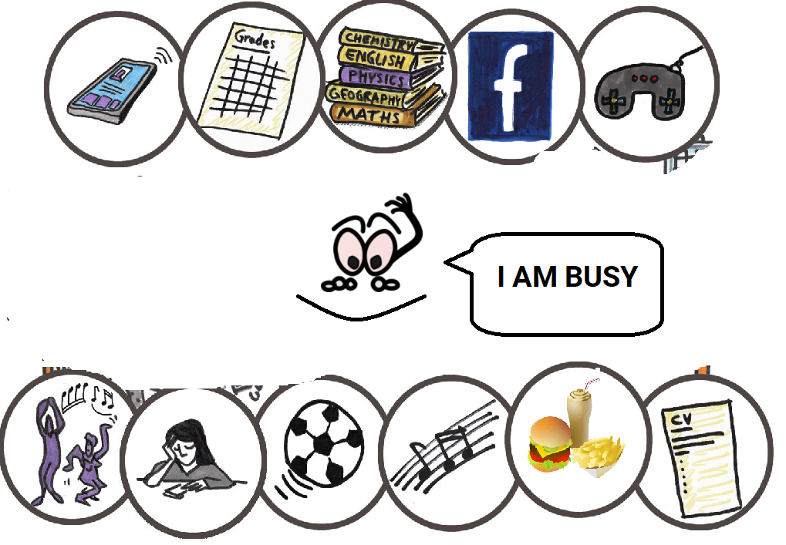
Are we like THOSE who were so busy, and ignored the invitation?
ARE WE GETTING TOO BUSY THAT WE IGNORE OR FORGET GOD’S INVITATION?
IF SO, LET US THINK ABOUT WHAT HAPPENED TO THOSE WHO
IGNORED THE INVITATION
WOULD WE WANT TO HAVE SUCH AN EXPERIENCE?

Slide 10
ARE WE LIKE THOSE WHO RESPONDED TO THE INVITATION?
ARE WE GETTING ready for the great feast?
IF SO,
"Happy Are Those Who Are Called To His Supper”- LUKE 14:15
HOW CAN WE PREPARE AND GET READY FOR THE GREAT FEAST?
BY KNOWING GOD’S WILL THROUGH HOLY SCRIPTURES
BY LIVING IN THE HOLY SPIRIT - FOLLOWING JESUS
THE SCARAMENTS OF THE CHURCH
HAVE YOU BEEN INVITED TO A PARTY BEFORE?
JUST REFLECT, HOW DID YOU PREPARE FOR THAT PARTY?

Slide 11
THE SACRAMENTS OF THE CHURCH PREPARE US FOR THE KINGDOM OF HEAVEN
BAPTISM
3. RECONCILIATION :
WE ARE INVITED AND
CLOTHED IN CHRIST
- CITIZENS OF HEAVEN.
RESTORES US BACK TO CHRIST.
HAVE WE MADE OUR CLOTH DIRTY BY DISOBEYING GOD?
IF SO, REPENT IN TRUE HEART AND CONFESS.
2. HOLY EUCHARIST
4. CONFIRMATION
- EMPOWERS US WITH
THE GIFTS OF
THE HOLY SPIRIT ,OUR GUIDE
PROVIDES US ETERNAL FOOD - JESUS IN HIS BODY AND BLOOD, TRANSFORMING US LIKE CHRIST
6. ANNOINTING OF THE SICK
5. MARRIAGE
7. HOLY ORDERS
“MANY ARE INVITED, BUT FEW ARE CHOSEN."
Let us strive to be the chosen ones!

Slide 12
WHY IS THIS FEAST SO SPECIAL?
BECAUSE HEAVEN IS SO SPECIAL.
AND WE ARE MADE THE CITIZENS OF HEAVEN THROUGH JESUS.
IF WE REALIZE THE JOY OF ETERNAL LIFE IN HEAVEN, WE WILL DESIRE IT THE MOST.
TO KNOW MORE ABOUT HEAVEN
READ REVELATION 22
SO LET’S DRESS UP AND GET READY !

Slide 13
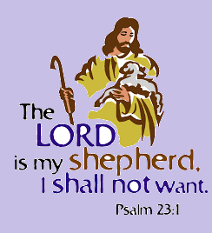
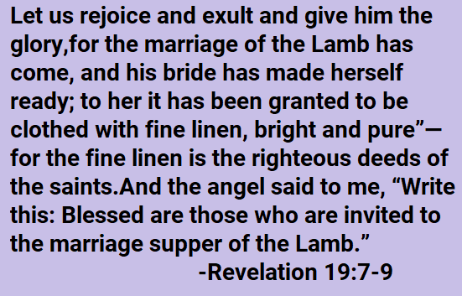
LET US PRAY
LORD JESUS, THANK YOU FOR INVITING US TO YOUR GREAT FEAST, THE KINGDOM OF HEAVEN, AND MAKING US THE CITIZENS OF HEAVEN BY YOUR GREAT SACRIFICE. GIVE US GRACE TO LIVE ALWAYS CLOTHED IN YOU, TO BE FOUND WORTHY WHEN YOU COME TO TAKE US FOR THE GREAT FEAST IN HEAVEN.
In Jesus’ name we pray, amen.

Slide 14
VERSE OF THE WEEK

Slide 15
THANK YOU.
GOD BLESS.
FOR MORE IDEAS , PLEASE VISIT:
WEBSITE: http://littleevangelist.com/childrens_liturgy.php
YOUTUBE CHANNEL:
https://www.youtube.com/channel/UCndM2GK0dnpWg5ECUscdDcA

