Slide 1
THE FAITH OF THE CANAANITE WOMAN
CHILDREN’S LITURGY AUGUST 16TH, 2020
GOSPEL: MATTHEW 15:22-33

Slide 2
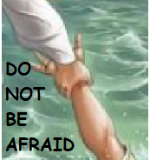
IN LAST WEEKS GOSPEL
WE HEARD ABOUT PETER’S COURAGE BY TRUSTING IN JESUS.
LIKE PETER, WE MUST TRUST IN JESUS AND STEP OUT IN COURAGE, TO WALK OVER THE TROUBLES AND CHALLENGES, NEVER LOOSING OUR FOCUS ON JESUS.
THIS WEEK GOSPEL SHOWS US; HOW OUR FAITH IN JESUS OPENS UP THE FOUNTAIN OF MERCY OF OUR LORD.

Slide 3
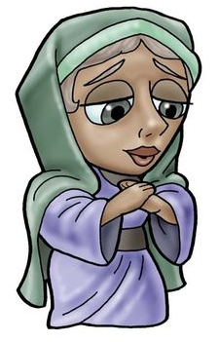
THE FAITH OF THE CANAANITE WOMAN
THERE WAS ONCE A CANAANITE WOMAN WHOSE DAUGHTER WAS POSSESSED BY EVIL.
CANAANITES WERE NOT LIKED BY THE JEWS IN THE OLDEN TIMES
IT WAS THOUGHT THAT ONLY JEWS,THE PEOPLE OF ISRAEL ARE THE PEOPLE OF GOD AND SALVATION ONLY BELONGED TO THEM.

Slide 4
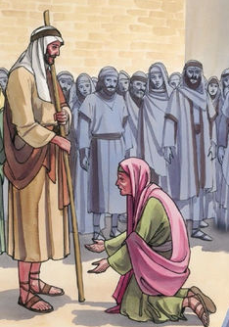
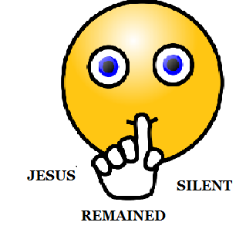
WHEN SHE KNEW THAT JESUS HAS COME TO HER DISTRICT,
SHE WENT TO JESUS AND CALLED OUT CRYING, “have pity on me, lord, son of David! ”
DO YOU THINK JESUS WOULD HELP HER?
JESUS WAS A JEW!!
“Have pity on me, Lord, Son of David! My daughter is tormented by a demon.”

Slide 5
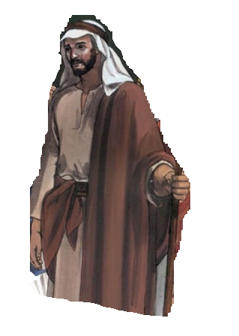
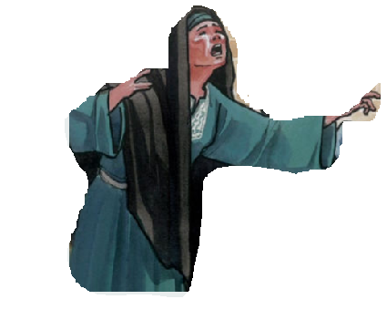
SHE KEPT ON CALLING BEHIND THEM
THE DISCIPLES ASKED JESUS TO SEND HER AWAY.
“I was sent only to the lost sheep of the house of Israel.”
“Please, Lord, for even the dogs eat the scraps that fall from the table of their masters.” ”
“Lord, help me.”
“It is not right to take the food of the children and throw it to the dogs.”
DO YOU THINK THAT JESUS IS BEING RUDE????

Slide 6
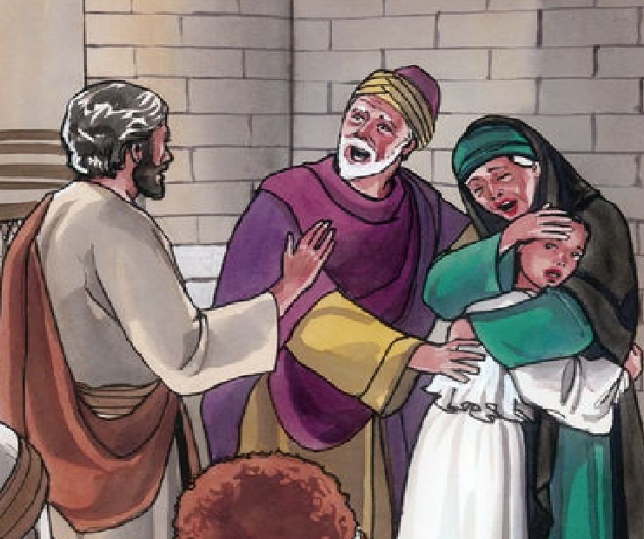
YOUR FAITH IS GREAT
SEEING HER STRONG FAITH; JESUS REPLIED TO HER,
“O woman, great is your faith! Let it be done for you as you wish.”
The woman’s daughter was healed
from that hour.

Slide 7
HAVE FAITH IN THE MERCY OF GOD
* LIKE THE WOMAN none of us ARE WORTHY , it is not our MERITS but GODS MERCY THROUGH OUR FAITH IN JESUS, THAT SAVES US
* THE WOMAN MAKES US REALIZE THAT salvation is available to all who have faith IN JESUS and not only to certain groups.
* JESUS GIVES SALVATION to all who believes in him and is truly desiring to live according to what Jesus says.
‘he saved us, not because of any works of righteousness that we had done, but according to his mercy, through the water of rebirth and renewal by the Holy Spirit.’
-Titus 3:5

Slide 8
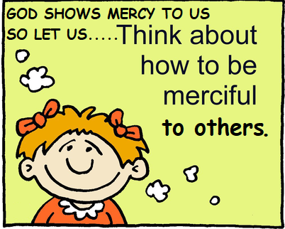
HAVE FAITH ! BE MERCIFUL!
No matter how unworthy or ineligible you feel, you are saved in Jesus NAME .
By your FAITH in Jesus and MERCY of GOD.
So, Never feel rejected or
Do not reject anyone.
LET US BE MERCIFUL AS OUR LORD.
Make everyone know about the mercy of our lord.

Slide 9
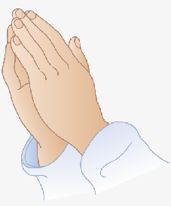
PRAYER
Dear Jesus ,thank you for the abundant mercy that you are showering upon us. Even though we are not worthy; your mercy saves us. Help us to humble ourselves and have great faith in you like the Canaanite woman and to be merciful as you are to all. Jesus son of god, have mercy on us. Amen.

Slide 10
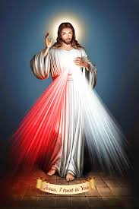
VERSES FOR THE WEEK
“Have mercy on me, Lord, Son of David”
-Matthew 15:22

Slide 11
THANK YOU
GOD BLESS YOU ALL..
FOR MORE IDEAS , PLEASE VISIT:
WEBSITE: http://littleevangelist.com/childrens_liturgy.php
YOUTUBE CHANNEL:
https://www.youtube.com/channel/UCndM2GK0dnpWg5ECUscdDcA

