Slide 1
The Most Holy Trinity
CHILDREN’S LITURGY JUNE 7TH, 2020
The grace of the Lord Jesus Christ
and the love of God and
the fellowship of the Holy Spirit be with all of you.
- 2 CORINTHIANS 13:13

Slide 2
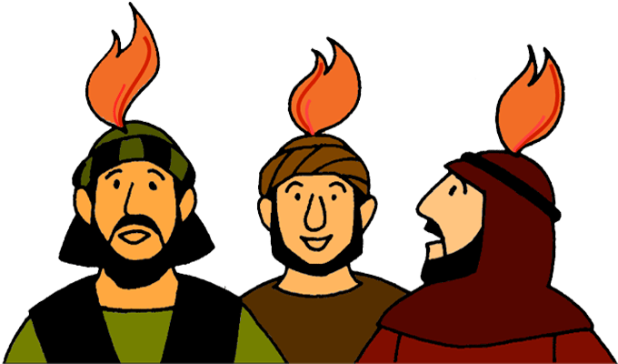
Let’s recap
WHAT DID WE CELEBRATE LAST SUNDAY?
WE CELEBRATED PENTECOST,
WHEN THE HOLY SPIRIT KINDLED THE APOSTLES
THE HOLY SPIRIT, WHOM JESUS BREATHED UPON THE APOSTLES (THE PROMISE FROM THE FATHER), WAS INFLAMED ON THE DAY OF PENTECOST AS THEY WERE WAITING AND PRAYING

Slide 3
ALL THREE PERSONS IN ONE
TODAY IS THE FEAST OF THE MOST HOLY TRINITY
DO YOU KNOW WHO IS THE MOST HOLY TRINITY?
CAN YOU COMPLETE THIS ?
IN THE NAME OF THE…………..
THE ………………….
AND THE ……………………. AMEN
FATHER
SON
HOLY SPIRIT

Slide 4
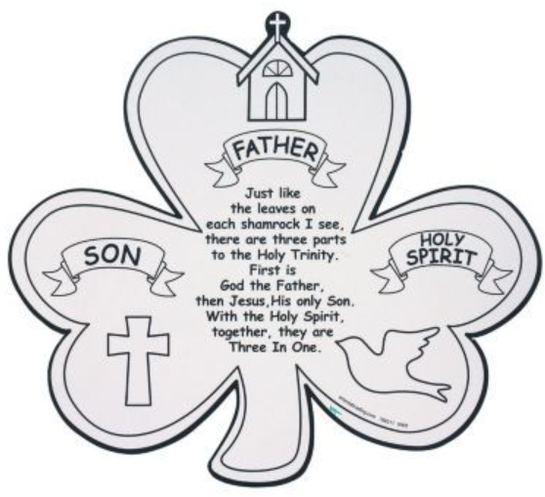
THE HOLY TRINITY: THE FATHER, THE SON AND THE HOLY SPIRIT is the communion of love
God is love and
this love is Jesus and
this love is poured out through Holy Spirit.
THREE PERSON IN ONE – THE TRIUNE GOD

Slide 5
“For God so loved the world that he gave his only Son, so that everyone who believes in him may not perish but may have eternal life. Indeed, God did not send the Son into the world to condemn the world, but in order that the world might be saved through him.” - John 3:16-17
The FATHER’S LOVE

Slide 6
THE FATHER
The Father so loved each one of us that he sent his son to save us from the sins
‘God’s love was revealed among us: God sent His one and only Son into the world, so that we might live through Him. And love consists in this: not that we loved God, but that He loved us and sent His son as the atoning sacrifice for our sins’ - John 4:9-10

Slide 7
JESUS - THE SON
THE EXPRESSION OF FATHER’S LOVE
The love of father manifested
He came down to live with us.
He showed us the way to life
He took all our sins and died for us, freeing us all from the sins
He resurrected giving us new hope and showering Grace upon us
Those who believes in him have eternal life. God sent his son not to condemn the world, but to save the world through him. (John 3:16)
Before going to father, he promised us
the Holy Spirit to all who believes in him

Slide 8
THE HOLY SPIRIT
-THE CARRIER OF GODS LOVE
Our helper WHOM father sent through Jesus Holy spirit, through our faith and baptism in the name of Jesus, came into us to live in us in fellowship with us, making us the children of god
Through him, gods love is poured into our hearts
THROUGH WHOM GOD CAME DOWN TO LIVE IN US FOREVER
“If you love me, you will keep my commandments. And I will ask the Father, and he will give you another Advocate, to be with you forever. - John 14:15-16

Slide 9
LET US GET TRY TO UNDERSTAND MORE
LET US THINK OF THE SUN
THE SUN GIVES US LIGHT
THE SUN ALSO GIVES US HEAT THROUGH this LIGHT
THE LIGHT AND THE HEAT COMES FROM THE SAME SOURCE THE SUN

Slide 10
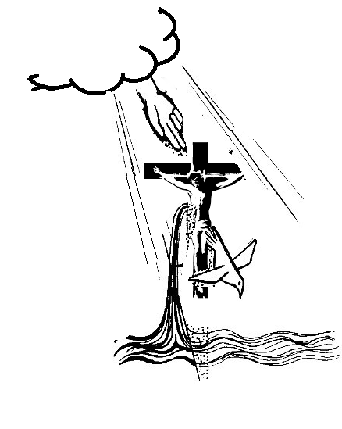
NOW THINK OF THE HOLY TRINITY
GOD THE FATHER SENDs THE LIGHT (JESUS)
JESUS IS THE LIGHT OF THE WORLD -> SHOWED US THE WAY OF TRUTH ANF LIFE
THE HOLY SPIRIT, THE HEAT -> SENt through Jesus , TO FILL EACH OF US WITH THE WARMTH OF GOD’S LOVE
FATHER
SON
HOLY SPIRIT
THE SON AND THE HOLY SPIRIT COMES FROM THE FATHER

Slide 11
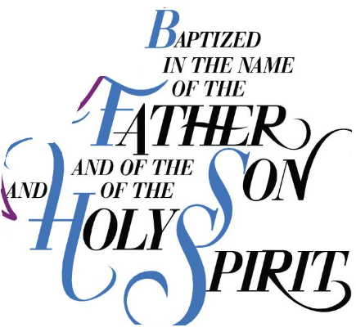
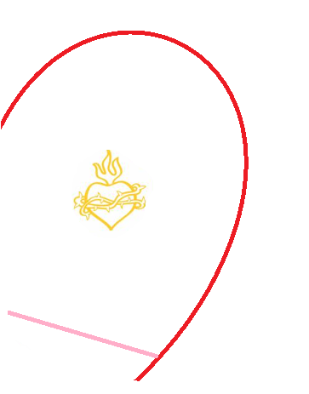
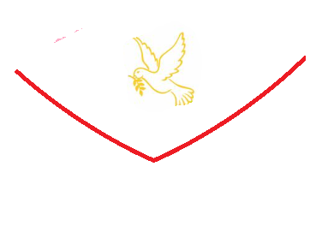
WE ARE CALLED TO BE IN THIS AMAZING LOVE THROUGH
HOLY COMMUNION
THE COMMUNION OF THE HOLY TRINITY IS DWELLING IN US
LOVE OF FATHER
GRACE OF JESUS CHRIST
FELLOWSHIP
OF
HOLY SPIRIT
BE WITH US -2 COR 13:13

Slide 12
Joined to family of divine love
Father revealed his love to us by giving his son jesus
Jesus bore all our sins and freed us from all our sins
Father send holy spirit through jesus and poured his love into us
The father son and holy spirit is in us by our faith in jesus
Let us grow and fill in and share the divine love by
being in communion with holy trinity

Slide 13
Verse for the week
“FOR GOD SO LOVED THE WORLD THAT HE GAVE HIS ONLY SON, SO THAT EVERYONE WHO BELIEVES IN HIM MAY NOT PERISH BUT MAY HAVE ETERNAL LIFE. - JOHN 3:16

Slide 14
LET US PRAY
Glory be to the Father, Who by His almighty power and love created me, making me in the image and likeness of God. Glory be to the Son, Who by His Precious Blood delivered me from hell, and opened for me the gates of heaven. Glory be to the Holy Spirit, Who has sanctified me in the sacrament of Baptism, and continues to sanctify me by the graces I receive daily from His bounty. Glory be to the Three adorable Persons of the Holy Trinity, now and forever. Amen.
Do you know this verse?
‘when the kindness and love of God our Savior appeared, ⁵ he saved us, not because of righteous things we had done, but because of his mercy. He saved us through the washing of rebirth and renewal by the Holy Spirit, whom he poured out on us generously through Jesus Christ our Savior, so that, having been justified by his grace, we might become heirs having the hope of eternal life’ - Titus 3:4-7
May the grace of the Lord Jesus Christ, the love of God and
the fellowship of the Holy Spirit be with all of you. - 2 CORINTHIANS 13:13

Slide 15
THANK YOU
FOR MORE ACTIVITIES AND IDEAS PLEASE VISIT
1.http://littleevangelist.com/childrens_liturgy.php
2.https://www.youtube.com/channel/UCndM2GK0dnpWg5ECUscdDcA

