Slide 1
BE FAITHFUL IN LITTLE THINGS.
GOSPEL: MATTHEW 25:14-30
CHILDREN’S LITURGY NOVEMBER 15TH, 2020

Slide 2
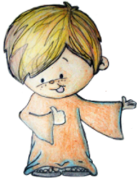
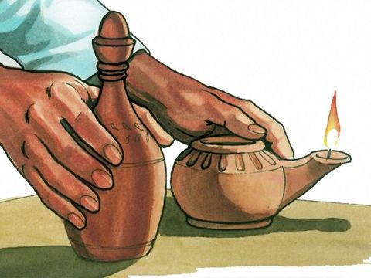
THE GOSPEL LAST WEEK WAS,
THE PARABLE OF THE TEN BRIDESMAIDS.
JESUS WAS TELLING EACH OF US TO:
STAY AWAKE, PREPARE AND BE READY!
…SINCE WE DO NOT KNOW THE HOUR OR THE DAY
OF THE LORD’S SECOND COMING.
GATHER THE OIL AS WE LIVE IN THE HOLY SPIRIT
ACCORDING TO THE WORD OF GOD.
STORE UP EXTRA OIL,
JUST LIKE THE WISE BRIDESMAIDS.
TO LIGHT UP OUR LAMP
WHEN THE LORD COMES.

Slide 3
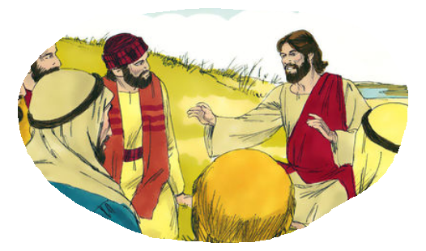
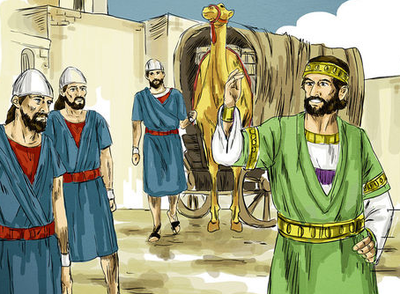
IN THE GOSPEL TODAY,
JESUS TELLS HIS DISCIPLES MORE ABOUT
WHAT THE KINGDOM OF HEAVEN WILL BE LIKE
ON DAY OF THE LORD’S RETURN.
ON THAT DAY, THE KINGDOM OF HEAVEN WILL BE LIKE A MAN, WHO IS GOING FOR A JOURNEY,
CALLS HIS SERVANTS AND
ENTRUSTS HIS WEALTH TO THEM.

Slide 4
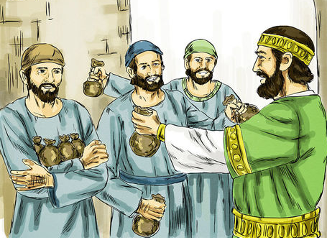
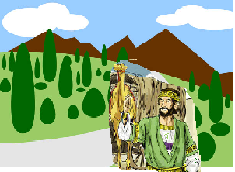
HE CALLED HIS SERVANTS: ,
TO ONE HE GAVE FIVE TALENTS, TO ANOTHER TWO,
TO ANOTHER ONE.
5 TALENTS
2 TALENTS
1 TALENT
EACH ONE ACCORDING TO HIS ABILITY.
THEN HE WENT ON HIS WAY.

Slide 5
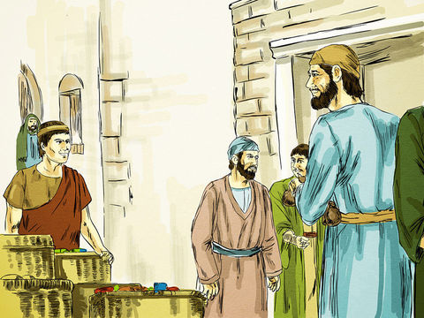
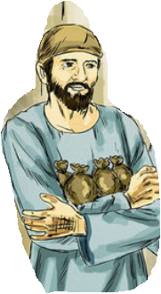
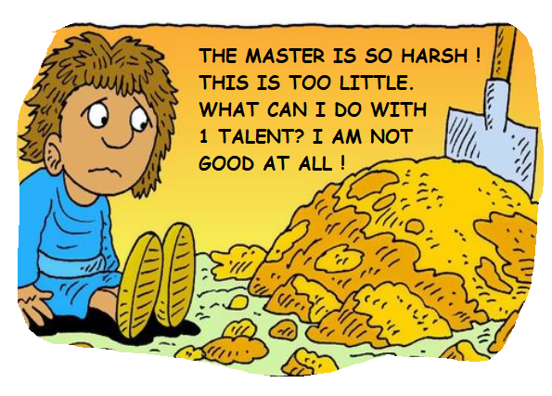
THE ONE WHO HAD RECEIVED THE FIVE TALENTS
WENT OFF AT ONCE AND TRADED WITH THEM AND MADE FIVE MORE TALENTS.
5 + 5 MORE = 10 TALENTS
IN THE SAME WAY, THE ONE WHO HAD THE TWO TALENTS MADE TWO MORE TALENTS.
2 +2 MORE = 4 TALENTS
BUT THE ONE WHO HAD RECEIVED THE ONE TALENT WENT OFF AND DUG A HOLE IN THE GROUND AND HID HIS MASTER’S MONEY.

Slide 6
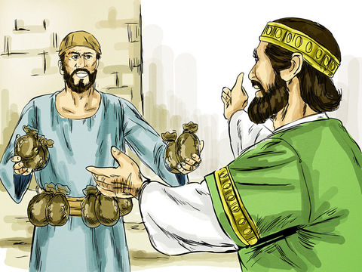
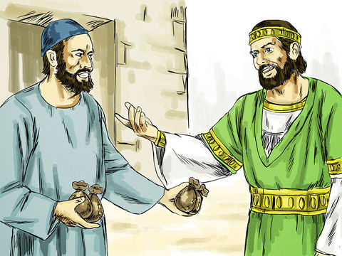
AFTER A LONG TIME, THE MASTER CAME BACK:
HE CALLED HIS SERVANTS TO SETTLE THE ACCOUNTS.
The ones who had received the five talents and two talents came forward…
Master, you handed over to me five talents; see, I have made five more talents.
Well done, good and trustworthy servant; you have been trustworthy in a few things, I will put you in charge of many things; enter into the joy of your master.
Well done, good and trustworthy servant; you have been trustworthy in a few things, I will put you in charge of many things; enter into the joy of your master.
Master, you handed over to me two talents; see, I have made two more talents.

Slide 7
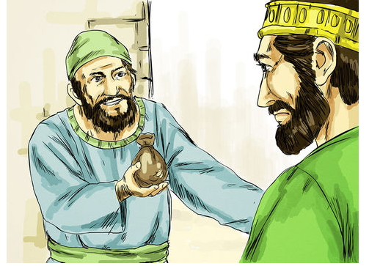
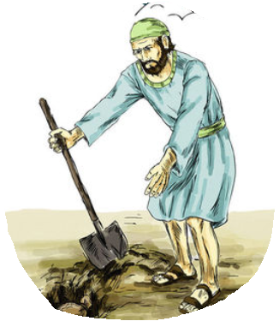
Then came the one who had received the one talent:
You wicked and lazy servant! You knew everything, did you? Then you should have invested my money with the bankers, and on my return, I would have received the interest.
He said,
Master, I knew that you were a harsh man, so I was afraid, and hid your talent in the ground.
Here you have what is yours.
THE MASTER WAS UNHAPPY WITH THE UNFAITHFUL SERVANT.

Slide 8
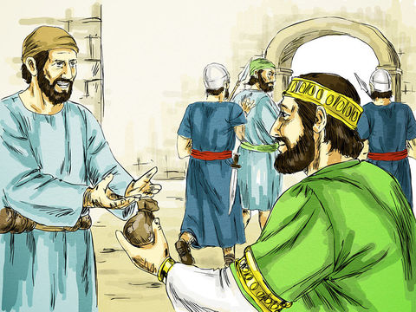
The master ordered:
Take the talent from him and give it to the one with the ten talents.
‘FOR TO ALL THOSE WHO HAVE, MORE WILL BE GIVEN, AND THEY WILL HAVE AN ABUNDANCE;
BUT FROM THOSE WHO HAVE NOTHING, EVEN WHAT THEY HAVE WILL BE TAKEN AWAY.’
The master ordered his worthless servant to be thrown into the outer darkness, where there will be weeping and gnashing of teeth.

Slide 9
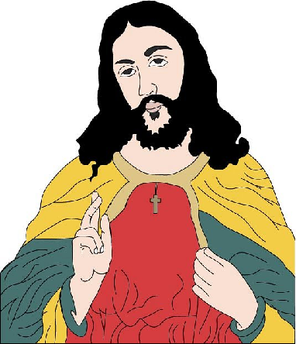
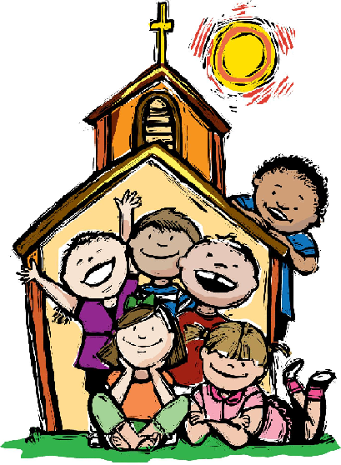
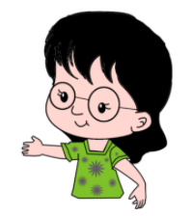
In the parable,
THE MASTER is JESUS.
THE SERVANTS ARE ME AND YOU.
THE TALENTS ARE THE HEAVENLY GIFTS
SHOWERED UPON US THROUGH THE HOLY SPIRIT.
A TALENT WAS A UNIT OF MEASUREMENT USED IN OLDEN DAYS FOR WEIGHING PRECIOUS METALS, LIKE GOLD AND SILVER.
1 TALENT IS WORTH A LOT !

Slide 10
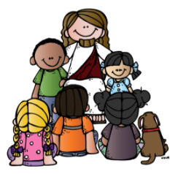
THROUGH THE PARABLE JESUS TELLS US:
*TO BE FAITHFUL TO THE HEAVENLY GIFTS GIVEN TO US,
NO MATTER HOW LITTLE WE MIGHT FEEL.
* BE HAPPY AND THANKFUL FOR WHAT GOD HAS GIVEN US.
* USE IT WISELY; LIKE THE FAITHFUL SERVANTS IN THE PARABLE.
* NOT TO BURY IT, BY JUDGING OR COMPLAINING
OR BY COMPARING IT WITH OTHERS.
* TO RESPECT EACH OTHERS' TALENTS.
BE FAITHFUL IN LITTLE THINGS THAT GOD HAS GIVEN US.
THEN HE WILL GIVE US MORE!
GOD GIVES US TALENTS ACCORDING TO HIS PLANS
IT IS NOT THE AMOUNT THAT MATTERS BUT OUR FAITHFULNESS.

Slide 11
‘FOR TO ALL THOSE WHO HAVE, MORE WILL BE GIVEN, AND THEY WILL HAVE AN ABUNDANCE.’
Our talents MULTIPLY when we USE them wisely and SHARE them for the good of others.
WHAT ARE WAYS THAT WE CAN USE OUR TALENTS WISELY?
USE IT IN THE WILL OF GOD.
USE IT WITHOUT ANY COMPLAINTS OR LAZINESS.
USE IT FOR THE GOOD OF ALL.
USE IT FOR GOD TO BE GLORIFIED BY OUR LIFE.
USE IT FOR HIS KINGDOM, UNTIL HIS RETURN.
BE THANKFUL TO GOD FOR EVERYTHING.
WHEN JESUS COMES AGAIN, HE WANTS US TO BE SEEN IN ABUNDANCE.
HE WANTS US TO ENTER INTO HIS ETERNAL JOY.

Slide 12
GOD HAS BLESSED ALL HIS CHILDREN WITH
SPECIAL GIFTS OR ABILITIES .
(SEEK HELP TO READ 1 Corinthians 12 and Romans 12:6-8)
Can you think of one of your Talents or Abilities?
DISCOVER YOUR TALENT!
Why not ask your parents or friends what they feel you are good at?
WHATEVER TALENTS GOD HAS GIVEN US,
USE IT WISELY FOR THE GLORY OF GOD.
GOD REWARDS OUR FAITHFULNESS.

Slide 13
LET US PRAY,
DEAR GOD, WE THANK YOU FOR YOUR GREATEST GIFT FOR US - YOUR SON JESUS.
GIVE US GRACE TO BE FAITHFUL IN THE LITTLE THINGS YOU HAVE GIVEN US.
HELP US TO USE IT WISELY FOR THE GOOD OF OTHERS AND FOR YOUR GLORY.
SO THAT, WHEN JESUS COMES, WE ARE SEEN IN YOUR ABUNDANCE TO ENTER YOUR ETERNAL HAPPINESS.
IN JESUS’ NAME WE PRAY, AMEN.

Slide 14
VERSE OF THE WEEK

Slide 15
THANK YOU AND GOD BLESS YOU ALL
KEEP LITTLE EVANGELIST IN YOUR SPECIAL PRAYERS.
FOR MORE IDEAS PLEASE VISIT:
WEBSITE: http://littleevangelist.com/childrens_liturgy.php
YOUTUBE CHANNEL:
https://www.youtube.com/channel/UCndM2GK0dnpWg5ECUscdDcA

