Slide 1
The Advocate to be with us always THE SPIRIT OF TRUTH
Children’s Liturgy – Sixth Sunday of Easter
May 17th, 2020
GOSPEL: JOHN 14:15-21

Slide 2
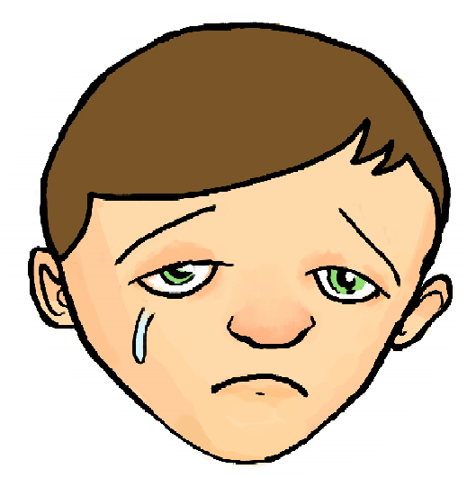
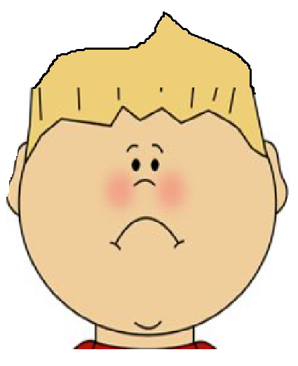
I WILL NEVER LEAVE YOU AS ORPHANS!
The disciples were very sad as Jesus revealed that He is going to suffer, die, resurrect and is going back to Father.
IMAGINE IF SOMEONE SO DEAR TO YOU SAYS THIS!!
The DISCIPLES started to feel a bit left out and tensed.
DISCIPLES FELT SAD BECAUSE THEY LOVED JESUS.
THEY LOVED JESUS BECAUSE …THEY WERE WITH HIM FOR SO LONG AND
THEY HEARD HIS WORDS AND SAW WHAT HE DID-
THEY TRUSTED IN JESUS!

Slide 3
HOW CAN THE DISCIPLES RECEIVE THIS HELPER?
In today’s Gospel, we see Jesus assuring the DISCIPLES about a HELPER that they will receive to be with them always and that He and Father will come and live in them.

Slide 4
IF YOU LOVE JESUS - THEN you will OBEY HIS WORDS
‘JESUS TOLD THEM, “If you love me, you will keep my commandments. And I will ask the Father, and he will give you another Advocate, to be with you forever. This is the Spirit of truth –JOHN 14:15-17
AND YOU WILL RECEIVE THE HELPER FROM FATHER IN HEAVEN TO BE WITH YOU FOREVER
THE SPIRIT OF TRUTH

Slide 5
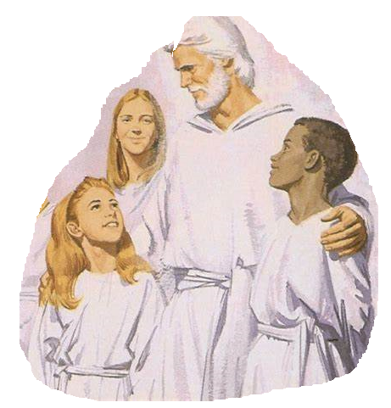
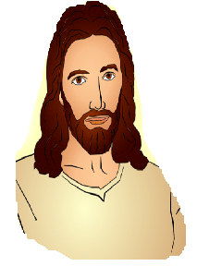
THERE ARE MORE PROMISES FOR THOSE WHO KEEP HIS WORDS…
They who have my commandments and keep them are those who love me; and those who love me will be loved by my Father, and I will love them and reveal myself to them.”(JOHN 14:21)
They who have my commandments and keep them are those who love me; and those who love me will be loved by my Father, and I will love them and reveal myself to them.”(JOHN 14:21)
THEY WILL BE LOVED BY
FATHER AND JESUS
JESUS WILL REVEAL HIMSELF TO THEM
THIS PROMISE IS FOR EACH OF US WHO OBEYS HIS WORD

Slide 6
WE CANNOT OBEY HIM UNLESS WE LOVE HIM OR BELIEVE IN HIM..
HOW IS THIS POSSIBLE?
WHAT DID JESUS TELL US LAST SUNDAY?
JESUS TOLD TO BELIEVE IN HIM
BY THE WORDS HE SPEAK
BY THE WORKS HE DOES
The words that I say to you I do not speak on my own; but the Father who dwells in me does his works. ¹¹ Believe me that I am in the Father and the Father is in me; but if you do not, then believe me because of the works themselves. John 14:10-11

Slide 7
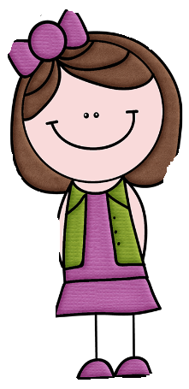
KNOW JESUS MORE.. TO TRUST HIM MORE, TO LOVE HIM MORE, TO OBEY HIM MORE AND MORE. AND RECEIVE THE HELPER TO BE WITH US FOREVER
TAKE YOUR BIBLE…READ IT
YOU WILL BE HELPED BY THE HELPER FROM HEAVEN TO KNOW JESUS MORE..
Increase in BELIEF increases our LOVE that increases our OBEDIENCE

Slide 8
THE WORLD CANNOT RECEIVE HIM
THE WORLD CANNOT RECEIVE OR SEE HIM BECAUSE THEY DIDN’T BELIEVE IN JESUS OR KEEP HIS WORDS
the world will no longer
see me, but you will see me; because I live, you also will live. John 14:19

Slide 9
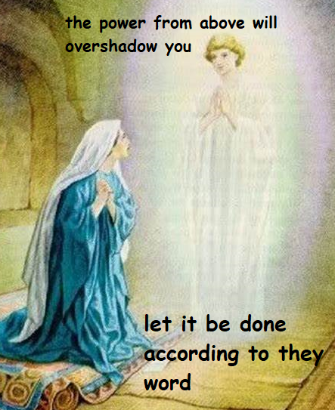
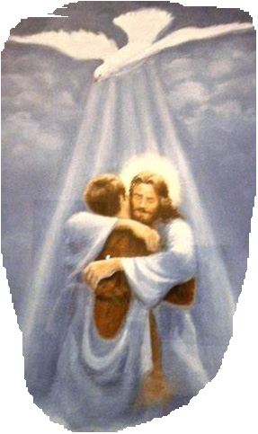
RECEIVE THE POWER FROM ABOVE - THE HOLY SPIRIT
When we receive a word from God, let us accept it as our own
Have full TRUST that we will receive HELP FROM THE HEAVENLY HELPER - THE HOLY SPIRIT, to accomplish it in God’s will
CAN WE FIND OUT FROM THE BIBLE THE PERSONS WHO RECEIVED THE POWER OF HOLY SPIRIT TO ACCOMPLISH GOD’S WILL THROUGH THEIR LIFE?

Slide 10
LET US PRAY
DEAR JESUS INCREASE OUR FAITH AS WE MEDITATE ON YOUR WORDS, GIVE US GRACE TO KEEP YOUR WORDS AND WORKS, SO WE LOVE YOU MORE AND MORE.
SEND FORTH YOUR HOLY SPIRIT TO HELP US AND LEAD US TO THE TRUTH - THAT IS YOU ITSELF, AS WE SAY WITH OUR MOTHER MARY ‘LET IT BE DONE ACCORDING TO THY WORD’
WE PRAY FOR ALL WHO HAVE CHALLENGES IN THEIR FAITH , GIVE THEM STRENGTH . IN JESUS NAME WE PRAY, AMEN

Slide 11
Verses for today: “If you love me, you will keep my commandments. And I will ask the Father, and he will give you another Advocate, to be with you forever. This is the Spirit of truth, -John 14:15-17

Slide 12
THANK YOU
For more ideas and activities, Please visit:
http://littleevangelist.com/childrens_liturgy.php
https://www.youtube.com/channel/UCndM2GK0dnpWg5ECUscdDcA

