Slide 1
COME, SEE AND SPREAD JESUS.
Gospel: John 1:35-42
Children’s Liturgy January 17th ,2021

Slide 2
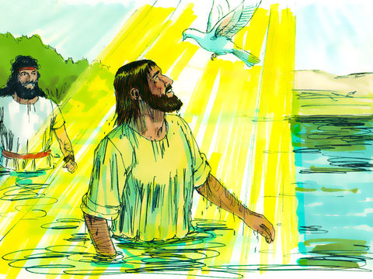
In the Gospel Last Week, it was,
“You are my Son, the Beloved; with you I am well pleased.”
THE BAPTISM OF OUR LORD JESUS
As Jesus was baptized, the heavens opened and the Spirit descended like a dove on him.
And a voice came from heaven…
THE BAPTISM OF THE LORD REVEALED THE HOLY TRINITY - THE FATHER, THE SON AND THE HOLY SPIRIT.
Each one of us are baptised in the name of the Father, Son and Holy Spirit to be Children of God.
Let us, LIVE OUR BAPTISM
LIVE A LIFE PLEASING TO GOD
LIVE IN HOLY SPIRIT

Slide 3
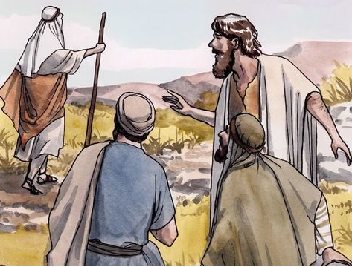
This week in the gospel,
John was standing with two of his disciples.
He watched Jesus walk by, he said,
“Behold,
the Lamb of God.”
The two disciples,
what he said
and followed Jesus.

Slide 4
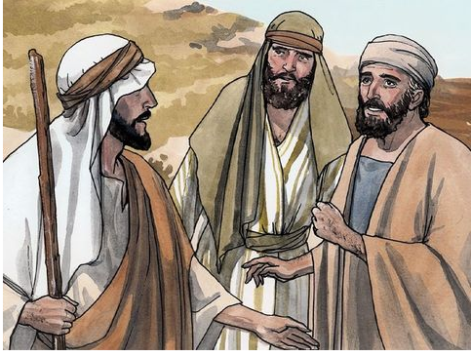
Jesus turned and saw them following him.
He said to them,
“What are you looking for?”
“Rabbi” “where are you staying?”
He said to them,
‘Rabbi’, translated means Teacher .
“Come, and you will see.”
SEE
COME

Slide 5
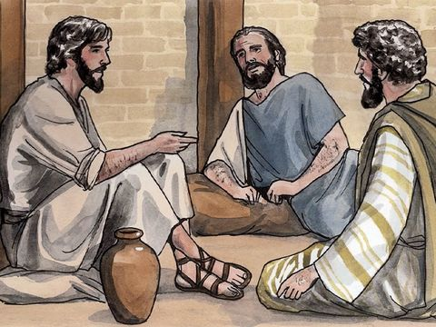
So, they went and saw where Jesus was staying. They stayed with him that day.
STAY WITH JESUS

Slide 6
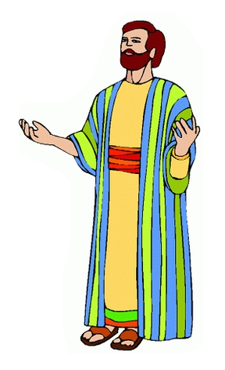
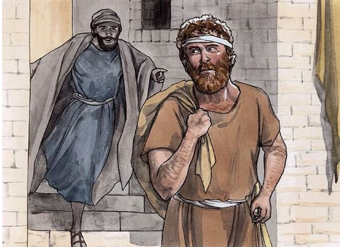
Andrew, the brother of Simon Peter, was one of the two who heard John and followed Jesus.
He first found his own brother Simon
and told him,
‘Messiah’ translated means Christ .
“We have found the Messiah”

Slide 7
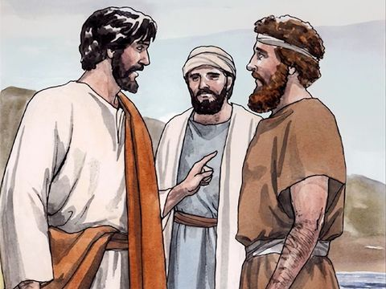
Jesus looked at Simon and said,
Andrew brought Simon to Jesus.
“You are Simon the son of John; you will be called Cephas”
Cephas” - which is translated Peter.

Slide 8
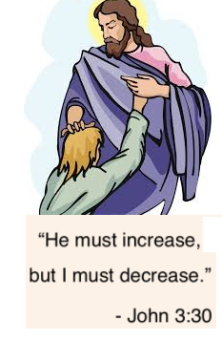
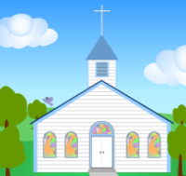
BEHOLD ! THE LAMB OF GOD.
HEAR JESUS
John testified about what was revealed to him about Jesus.
John revealed and pointed to his disciples; 'the real one' that they should follow.
The disciples heard about Jesus from John.
HEAR JESUS
We also hear about Jesus from many sources.
How are we responding?

Slide 9
COME AND YOU WILL SEE.
SEEK, FOLLOW, STAY AND KNOW JESUS
What did Andrew and the other disciple do when they heard John saying,
‘Behold, the Lamb of God’ ,as Jesus walked by?
They followed Jesus and
sought Jesus about His place of Stay.
Jesus says,
They stayed with him and remained with him, to understand more about Him.
Jesus want us to do this too..
TO SEEK AND FOLLOW HIM,
TO REMAIN IN HIM
TO KNOW MORE ABOUT HIM
through Prayer, Living Word, Sacraments, Holy Spirit..
IS THAT ENOUGH?

Slide 10
WHAT DID ANDREW DO AFTER HE KNEW ‘JESUS THE MESSIAH’?
SPREAD JESUS
Andrew went to his brother and shared about Jesus.
He brought his brother to Jesus,
who changed his life.
We too must allow Jesus to transform us and others.
In Whatever we do or say, We must reflect and witness ‘Jesus’ in whom we abide with and lead others to Jesus who is the real LIFE-CHANGER.

Slide 11
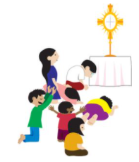
So, let us,
HEAR, FOLLOW AND SEEK the real way of salvation ‘Jesus’.
ABIDE in Jesus and KNOW him more.
Let Jesus TRANSFORM us.
SHARE JESUS AND LEAD all to Jesus, the real life-giver by TESTIFYING Jesus through our life in Christ.
LET IT BE DONE IN US ACCORDING TO HIS WORD.

Slide 12
LET US PRAY,
Dear Lord, we thank you for giving us Jesus, our salvation. We thank you for everyone and everything that is helping us to reach Jesus. Give us your grace and wisdom by the power of Holy Spirit to abide with Jesus always and to know him more and more. Give us the courage to lead others to Jesus-your transforming love, by reflecting him through our life, words and actions. Let Jesus increase and we decrease.
In Jesus’ name we pray, amen.

Slide 13
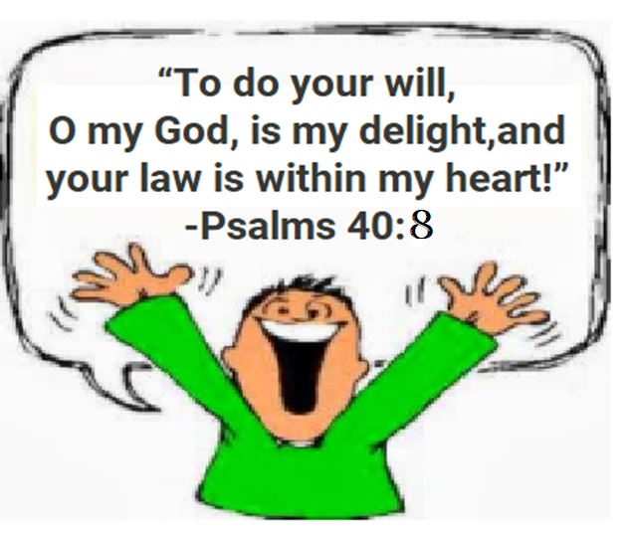
VERSE OF THE DAY

Slide 14
THANK YOU
GOD BLESS YOU ALL.
KEEP LITTLE EVANGELIST IN YOUR SPECIAL PRAYERS
FOR MORE IDEAS PLEASE VISIT:
WEBSITE:
http://littleevangelist.com/childrens_liturgy.php
YOUTUBE CHANNEL:
https://www.youtube.com/channel/UCndM2GK0dnpWg5ECUscdDcA

