Slide 1
‘that is why I came..’
Gospel: Mark 1:29-39
Children’s Liturgy February 7th, 2021
Notes:
Line spacing + Page numbers

Slide 2
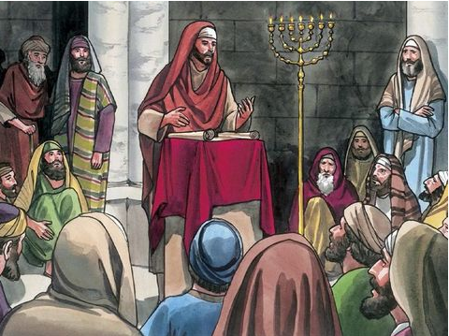
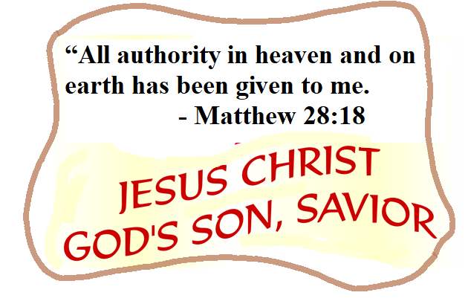
Last week in the Gospel
We saw, Jesus taught with authority and his teachings made a great impression on all those who were listening.
The word of Jesus has power and authority and it happened as He proclaimed the word.
When he commanded, even the unclean spirits obeyed .
Believe in the authority of Jesus and in the power of God's word that transform our lives
Jesus himself was the living word
made flesh, the son of God.
Let us approach the word of God in Jesus name, in faith.

Slide 3
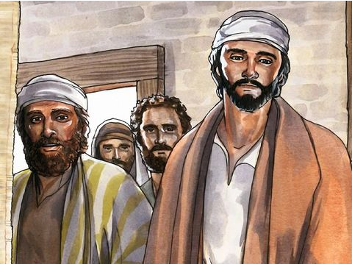
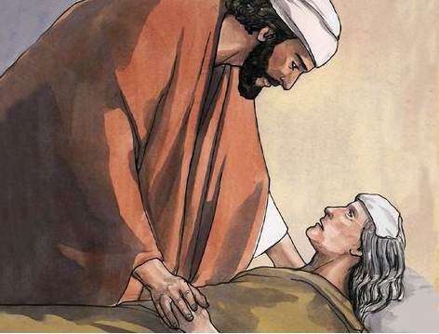
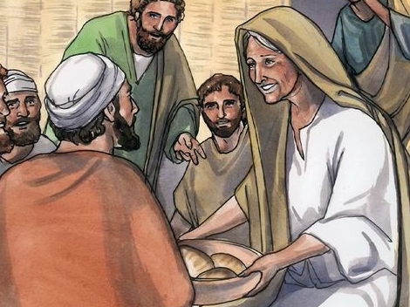
Today in the Gospel we see,
From the synagogue, Jesus went with James and John
straight to the house of Simon and Andrew.
Simon’s mother-in-law was unwell with fever
and they told about her to Jesus.
He went to her, took her by the hand
and helped her up.
The fever left her, and she began to wait on them.

Slide 4
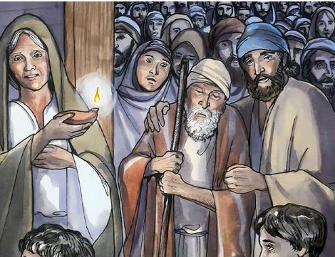
That evening, after sunset, they brought to him all who were sick and those who were possessed by devils.
The whole town came crowding round the door,
and Jesus cured many
who were suffering from diseases
of one kind or another;
He also cast out many devils, but he would not allow them to speak, because they knew who he was.

Slide 5
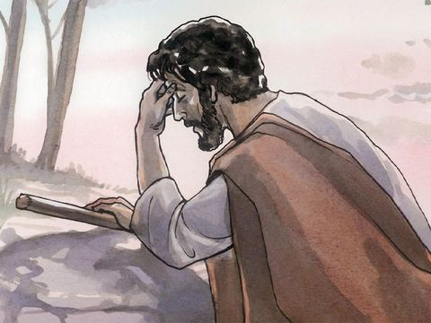
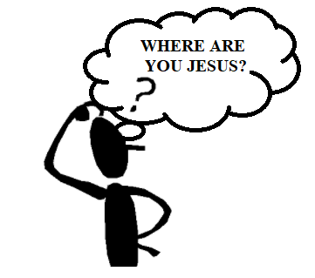
In the morning, long before dawn
Jesus got up and left the house,
and went off to a lonely place,
and prayed there.
Simon and his companions set out in search of him.

Slide 6
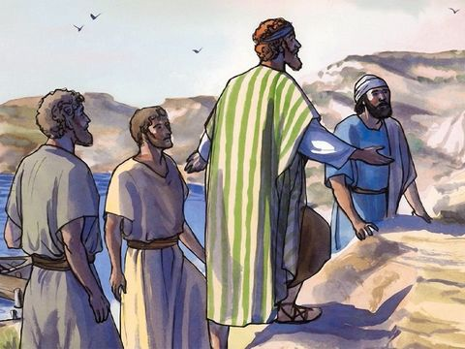
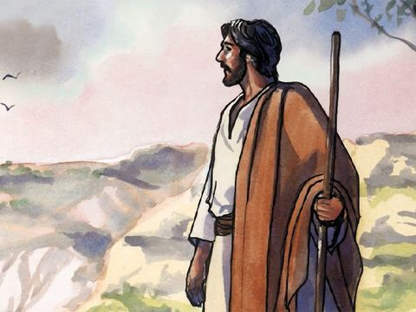
When they found him, they said,
‘Let us go elsewhere, to the neighboring country towns, so that I can preach there too,
because that is why I came.’
‘Everybody is looking
for you.’
He answered,
And he went all through Galilee, preaching in their synagogues and casting out devils.

Slide 7
to help us, heal us, deliver us and make us experience the love of God.
Jesus entered Simon’s house and healed his mother-in-law.
Jesus has come into us too ..
Let us offer all our prayers to Jesus, trusting in his providence.
Simon’s mother-in-law began to serve Jesus the moment she was healed.
Are we happy to serve the lord?
How can we serve the lord?
Jesus is showing us the way….

Slide 8
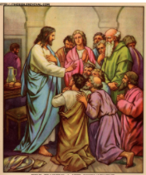
‘...that is why I came'
Jesus came to preach the good news of forgiveness and salvation.
To bring everyone to the love of God.
As he entered Simon’s house, He healed his mother-in-law.
As preached, he cured and delivered many people physically and spiritually.
He set them free to experience God’s love .
Jesus was ready to help as many people as he could. He was never tired.
He stopped the evil spirits from making him known to others.
Jesus did not want to gain fame for what he was doing.
His intention was only to help everyone and make them know the love of God.

Slide 9
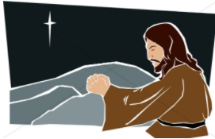
How was Jesus able to do such marvellous deeds?
We see in the gospel that Jesus is waking up early in the start of the day and
going to a lonely place to talk to his father.
This is PRAYER
Jesus listened to his
father in heaven .
He did everything in heavenly wisdom
Jesus gained strength in prayer
by filling in father’s love
The prayer gave Jesus strength to cure and
help many people in love of god.

Slide 10
So, how can we serve our lord? How can we accomplish the will of God?
We must start our day in prayer
To get wisdom of god to do everything according to his wish
To get strength to accomplish everything in love of god.
Prayer fills us with love and grace of God
Prayer helps us to fill us in more of Gods likeness
To do everything for the glory of god and out of god’s love,
without complaining or being proud, selfish or getting fed up.

Slide 11
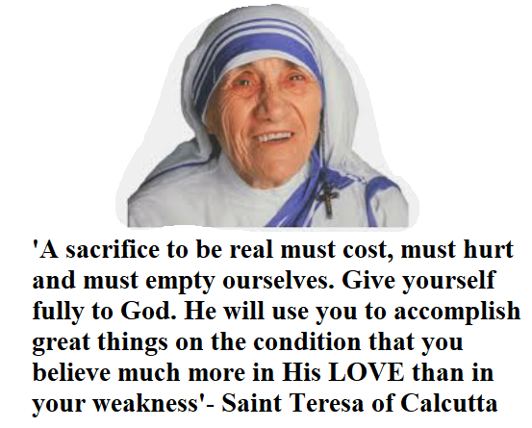
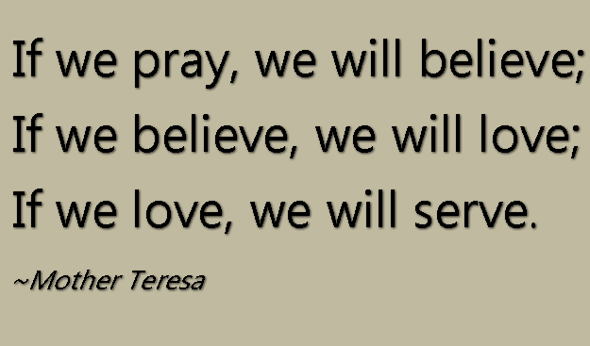
Do you know Saint Teresa of Calcutta?
She dedicated her life serving the poor and the lepers
She was able to do all things in Jesus, for Jesus and with Jesus, who strengthened her through daily reception of the Eucharist.
She says,
“without him I cannot be — I am helpless”.

Slide 12
PRAY… LOVE….SERVE
....that is why we are sent in Jesus name.
Let our life be surrendered to serve our lord, who gave himself for us and delivered us and cured us from the curse of sin.
Let us start off our day with prayer
to know Lords wish and
to gain strength to do everything in love of God.
Let us thus spread the good news of forgiveness and salvation through Jesus
* by living the Gospel in the power of God’s love,
* by being available for everyone who needs our help.

Slide 13
Let us Pray,
“Dear Lord, thank you for giving us Jesus. Thank you for forgiving us , healing us, and delivering us by filling us in your love. Give us grace to spent time with you in prayer, to know your will and live each moment according to Gods will. Fill us in God’s love, wisdom and power of Holy spirit to live according to the plans of heaven by helping each other, without complaining or getting fed up. Grant this by your grace.
In Jesus name we pray, Amen ."

Slide 14
Verse for the Day

Slide 15
THANK YOU
GOD BLESS YOU ALL
KEEP LITTLE EVANGELIST IN YOUR SPECIAL PRAYERS.
FOR MORE IDEAS PLEASE VISIT:
WEBSITE:
http://littleevangelist.com/childrens_liturgy.php
YOUTUBE CHANNEL:
https://www.youtube.com/channel/UCndM2GK0dnpWg5ECUscdDcA

