Slide 1
HE TAUGHT THEM WITH AUTHORITY
GOSPEL: MARK 1:21-28
CHILDRENS LITURGY JANUARY 31ST, 2021

Slide 2
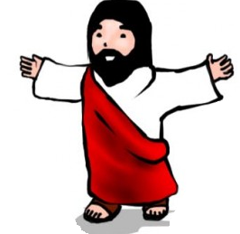
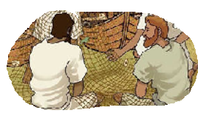
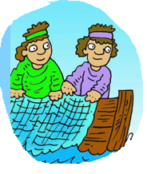
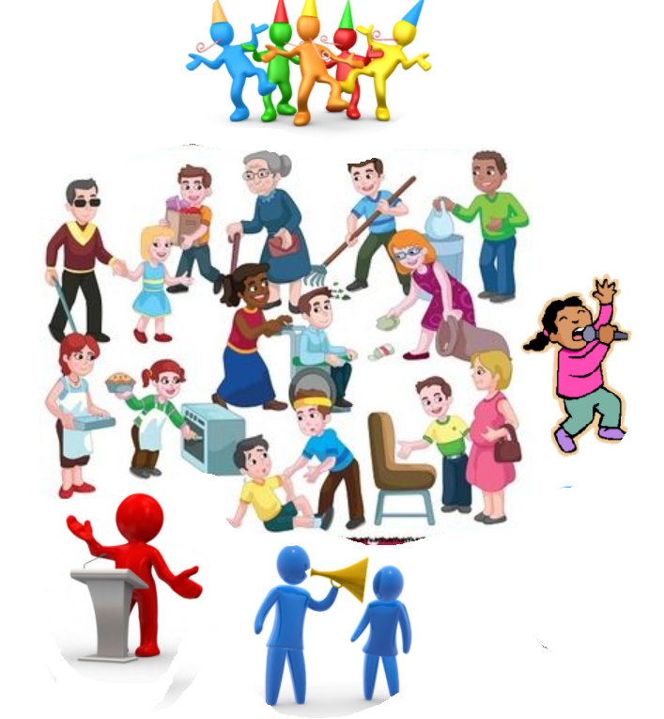
LAST WEEK IN THE GOSPEL
WE SAW JESUS BEGINNING HIS MISSION, HE CAME TO GALILEE PROCLAIMING THE GOOD NEWS.
‘The time has come’ he said ‘and the kingdom of God is close at hand. Repent, and believe the Good News.’
JESUS CALLED ,
JAMES AND JOHN
PETER AND ANDREW
FOLLOW ME!
THEY LEFT EVERYTHING AND FOLLOWED HIM.
Jesus entrusts us the mission of gaining the souls of the children of God, by spreading the good news of forgiveness and salvation in Jesus name.
LET US OFFER
OURSELVES AND
FOLLOW JESUS.
Jesus is calling us too.

Slide 3
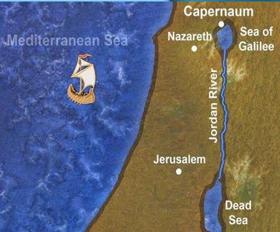
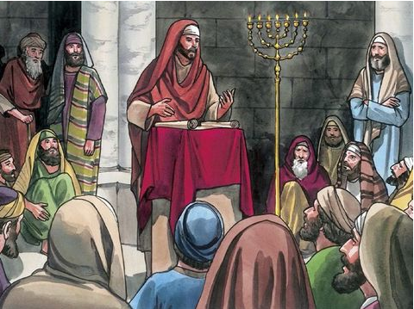
IN THE GOSPEL TODAY WE SEE,
Jesus and his disciples going to as far as Capernaum.
On the Sabbath day,
Jesus went to the synagogue
and began to teach.
SCRIBES
ARE TEACHERS OF SCRIPTURES
His teaching made a deep impression
on them….
…..because, unlike the scribes, he taught them with authority.

Slide 4
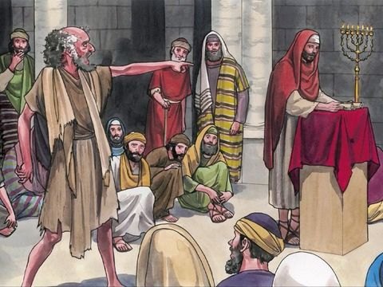
In their synagogue, just then, there was a man possessed by an unclean spirit.
He shouted,
‘What do you want with us, Jesus of Nazareth?
Have you come to destroy us?
I know who you are: the Holy One of God.’

Slide 5
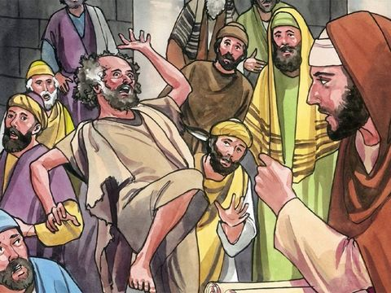
But Jesus said sharply,
‘Be quiet!
Come out of him!’
The unclean spirit threw the man into convulsions and with a loud cry went out of him.

Slide 6
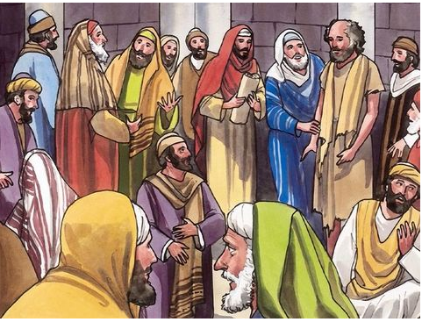
The people were so astonished that they started asking each other what it all meant.
They said,
‘Here is a teaching that is new and with authority behind it: he gives orders even to unclean spirits and they obey him.’
And his reputation rapidly spread everywhere,
through all the surrounding Galilean countryside.

Slide 7
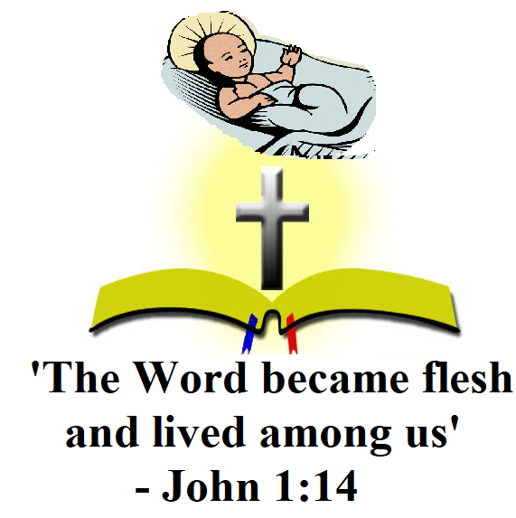
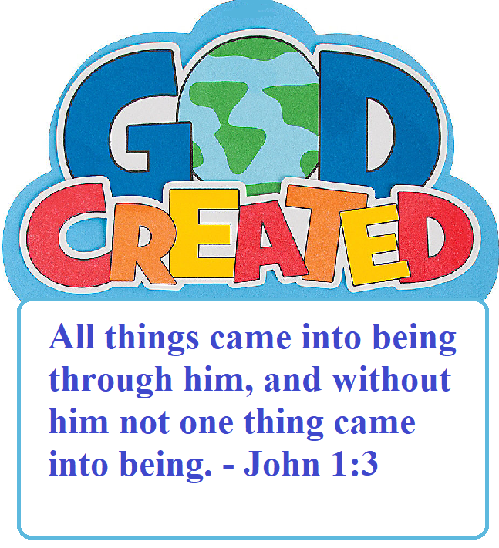
HE TAUGHT THEM WITH AUTHORITY
At the command of the word from Jesus, a man who had unclean habits was transformed to a good person.
The word of Jesus has power and authority.
When Jesus spoke a word, it happened.
When he commanded, the unclean spirits obeyed ,
even the wind and the sea obeyed too(Mark 4:35-41).
Why Jesus’s teachings were in authority?
Jesus himself was
the living word made flesh, the son of God.
It was with this word that
everything was made.

Slide 8
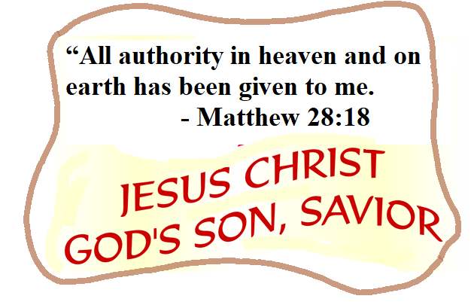
Do we believe in the authority of Jesus and that God's word has power to transform our lives?
JESUS SAYS, ‘THE WORDS THAT I HAVE SPOKEN TO YOU ARE SPIRIT AND LIFE.’(JOHN 6:63)
Let us Trust in the
word of God,
that made everything.
The word of God has power:
to create,
to guide us to truth,
to give life,
to heal,
to transform,
to deliver
to purify….
Let us approach the word of God in Jesus name, in faith.
with an eagerness to do what the Lord desires for us; through his everlasting word,
in humility and full surrender.

Slide 9
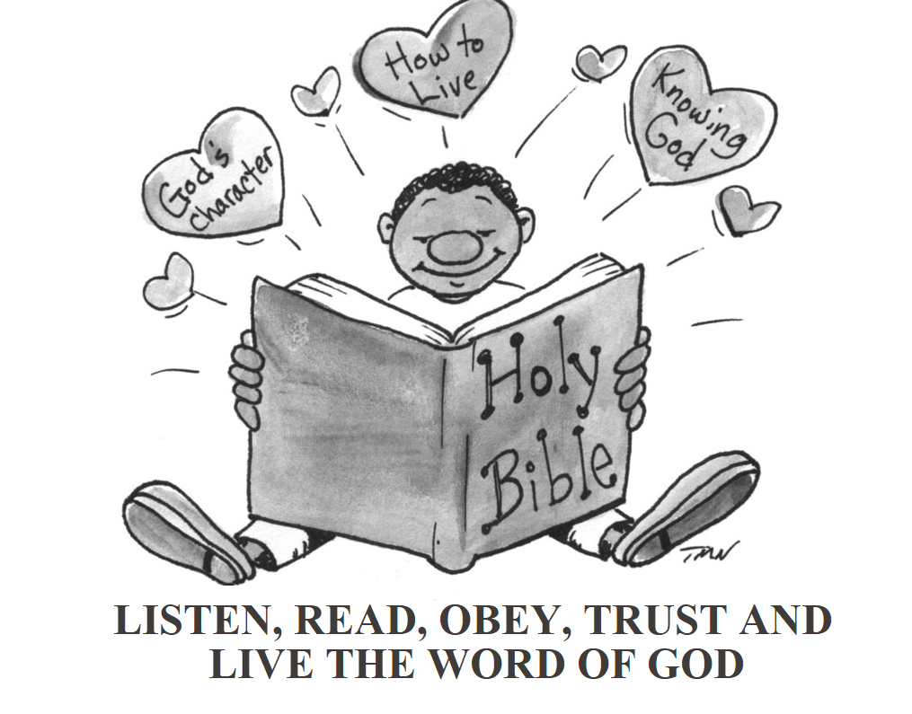
A NEW TEACHING WITH AUTHORITY
Are we willing to be taught by the Lord?
FOLLOW THE JESUS WAY…SEEK HIS WAY IN THE GOSPEL.
Are we ready to allow the word to transform our lives?
Jesus lived out what He was teaching.
Let us
live in
Jesus way.

Slide 10
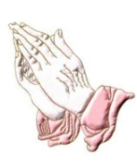
Let us pray,
Dear Lord Jesus, your word is spirit and life. We thank you for giving us new birth by your living word. Give us grace by your Holy Spirit to have faith in the power of your word that transforms us to your likeness. We offer all our weaknesses and concerns to the authority of Jesus and his powerful words to transform us and all whom we pray for, to the likeness of God.
In Jesus’ name we pray, Amen .

Slide 11
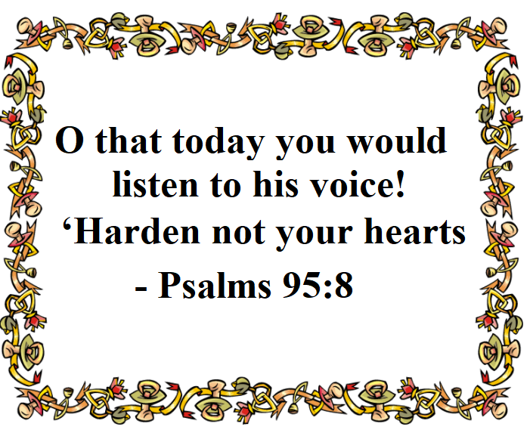
VERSE OF THE DAY

Slide 12
THANK YOU
GOD BLESS YOU
KEEP LITTLE EVANGELIST IN YOUR SPECIAL PRAYERS.
FOR MORE IDEAS PLEASE VISIT:
WEBSITE:
http://littleevangelist.com/childrens_liturgy.php
YOUTUBE CHANNEL:
https://www.youtube.com/channel/UCndM2GK0dnpWg5ECUscdDcA

