Slide 1
TAKE UP YOUR CROSS, AND FOLLOW JESUS.
CHILDREN’S LITURGY AUGUST 30TH, 2020
GOSPEL: MATTHEW 16:21-27

Slide 2
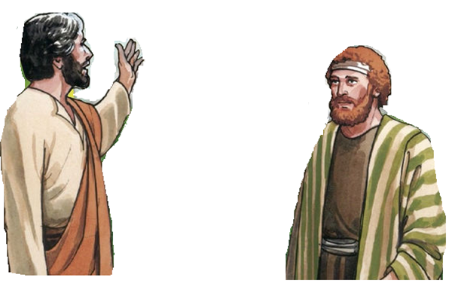
IN THE GOSPEL LAST WEEK,
‘who do you say that I am?’
“You are the Messiah, the Son of the living God.”
WE SEE THAT PETER COURAGEOUSLY CONFESSED HIS FAITH IN JESUS - AS MESSIAH, THE SON OF GOD.
JESUS CALLS HIM ROCK AND ASSIGNS HIM GREAT MISSIONS .
“Blessed are you, Simon son of Jonah! For flesh and blood has not revealed this to you, but my Father in heaven.”
LET’S SEE WHAT HAPPENS TO PETER THIS WEEK

Slide 3
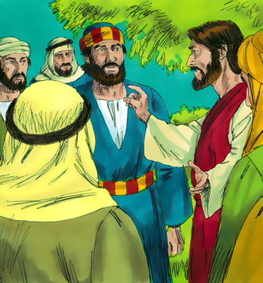
AS THE GREAT MISSION WAS REAVEALED, JESUS BEGAN TO SPEAK ABOUT ‘HOW HE WAS GOING ACCOMPLISH IT’
JESUS SAID,
DEAR FRIENDS, I MUST GO TO JERUSALEM AND I WILL UNDERGO GREAT SUFFERING FROM THE HANDS OF THE ELDERS AND CHIEF PRIESTS AND SCRIBES, AND WILL BE KILLED, AND ON THE THIRD DAY I WILL BE RAISED.

Slide 4
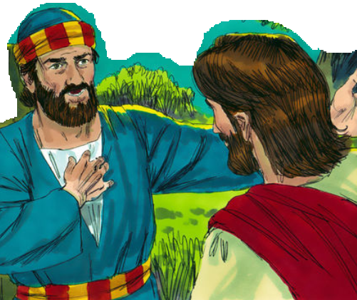
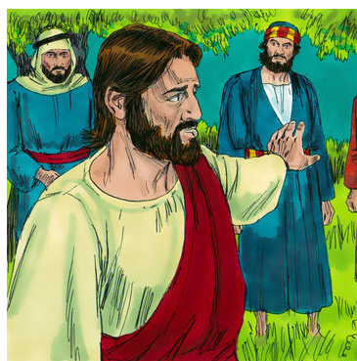
WHEN Peter HEARD ABOUT THE HARDSHIPS, HE took Jesus aside and began to rebuke him.
“God forbid it, Lord! This must never happen to you.”
“Get behind me, Satan! You are a stumbling block to me; for you are setting your mind not on divine things but on human things.”
Are we becoming stumbling blocks too?
What have we set our minds on?
Jesus turned and said to Peter,

Slide 5
JESUS TRIES TO MAKE HIS FRIENDS CLEAR OF ‘WHAT IT ACTUALLY MEANS TO BE HIS FOLLOWER’
JESUS TOLD HIS DISCIPLES THAT, “IF ANY WANT TO BECOME MY FOLLOWERS THEN,
-> LET THEM DENY THEMSELVES
-> TAKE UP THEIR CROSS AND
-> FOLLOW ME.”
Jesus makes them understand that giving our life to gain the world, comfort and safety is not true life..
Jesus made them understand how to find true life
One who gives his life for Jesus’ sake is the one who is really finding it.
‘Those who want to save their life will lose it, and those who lose their life for my sake will find it.
For what will it profit them if they gain the whole world but lose their life? Or what will they give in return for their life?’

Slide 6
DO WE SOMETIMES THINK LIKE PETER?
IN TIMES OF TROUBLES OR
IN TIMES THAT WE NEED TO SACRIFICE OUR WISHES,
ARE WE ABLE TO DENY OUR OWN SELF AND OUR OWN WAYS AND WISHES TO FOLLOW JESUS WAY?
THIS IS WHAT JESUS TEACHES US TODAY AS HE SAID,
DENY YOUR SELF, TAKE UP YOUR DAILY CROSS AND FOLLOW JESUS WAY.

Slide 7
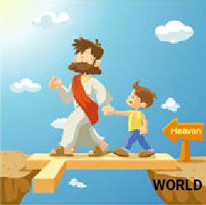
WHY JESUS WAY?
* BECAUSE JESUS WALKED THIS WAY AND REACHED HEAVEN. THIS IS WHERE WE MUST REACH TOO.
* HE DENIED HIS PLEASURES AND TOOK UP THE CROSS FOR SAVING US
LET US TRY IT THIS WEEK!
IN ALL THINGS WE DO,
LET US TRY TO DENY OUR OWN SELFISH DESIRES AND TAKE THE CROSS-
BY OFFERING THE PAIN THAT WE EXPERIENCE IN DENYING OURSELVES, FOR SALVATION OF SOULS AND THEN DO WHAT JESUS WOULD HAVE DONE .
THOSE WHO BELIEVE IN JESUS WILL NOT PERISH BUT WILL HAVE ETERNAL LIFE.
- (John 3:16)

Slide 8
LET US PRAY
DEAR JESUS, WE KNOW YOU ARE THE FULLNESS OF OUR LIFE. THANK YOU FOR SHOWING US THE WAY TO HEAVEN. GIVE US THE GRACE TO DENY OUR SELF, TAKE OUR CROSS AND FOLLOW YOU, TO REACH WHERE YOU ARE. WE ARE SORRY FOR ALL THE TIMES WE WERE SELFISH AND DENIED THE CROSS. WE PROMISE BY YOUR GRACE TO OFFER ALL OUR PAINS FOR THE SALVATION OF SOULS, FOR THE SAKE OF YOUR SORROWFUL PASSION. AMEN
NEVER MISS ANY OF YOUR CHANCES TO DENY YOURSELF. TAKE UP THE CROSS,
OFFER ALL YOUR PAINS AND STURGGLES FOR THE SAKE OF JESUS PASSION TO GAIN SOULS FOR HEAVEN
CAN YOU FIND OUT ???
WHAT DID JESUS GAIN WHEN HE DENIED HIMSELF, TOOK UP THE CROSS AND FOLLOWED WHAT HIS FATHER SAID?

Slide 9
VERSES FOR THIS WEEK
“IF ANY WANT TO BECOME MY FOLLOWERS, LET THEM DENY THEMSELVES AND TAKE UP THEIR CROSS AND FOLLOW ME.”
- MATTHEW 16:24

Slide 10
THANK YOU
GOD BLESS YOU ALL!
FOR MORE IDEAS, PLEASE VISIT:
WEBSITE: http://littleevangelist.com/childrens_liturgy.php
YOUTUBE CHANNEL: ttps://www.youtube.com/channel/UCndM2GK0dnpWg5ECUscdDcA

