Slide 1
‘The zeal for your house consumes me’.
Children’s Liturgy March 7th ,2021
Gospel : John 2:13-25

Slide 2
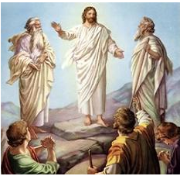
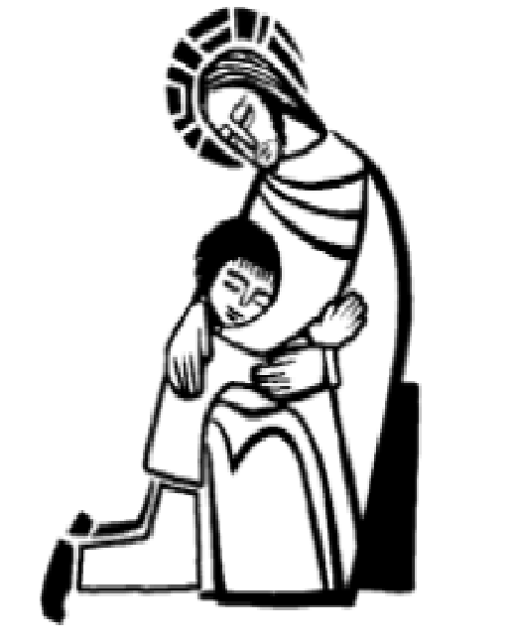
Last week in the Gospel we saw,
Jesus led Peter James and John up a high mountain where they could be alone.
He transfigured before them,
revealing to them His Divine and Holy nature.
Jesus is inviting us to the high mountains of PRAYER .
In our prayer times, Jesus reveals to us to know Him more .
ARE WE READY TO FOLLOW JESUS WHEN HE CALLS US TO HIGH PLACES OF PRAYER?
The voice from the cloud- the voice of Father in Heaven-directs each of us,
‘This is my Son, the Beloved. Listen to him.’

Slide 3
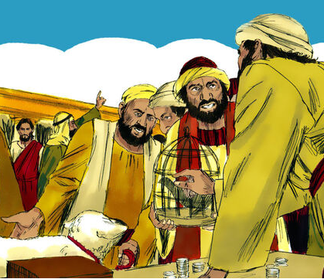
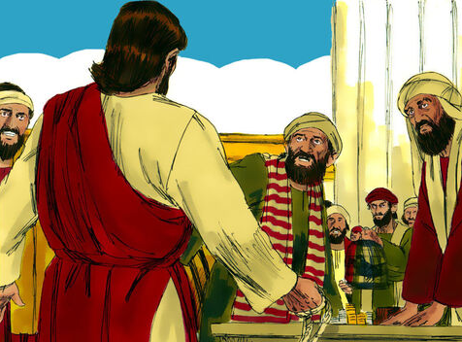
In Gospel Today,
Just before the Jewish Passover Jesus went up to Jerusalem.
In the Temple he found,
people selling
cattle and sheep and pigeons
and the money-changers
sitting at their counters there.

Slide 4
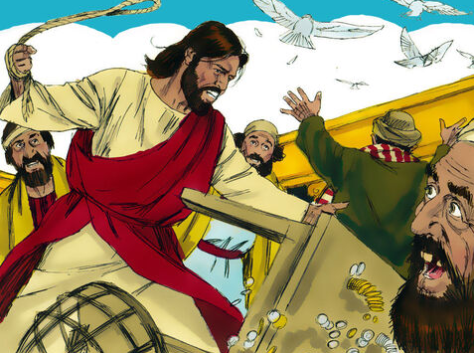
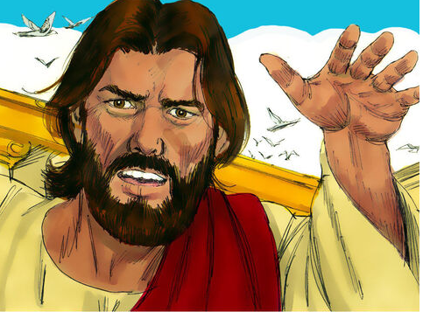
Making a whip out of some cord, he drove them all out of the Temple,
cattle and sheep as well,
scattered the money-changers’ coins,
knocked their tables over .
He said to the pigeon-sellers,
‘Take all this out of here and stop turning my Father’s house into a market.’
Then his disciples remembered the words of scripture:
‘Zeal for your house will devour me’.

Slide 5
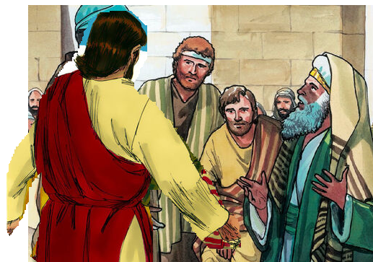
The Jews intervened and said,
Jesus said,
‘Destroy this sanctuary, and in three days I will raise it up.’
What sign can you show us to justify what you have done?’
But he was speaking of the sanctuary that was his body.
When Jesus rose from the dead, his disciples remembered that he had said this,
The Jews replied,
and they believed the scripture and the words he had said.
‘It has taken forty-six years to build this sanctuary: are you going to raise it up in three days?’

Slide 6
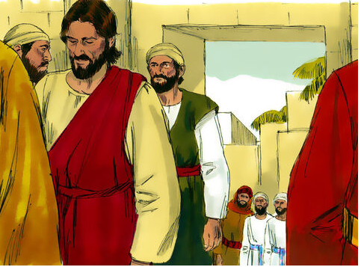
During his stay in Jerusalem for the Passover,
many believed in his name when they saw the signs that he gave.
But Jesus knew them all and did not trust himself to them;
He never needed evidence about any man; he could tell what a man had in him.
THIS IS THE GOSPEL OF THE LORD.
RESPONSE: PRAISE TO YOU LORD JESUS CHRIST

Slide 7
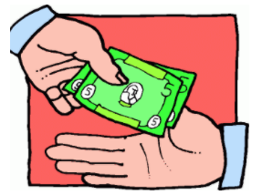
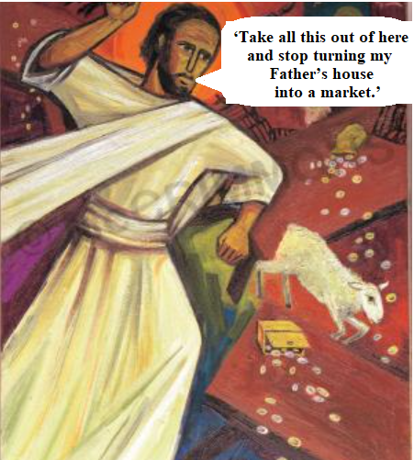
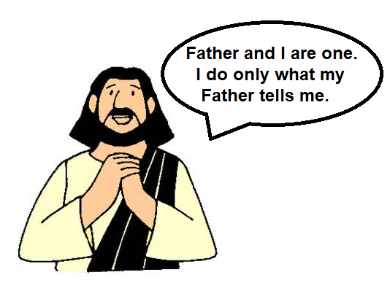
Reflection
In the Temple, Jesus found people selling
Pigeons, cattle and Sheep
He said,
And money changers.
Why do you think Jesus reacted like this?
THE ZEAL OF THE FATHERS HOUSE CONSUMED HIM.
It is the passion and love to His father that came out as a Zeal to cleanse the temple.
What will we feel when we see the Church like this?
surprise , anger , pain , indifference???

Slide 8
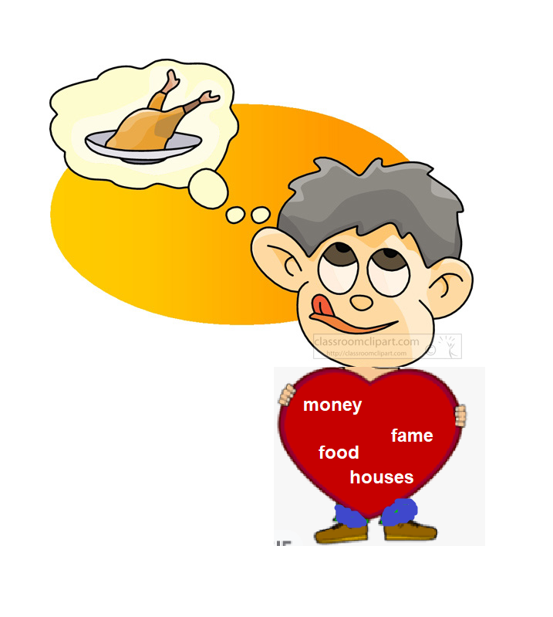
What might have prompted the people to make the temple like a market place?
Forgetting about the true worship of God.
Putting worldly things and their gains more important than God.
Jesus reveals: how we loose the focus from God
by getting distracted over worldly things.
Our actions reflect our hearts intentions and priorities.
Let us check on our actions and what is in our heart?
Do we get distracted during prayers or Holy Mass?
Are we more focusing on the external worldly things more than Jesus?
Jesus wants us to focus and give priority only to God.

Slide 9
Jesus was questioned regarding his authority of doing such an action.
“What sign can you show us to justify what you have done?”
Jesus gave the most important sign:
‘Destroy this sanctuary, and in three days I will raise it up.’
Jesus was saying about the body as temple of god.
He gave the sign of His passion, death and resurrection;
that cleansed the sins of the world ,
restoring everyone who believes in Him as children of God- MAKING US THE HOUSE OF LORD.
Let us think , how Jesus gave himself to cleanse us?
how Jesus made us the house of the lord?

Slide 10
Jesus transformed Our Body as the Temple of God
by sending down the holy spirit upon us.
Are we having the zeal like Jesus
to keep lords house holy ?
Let us check the intentions and priorities of our heart?
What is filling in our heart?
Are we getting distracted by giving importance to material things?
Through the Gospel, Jesus wants to challenge our disrespectful actions arising out of the disrespectful use of our body.
Jesus is zealous to cleanse our body- we are His temple.

Slide 11
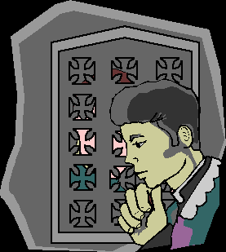
Jesus came to cleanse us and bring us back to God
In this Lenten time , let us offer ourselves in faith
to the authority and power of Jesus to cleanse us and renew as Lords house.
SELFISHNESS
PRIDE
GREED
JEALOUSY
ANGER???
Let us Examine our conscience:
What are the things Jesus wishes to take away from us to make us his house?
Let us Confess to our Lord and
allow Him to cleanse us.
JESUS WANTS US TO CONSECRATE OURSELVES
TO BELONG TO JESUS ONLY.
LET ALL OUR ACTIONS BE OUT OF ZEAL TO OUR LORD.

Slide 12
Let us pray,
Dear Lord, we thank you for your love that gave Jesus to cleanse us and make us your house. Give us the zeal to love to you and to offer ourselves as your own. Let everything we do be out of love for you. Let your love help us to respect each other and to approach the place of God in reverence.
In Jesus name we pray, amen.

Slide 13
Verse of the day

Slide 14
God Bless you
KEEP LITTLE EVANGELIST
IN YOUR SPECIAL PRAYERS
FOR MORE IDEAS PLEASE VISIT:
WEBSITE:
http://littleevangelist.com/childrens_liturgy.php
YOUTUBE CHANNEL:
https://www.youtube.com/channel/UCndM2GK0dnpWg5ECUscdDcA

