Slide 1
THE GREATEST TREASURE
CHILDREN’S LITURGY JULY 26TH, 2020
GOSPEL: MATTHEW 13:44-46

Slide 2
DO YOU LOVE TREASURES?
HOW WILL SOMETHING BECOME A TREASURE TO US?
HOW DOES IT MAKE US FEEL?
BUT WHAT HAPPENS AFTER SOME TIME?
ARE WE HAPPY FOREVER WITH THE TREASURE?
IN TODAY’S GOSPEL JESUS TELLS US ABOUT THE GREATEST TREASURE ,WITH AN EVERLASTING JOY

Slide 3
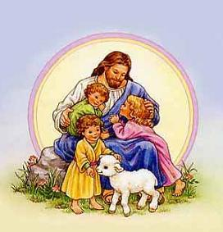
THE GREATEST TREASURE TO BE DESIRED
THE KINGDOM OF HEAVEN
JESUS MAKES HIS FRIENDS UNDERSTAND ABOUT THE JOY AND THE VALUE OF THE KINGDOM OF HEAVEN THROUGH PARABLES

Slide 4
THE KINGDOM OF HEAVEN IS LIKE,
A TREASURE BURIED IN THE FIELD WHICH A PERSON FINDS
HE HIDES IT BACK
AND OUT OF JOY OF FINDING IT, HE GOES AND SELLS ALL THAT HE HAS TO BUY THE FIELD.

Slide 5
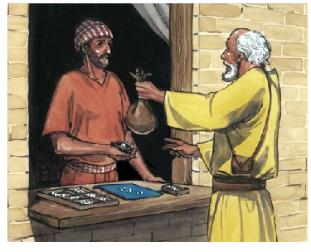
THE KINGDOM OF HEAVEN IS ALSO LIKE,
A MERCHANT, WHO WAS IN SEARCH FOR FINE PEARLS ; FINDS A PEARL OF GREAT PRICE
HE GOES AND SELLS ALL THAT HE HAS; TO BUY THIS PEARL

Slide 6
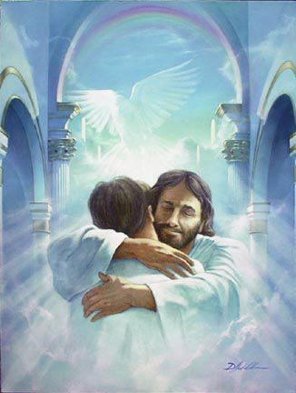
SO WHAT IS JESUS TELLING US ABOUT THE KINGDOM OF HEAVEN?
THE KINGDOM OF HEAVEN IS SO PRECIOUS.
IT IS THE GREATEST TREASURE. THERE ISN’T ANYTHING THAT IS MORE VALUABLE.
GIVE EVERYTHING YOU HAVE; TO GAIN IT.
IT IS THE EVERLASTING JOY OF BEING IN COMMUNION WITH GOD FOREVER.
IT IS HIDDEN BUT WILL BE FOUND BY THOSE WHO SEARCHES.

Slide 7
WHY IS IT SO PRECIOUS?
HOW CAN WE GAIN THE KINGDOM?
* THE KINGDOM OF GOD IS FULL OF LOVE, JOY ,PEACE AND RIGHTEOUSNESS.
* IT IS THE STATE OF BEING IN CLOSE COMMUNION WITH GOD AND IN HIS LOVE.
* THE KINGDOM OF GOD IS EVERLASTING.
* THERE IS NO SADNESS, PAIN OR ANYTHING BAD IN IT.
* WE ARE ETERNALY LIVING IN THE PRESENCE OF OUR LORD.
JESUS PAID THE PRICE : HE GAVE HIMSELF TO GAIN IT FOR US.
FOLLOW THE JESUS WAY TO ENTER THE KINGDOM OF GOD.
READ MORE ABOUT THE KINGDOM OF GOD IN REVELATION 21 & 22 FROM THE BIBLE

Slide 8
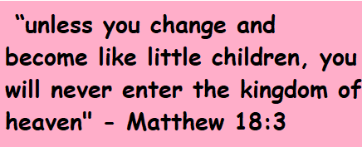
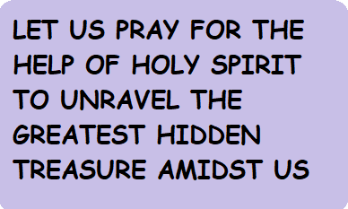
SO WHY HESITATE? LET US CARRY ON IN JOY… FOLLOW THE JESUS WAY..
DEAR LORD, GRANT THESE BY YOUR GRACE. IN JESUS’ NAME WE PRAY, AMEN

Slide 9
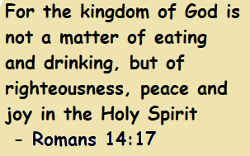
VERSES FOR THE WEEK
“The kingdom of heaven is like a treasure ”
- Matthew 13:44

Slide 10
THANK YOU GOD BLESS
FOR MORE IDEAS , PLEASE VISIT:
WEBSITE: http://littleevangelist.com/childrens_liturgy.php
YOUTUBE CHANNEL:
https://www.youtube.com/channel/UCndM2GK0dnpWg5ECUscdDcA

