Slide 1
FORGIVE; TO BE FORGIVEN
MATTHEW 18:21-35
CHILDREN’S LITURGY 13TH SEPTEMBER 2020

Slide 2
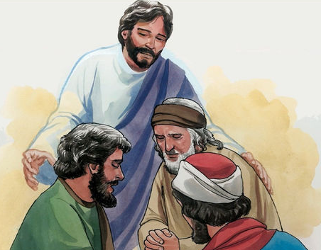
GOSPEL, LAST WEEK
WAS ABOUT GIVING CHANCES: GIVE CHANCES FOR OUR FRIENDS TO RETURN AND TO RECONCILE.
IT WAS ALSO ABOUT THE POWER OF PRAYING TOGETHER - JESUS IS PRESENT AMIDST TWO OR THREE GATHERED IN HIS NAME AND THAT IF THEY AGREE ON A COMMON THING AND PRAY, IT WILL BE GRANTED TO THEM BY THE HEAVENLY FATHER.

Slide 3
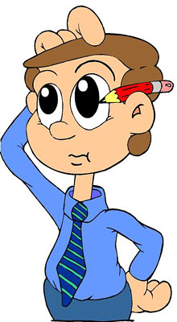
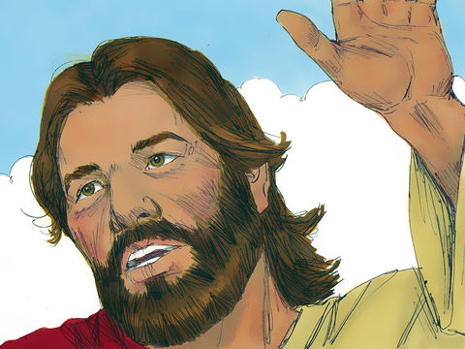
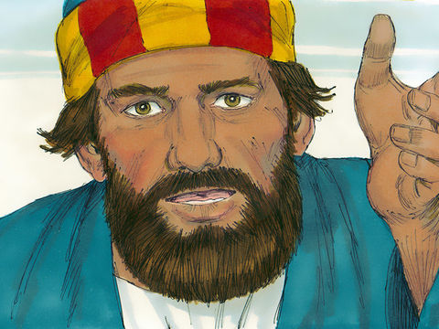
JESUS ASKS HIS FRIENDS TO GIVE CHANCES TO PEOPLE TO CORRECT THEIR WRONGS AND COME BACK TO GOD
PETER IN DOUBT, ASKS JESUS:
THAT SOUNDS LIKE A LOT OF TIMES - IS IT LIMITLESS?
‘HOW MANY TIMES MUST WE FORGIVE A PERSON DOING WRONG, IS SEVEN TIMES ENOUGH?’
NOT SEVEN TIMES BUT SEVENTY-SEVEN TIMES!

Slide 4
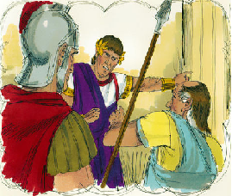
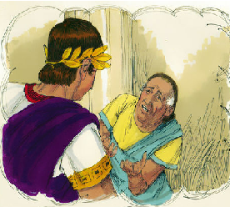
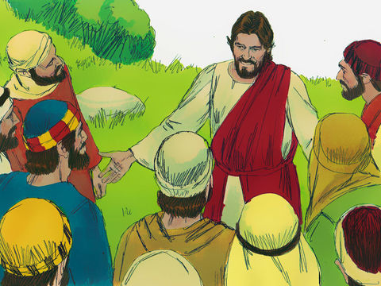
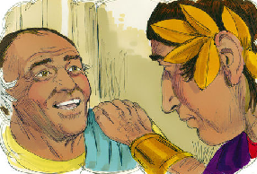
KINGDOM OF HEAVEN AND FORGIVENESS
JESUS EXPLAINED IT WITH A PARABLE:
*He calls in a man who owes a huge amount (equal to a million pounds) and asks him to pay it back.
* He was found unable to return it back
* The king ordered him to be sold, along with his wife, his children, and all his property, in payment of the debt
The kingdom of Heaven is like a king who decides to settle his accounts with his servants. …
The man then fell before the king, paid homage and pleaded before him crying, “Be patient with me, and I will pay you back in full.”
Moved with compassion, the king forgave him for the loan and let him go.

Slide 5
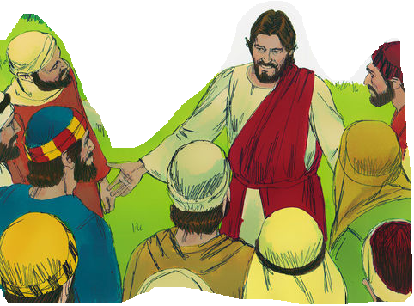
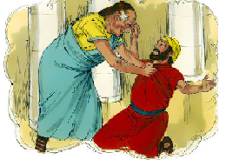
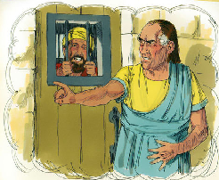
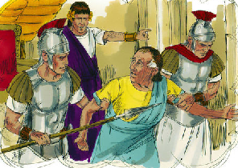
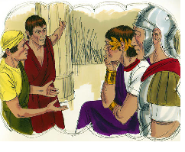
JESUS CONTINUED
……when this servant came out, he saw one of his friends who owed him a very small amount of money
But he refused and put him in prison until he paid back the debt.
The man pleaded, falling on his knees, “Be patient with me, and I will pay you back.”
He seized him, choked him and demanded his money back.
The king called the man and said, “You wicked servant! I forgave your entire debt when you pleaded to me. You must have done the same to your friend too”. Being angry with him, the king handed him to the soldiers and put him in prison till he paid his debts back.
When few of his fellow servants saw what had happened, they were deeply disturbed, and reported it to the king.

Slide 6
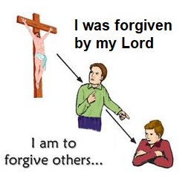
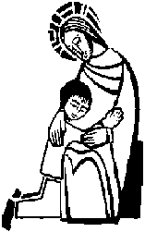
Narrating the parable, Jesus said to His disciples that,
‘HEAVENLY FATHER WILL NOT FORGIVE YOUR DEBTS UNLESS EACH OF YOU FORGIVE YOUR BROTHER FROM YOUR HEART.’
OUR HEAVENLY FATHER FORGAVE ALL OF OUR SINS BY GIVING JESUS AND SAVED US MAKING US HIS CHILDREN.
SO, HOW SHOULD WE BEHAVE TO OTHERS?

Slide 7
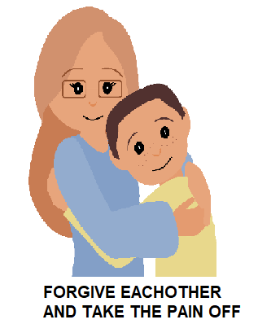
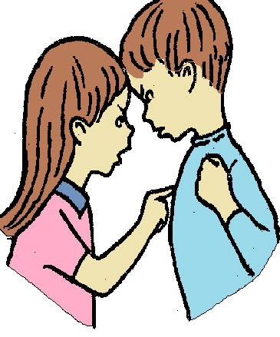
FORGIVE; TO BE FORGIVEN
THROUGH TODAY’S GOSPEL JESUS SAYS THAT, IF WE DON’T FORGIVE OTHERS, OUR FATHER WILL NOT FORGIVE US.
LET US THINK OF TIMES THAT WE HAVEN’T FORGIVEN SOMEONE
NEXT TIME WHEN WE FEEL HURT BY SOMEONE, LET US DO AS JESUS SAID TO US TODAY,
LET US FORGIVE!
WHEN WE FIND IT HARD TO FORGIVE,
LET US THINK OF THE PASSION THAT JESUS SUFFERED FOR US THAT LED TO THE FORGIVENESS OF OUR SINS.
GOD’S GRACE WILL HELP US TO FORGIVE OTHERS AND TO PRAY FOR THEM FROM OUR HEART.

Slide 8
LET US PRAY,
DEAR HEAVENLY FATHER, WE THANK YOU FOR FORGIVING US ALL OUR SINS, BY PAYING A GREAT PRICE ‘JESUS’ YOUR ONLY SON . WE ARE SORRY FOR THE TIMES THAT WE FAILED TO FORGIVE OTHERS. GIVE US THE GRACE TO FORGIVE EACHOTHER THROUGH THE MERITS OF THE PASSION THAT JESUS ENDURED TO DELIVER US. IN JESUS NAME WE PRAY, AMEN

Slide 9
VERSES FOR THE WEEK

Slide 10
THANK YOU
GOD BLESS ALL
FOR MORE IDEAS, PLEASE VISIT:
WEBSITE: http://littleevangelist.com/childrens_liturgy.php
YOUTUBE CHANNEL:
https://www.youtube.com/channel/UCndM2GK0dnpWg5ECUscdDcA

