Slide 1
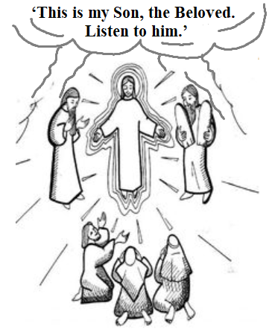
‘This is my Son, the Beloved. Listen to him.’
Gospel: Mark 9:2-10
Children’s Liturgy February 28th ,2021

Slide 2
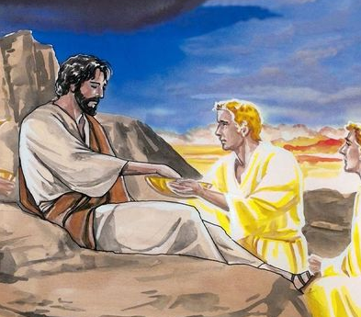
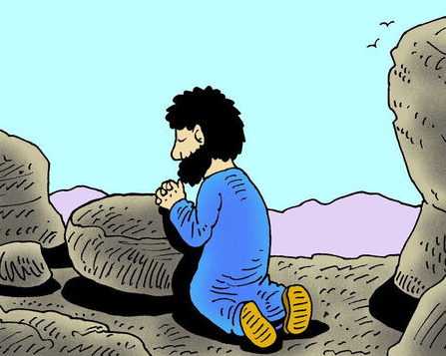
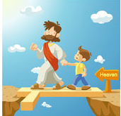
In the Gospel last week,
Jesus overcame all temptations through word of God, by heavenly help through prayer and fasting.
The Spirit drove Jesus out into the wilderness and was tempted by satan.
Jesus strengthened in spirit and began to preach the good news.
Through baptism we are called out from the world to God’s family.
THE GOSPEL ASSURES US THAT WE HAVE HEAVENLY HELP TO OVERCOME IT THROUGH JESUS.
Each time we offer ourselves to heavenly help and overcome temptations;
We get strengthened in spirit ,to proclaim the good news to all.

Slide 3
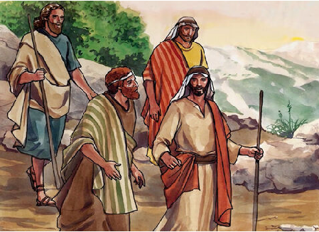
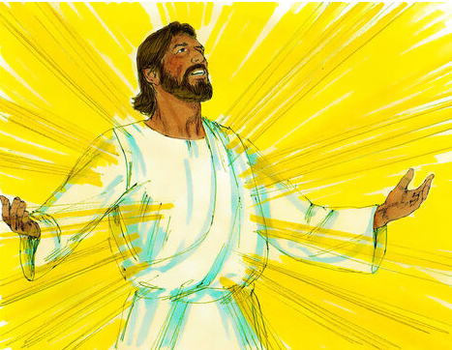
In Gospel Today,
Jesus took with him Peter and James and John and led them up a high mountain
where they could be alone by themselves.
There in their presence he was transfigured
His clothes became dazzlingly white,
whiter than any earthly bleacher could make them.

Slide 4
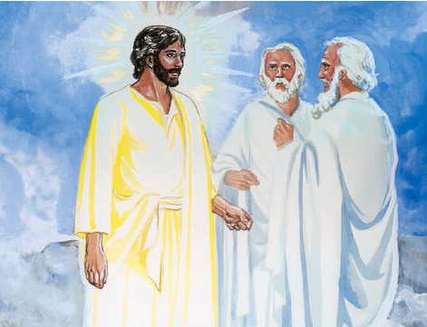
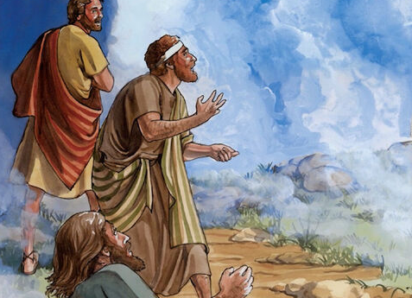
Elijah appeared to them with Moses;
and they were talking with Jesus.
Then Peter spoke to Jesus:
‘Rabbi, it is wonderful for us to be here; so, let us make three tents, one for you, one for Moses and one for Elijah.’
He did not know what to say; they were so frightened.

Slide 5
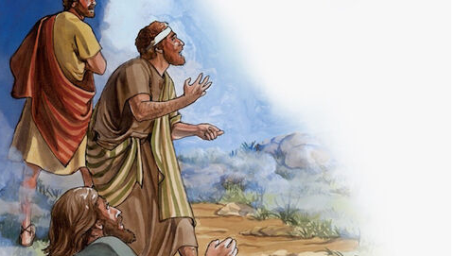
‘This is my Son, the Beloved.
Listen to him.’
…a cloud came, covering them in shadow;
and there came a voice from the cloud,

Slide 6
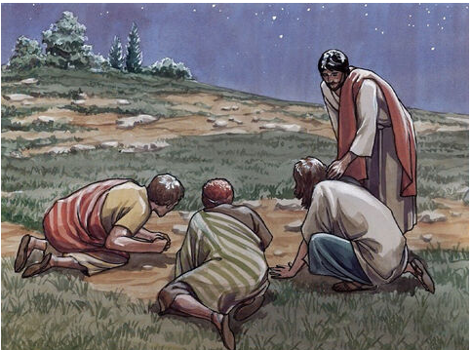
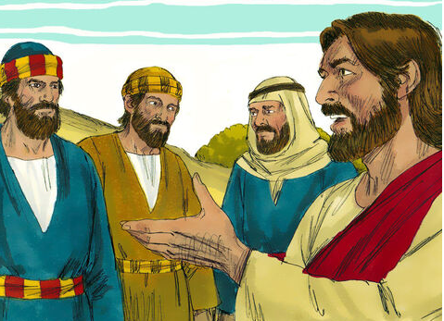
Then suddenly, when they looked round,
they saw no one with them anymore but only Jesus.
As they came down from the mountain he warned them to tell no one what they had seen, until after the Son of Man had risen from the dead.
They observed the warning faithfully, though among themselves they discussed what ‘rising from the dead’ could mean.
THIS IS THE GOSPEL OF THE LORD.
RESPONSE: PRAISE TO YOU LORD JESUS CHRIST

Slide 7
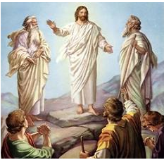
Reflection:
Jesus led them up a high mountain where they could be alone.
Have you been to mountains? How do you feel in this place?
calm,
peaceful,
and serene
Away from the distractions and chaos of this world.
In today’s Gospel,
we see Jesus leading His three friends to the mountain.
To reveal about Him more to them.
To be with them alone.
He TRANSFIGURED , revealing to them His Divine and Holy nature.
He lighted up the hope of ETERNAL LIFE in them by opening their eyes to see
Moses and Elijah living.

Slide 8
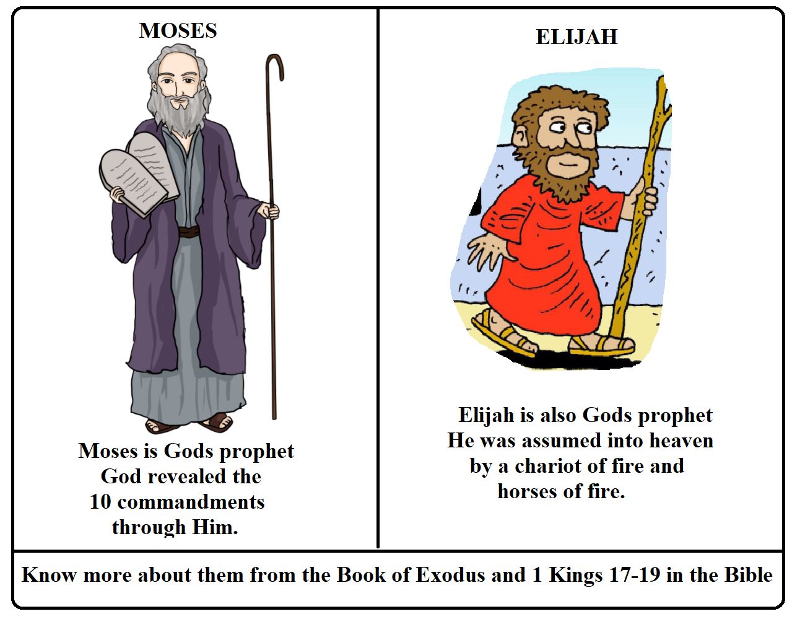
Do you know who is Moses and Elijah?

Slide 9
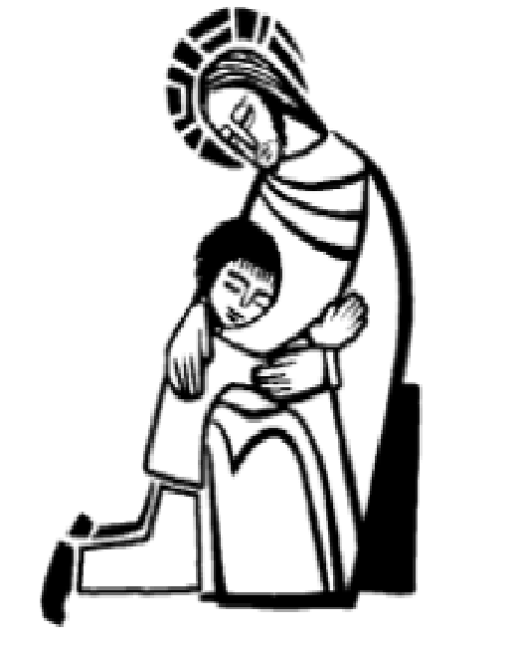
Jesus is inviting us to the high mountains of PRAYER .
He wishes to have us alone with Him,
away from worlds distractions.
He desperately wishes to talk to us and reveal to us many things.
PRAYER FILLS US WITH WISDOM AND
STRENGTH IN LOVE OF GOD
In our prayer times, Jesus reveals to us to know Him more .
He opens to us the heavenly truths and about the real state of eternity that we must reach.
ARE WE READY TO FOLLOW JESUS WHEN HE CALLS US TO HIGH PLACES OF PRAYER?

Slide 10
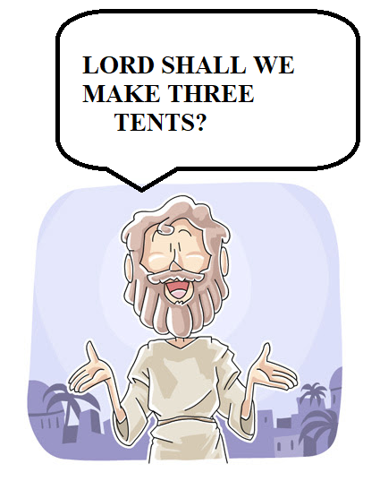
LISTEN TO JESUS.
Peter was so excited at the transfiguration of Jesus.
He began to devise his own plans.
Have we got too excited like Peter sometimes?
In our prayer times, Are we listening to Jesus or are we devising our plans ?
The voice from the cloud- the voice of Father in Heaven-directs each of us,
…always to Listen to Jesus, His beloved son and
not to devise our own plans.
‘This is my Son, the Beloved. Listen to him.’

Slide 11
TRUST! BE FAITHFUL! WAIT FOR JESUS!
Sometimes we might not understand clearly what Jesus is revealing.
DO NOT WORRY!!
THE DISCIPLES DIDN’T UNDERSTAND WHAT JESUS MEANT SAYING ‘RAISING FROM DEAD’ , UNTIL JESUS WAS RESURRECTED.
But they were FAITHFUL,OBEDIENT AND FOLLOWED Jesus in TRUST.
Let us put our faith in him and obey just like his friends
And Wait for his time.

Slide 12
SPEND TIME TO LISTEN TO JESUS, DO AS HE SAY.
This is The Fathers wish: always Listen to Jesus,
his beloved son and Do as He say.
Spent time in front of Blessed Sacrament.
Look to Jesus and Listen to him.
Receive Jesus frequently and abide in Him.
Read
to the word of God.
And Listen
Do Holy Rosary.
Meditate on Jesus’ Life, His passion and His love for us.
In this time of Lent, let us pray for God’s grace to spend more time with Jesus, who is waiting for us to talk with us and reveal many things.

Slide 13
Let us pray,
Dear Lord Jesus thank you for loving us so much and waiting for us each moment to talk to us. Give us grace to know more of your love and spend more time with you. Help us to listen to you more and give ourselves to you in obedience and faith.
In Jesus name we pray, Amen.

Slide 14
VERSE FOR THE DAY
A cloud came, covering them in shadow; and there came a voice from the cloud,
‘This is my Son, the Beloved. Listen to him.’
- Mark 9:7

Slide 15
GOD BLESS YOU ALL
KEEP LITTLE EVANGELIST IN YOUR SPECIAL PRAYERS
FOR MORE IDEAS PLEASE VISIT:
WEBSITE:
http://littleevangelist.com/childrens_liturgy.php
YOUTUBE CHANNEL:
https://www.youtube.com/channel/UCndM2GK0dnpWg5ECUscdDcA

