Slide 1
LOVE FULFILLS ALL LAWS
CHILDREN’S LITURGY OCTOBER 25TH 2020
GOSPEL: MATTHEW 22:34-40

Slide 2
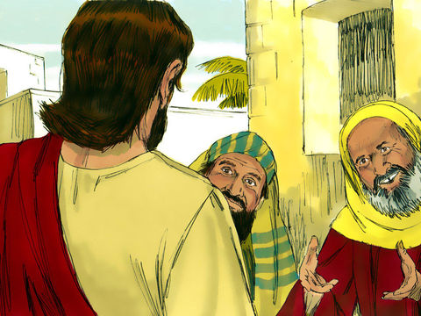
DO YOU REMEMBER LAST WEEK’S GOSPEL?
THE PHARISEES AND HERODIANS WERE PLOTTING PLANS TO TRAP JESUS.
JESUS ANSWERED TO THEM IN WISDOM,
‘TO GIVE GOD WHAT WE BELONGS TO GOD AND
TO THE WORLD WHAT BELONGED TO WORLD’
EVERYTHING ON EARTH BELONG TO GOD
IN EVERYTHING , GIVE GOD THE GLORY.
LIVE IN THE HOLY SPIRIT, DOING EVERYTHING IN WISDOM OF GOD,
AS JESUS LIVED IN THIS WORLD, GLORIFYING THE LORD BY OUR LIVES.

Slide 3
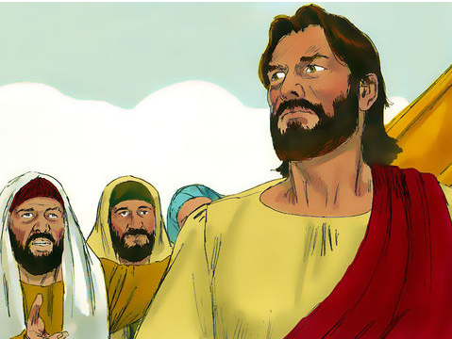
TODAY IN THE GOSPEL
"TEACHER, WHICH COMMANDMENT IN THE LAW IS THE GREATEST?"
A SCHOLAR OF THE LAW IS TESTING JESUS.

Slide 4
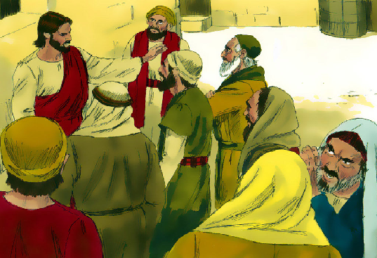
JESUS ANSWERED,
"You shall love the Lord, your God, with all your heart, with all your soul, and with all your mind. THIS IS THE GREATEST AND THE FIRST COMMANDMENT.
THE SECOND IS LIKE THIS: You shall love your neighbor as yourself.
‘The whole law and the prophets depend on these two commandments."

Slide 5
WHAT IS JESUS SPEAKING TO US THROUGH TODAY’S GOSPEL?
THE FIRST AND THE GREATEST COMMANDMENT
HOW CAN WE LOVE OUR GOD?
BY KNOWING ABOUT OUR LORD AND
ABOUT HIS LOVE TOWARDS US.
KNOW MORE ABOUT LORD’S LOVE
FROM THE BIBLE.
JESUS IS LORD’S LOVE TOWARDS EACH OF US

Slide 6
THE SECOND COMMANDMENT
GOD’S LOVE HAS BEEN POURED INTO OUR HEARTS THROUGH THE HOLY SPIRIT THAT HAS BEEN GIVEN TO US. - ROMANS 5:5
WE HAVE TO FILL IN THE LOVE OF GOD TO LOVE OUR NEIGHBORS.
BY LOVING OUR NEIGHBOURS,
WE LOVE GOD HIMSELF.

Slide 7
JESUS LIVES IN YOU AND ME
HOW CAN WE SHOW OUR LOVE TO OUR NEIGHBOURS?
FOLLOW THE JESUS WAY…
CARE
The more we GIVE LOVE,
the more we RECEIVE LOVE FROM GOD
SHARE
HELP
FORGIVE
SACRIFICE

Slide 8
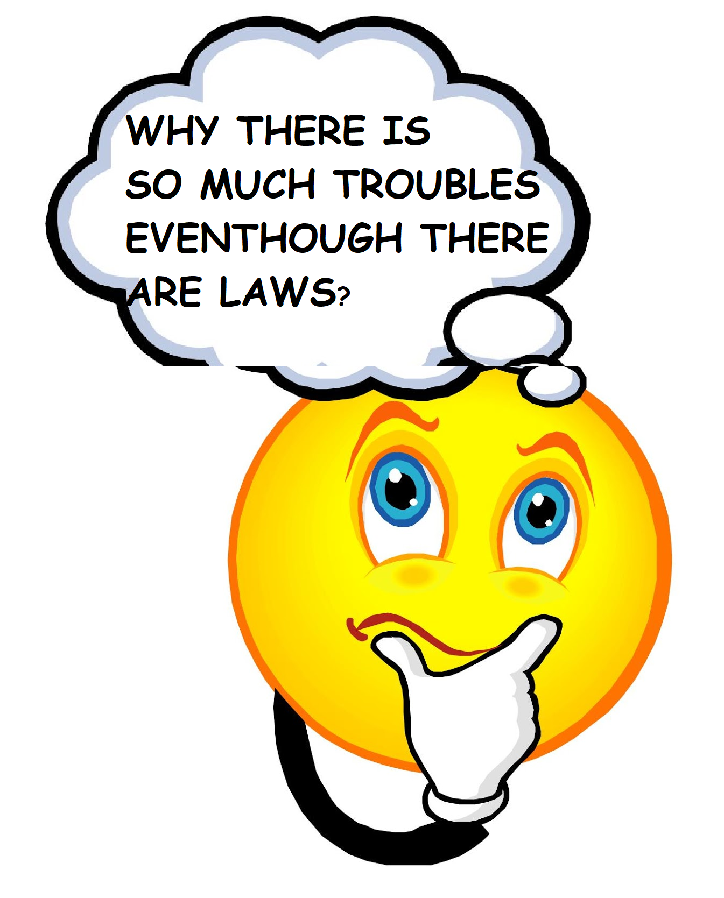
“THE WHOLE LAW AND THE PROPHETS DEPEND ON THESE TWO COMMANDMENTS."
WHY ARE COMMANDMENTS OR LAWS GIVEN?
TO LIVE BY TAKING CARE OF EACH OTHER AND THE WORLD IN HARMONY AND PEACE
ALL LAWS REFLECT OUR ACTIONS BASED ON
LOVE TOWARDS OUR FELLOW BEINGS
WHY IT GETS HARD TO FOLLOW IT?
DUE TO LACK OF LOVE
IF THERE IS LOVE, NO LAWS WILL BE VIOLATED.

Slide 9
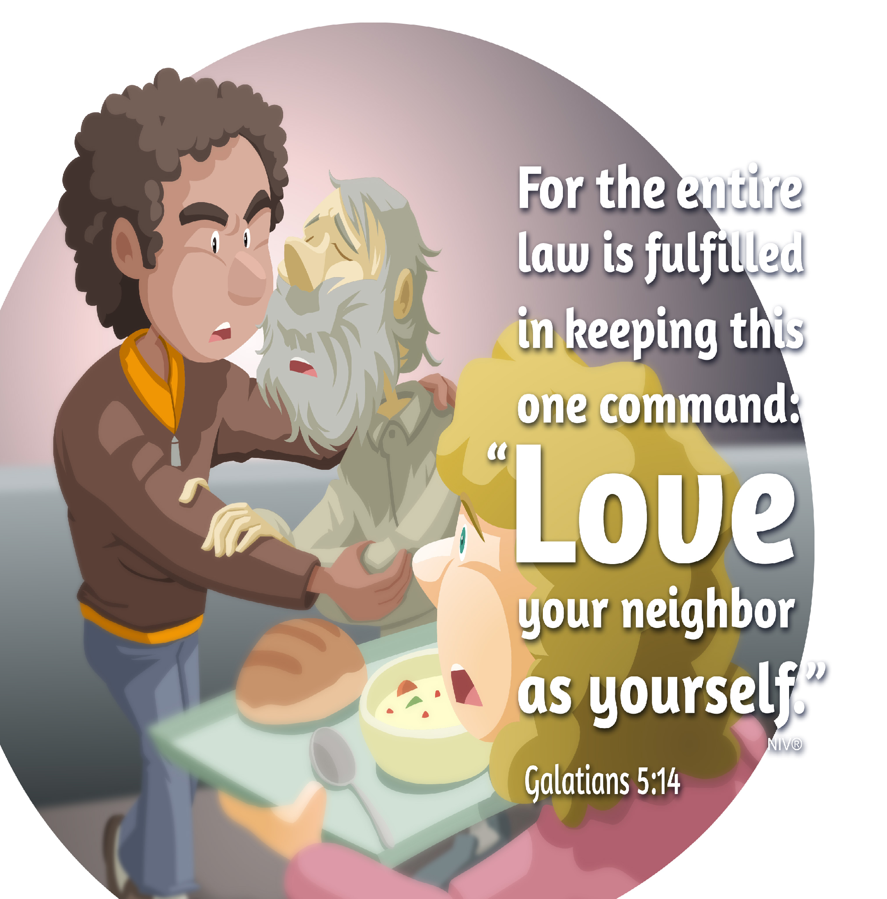
LET US CHECK ON THE LOVE WE HAVE.
LOVE FULFILLS ALL THE LAWS
OR
IS OUR LOVE SELFISH? BOASTING? PROUD?...
IS OUR LOVE LIKE THIS?

Slide 10
LET US PRAY,
Dear Lord, thank you for loving us unconditionally. Give us power to know more of the love of Christ; so that we may be filled with the fullness of God. Pour your love into our hearts through your Holy Spirit to love our neighbours as ourselves, as you are loving us.
In Jesus’ name we pray, Amen

Slide 11
VERSE FOR THE WEEK
‘You shall love the Lord, your God, with all your heart, with all your soul, and with all your mind.
You shall love your neighbor as yourself. ’
-Matthew 22:37-39

Slide 12
THANK YOU AND GOD BLESS YOU ALL
FOR MORE IDEAS , PLEASE VISIT:
WEBSITE: http://littleevangelist.com/childrens_liturgy.php
YOUTUBE CHANNEL:
https://www.youtube.com/channel/UCndM2GK0dnpWg5ECUscdDcA
PLEASE KEEP LITTLE EVANGELISTS IN YOUR SPECIAL PRAYERS

