Slide 1
WHO DO YOU SAY THAT I AM?
GOSPEL: MATTHEW 16:13-20
CHILDREN’S LITURGY AUGUST 23RD, 2020

Slide 2
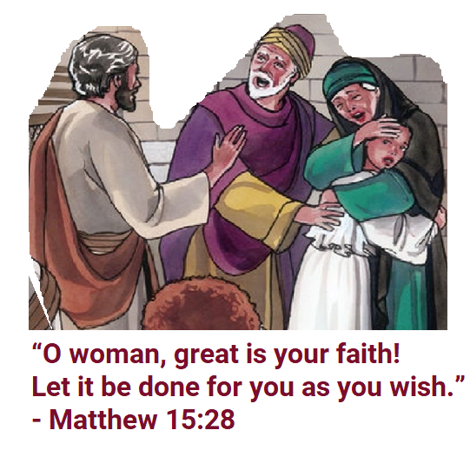
IN THE GOSPEL, LAST WEEK
WE SAW THE CANAANITE WOMAN’S GREAT FAITH IN JESUS
FAITH IN JESUS OPENED UP THE FOUNT OF MERCY FOR HER
HER PRAYER WAS ANSWERED ACCORDING TO HER WISH THROUGH HER FAITH
IN TODAY’S GOSPEL, WE SEE PETER PROFESSING HIS FAITH IN JESUS

Slide 3
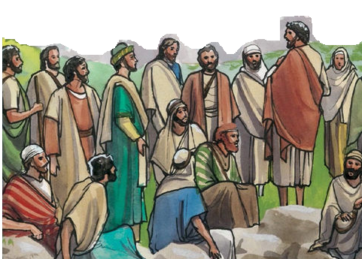
JESUS ASKS HIS DISCIPLES WHO PEOPLE THINK HE IS
SOME SAY YOU ARE JEREMIAH
WHO DO PEOPLE SAY THAT THE SON OF MAN IS?
SOME SAY YOU ARE ELIJAH
DO YOU KNOW WHO THESE PEOPLE ARE?
ELIJAH
JEREMIAH
JOHN THE BAPTIST
THEY ARE PROPHETS, WHO GOT MESSAGES FROM GOD TO TELL THE PEOPLE.
SOME SAY YOU ARE JOHN THE BAPTIST

Slide 4
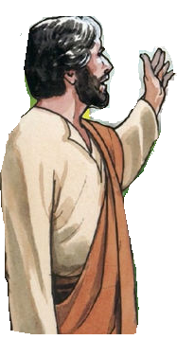
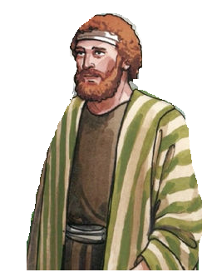
JESUS WANTS TO KNOW WHO WE THINK THAT HE IS!
The people saw our Lord just as one of the prophets.
Jesus asks his disciples,
‘who do you say that I am?’
Simon Peter answered,
“You are the Messiah, the Son of the living God.”

Slide 5
JESUS CALLS PETER ‘BLESSED’
“Blessed are you, Simon son of Jonah! For flesh and blood has not revealed this to you, but my Father in heaven”.
PETER PROFESSED HIS FAITH - JESUS IS THE MESSIAH, THE SON OF THE LIVING GOD.
THIS WAS REVEALED TO HIM BY THE HEAVENLY FATHER.

Slide 6
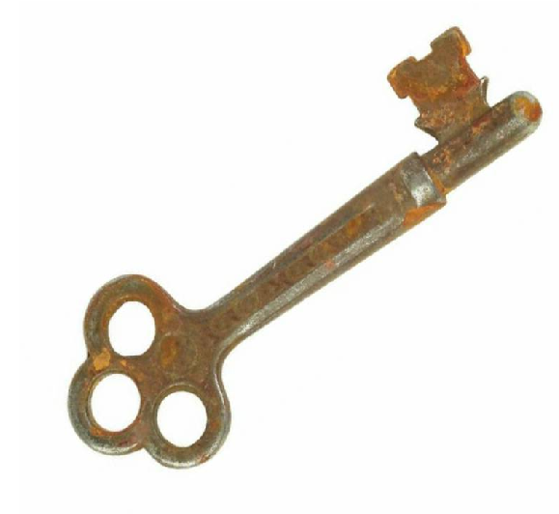
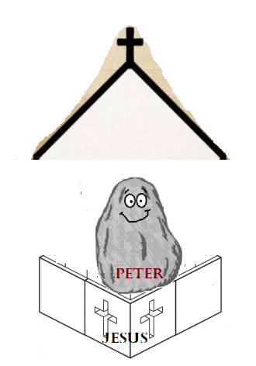
THE ROCK AND THE KEYS..
When Peter PROFESSED his faith, Jesus gave him the AUTHORITY by saying, “you are PETER - THE ROCK”.
1. On this ROCK I will build my church, and the gates of Hades will not prevail against it.
2. I will give you the KEYS of the kingdom of heaven, and whatever you bind on earth will be bound in heaven, and whatever you loose on earth will be loosed in heaven.”

Slide 7
JESUS GAVE THE AUTHORITY TO THE CHURCH THROUGH PETER TO CARRY ON HIS MISSION THROUGH HOLY SPIRIT…
WE BELONG TO THE CHURCH
* The church helps us to grow in Jesus and walk in his way
* The church has authority to loose and bind – to absolve our sins
* The church has the key that helps us to know about heaven and to lead us to heaven through Jesus.
So along with the church, let us profess our faith in Jesus.
“YOU ARE THE MESSIAH, THE SON OF THE LIVING GOD.”
JESUS ENTRUSTED THIS AUTHORITY TO THE CHURCH THROUGH THE MINISTRY OF THE APOSTLES AND IN PARTICULAR, THROUGH THE MINISTRY OF PETER, THE ONLY ONE TO WHOM HE SPECIFICALLY ENTRUSTED THE KEYS OF THE KINGDOM. (CCC553)

Slide 8
WHO DO WE THINK JESUS IS?
Jesus calls Peter “blessed” because he understood who Jesus is.
How do you think Peter understood this?
Jesus says that ‘For flesh and blood has not revealed this to you, but my Father in Heaven.’
Jesus is revealed to us only by the Father in Heaven.
JESUS WANTS US TO KNOW HIM PERSONALLY THROUGH THE CHURCH TO WHOM HE HAS GIVEN THE AUTHORITY TO REVEAL HIM.

Slide 9
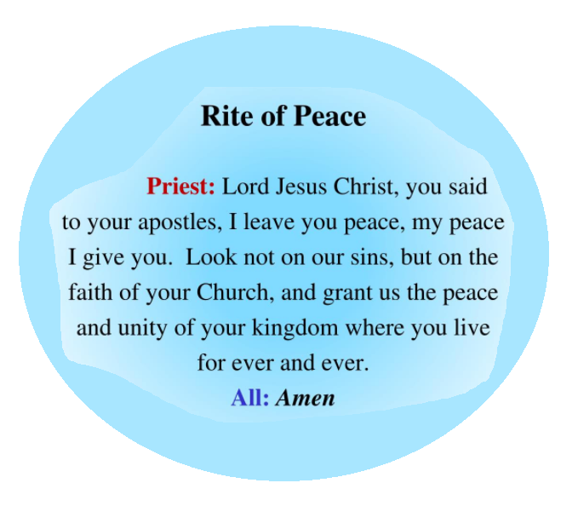
LET US PRAY
Try to listen to this prayer next time you go for Holy Mass
Dear Father in Heaven,
we thank you and praise you for joining us together in your family – the Church. We pray for our Pope, all the Priests and the Clergy. Anoint them and help them to lead all your children to Jesus. In Jesus’ name we pray,
Amen.

Slide 10
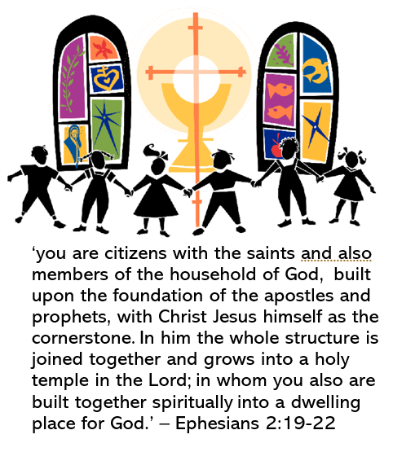
VERSES FOR THE WEEK
“Who do you say that I am?”
Simon Peter answered,
“You are the Messiah,
the Son of the living God.”
- Matthew 16:15-16

Slide 11
THANK YOU
FOR MORE IDEAS, PLEASE VISIT:
WEBSITE: http://littleevangelist.com/childrens_liturgy.php
YOUTUBE CHANNEL: https://www.youtube.com/channel/UCndM2GK0dnpWg5ECUscdDcA
GOD BLESS YOU ALL

