Slide 1
PREPARE THE WAY FOR THE LORD
SECOND SUNDAY OF THE ADVENT
Gospel: Mark 1:1-8
CHILDREN’S LITURGY DECEMBER 6TH, 2020

Slide 2
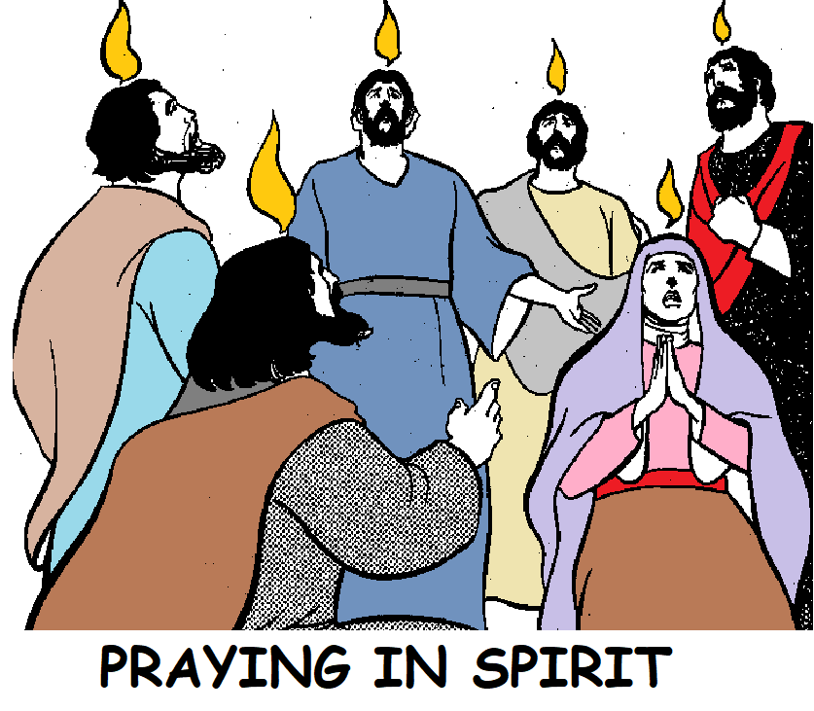
LAST WEEK IN THE GOSPEL
JESUS WAS TELLING HIS DISCIPLES ABOUT
THE TIME OF THE SECOND COMING AND THE NECESSITY FOR WATCHFULNESS.
The time of His second coming is not known for us.
HENCE, WE HAVE TO BE:
VIGILANTLY FULFILING WHAT GOD IS ENTRUSTING US
BY REVEALING THROUGH HOLY SPIRIT.
SO THAT WHEN HE COMES WE ARE FOUND READY FOR HIM.

Slide 3
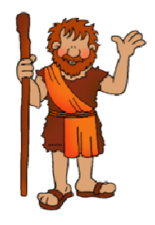
THIS WEEK, IN THE GOSPEL WE SEE,
John the Baptist was the son of Zechariah, who was a priest, and Elizabeth, who was the cousin of Mother Mary.
John the Baptist
appearing in the desert.
Do you know who
John the Baptist is?
God chose John the Baptist from the mother’s womb for a great mission:
HE WAS THE FORERUNNER OF JESUS.
HE PREPARED THE WAY FOR JESUS IN THE HEARTS OF THE PEOPLE.

Slide 4
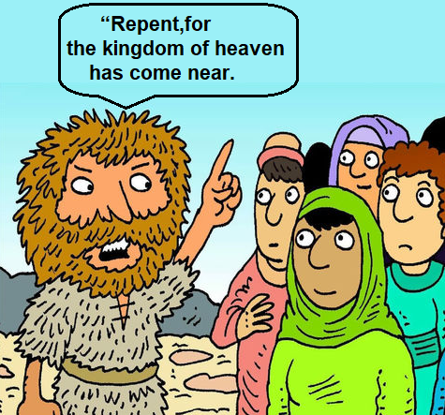
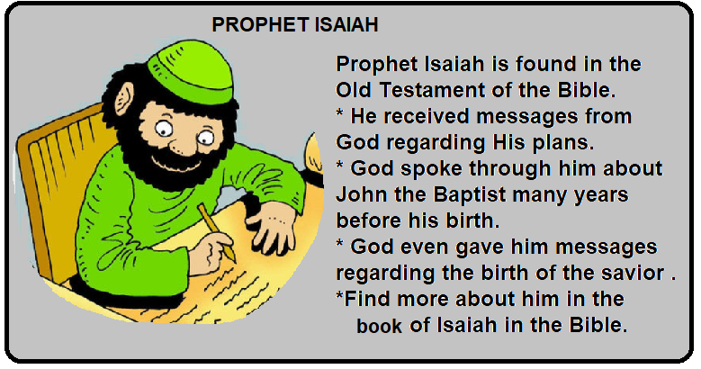
JOHN THE BAPTIST CAME PROCLAIMING THE BAPTISM OF REPENTANCE FOR THE FORGIVENESS OF SINS.
It was regarding him that Isaiah the prophet said,
“Behold, I am sending my messenger ahead of you; he will prepare your way”.
A voice of one crying out in the desert: “Prepare the way of the Lord, make straight his paths.”

Slide 5
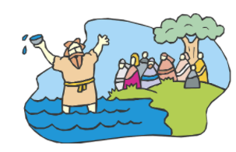
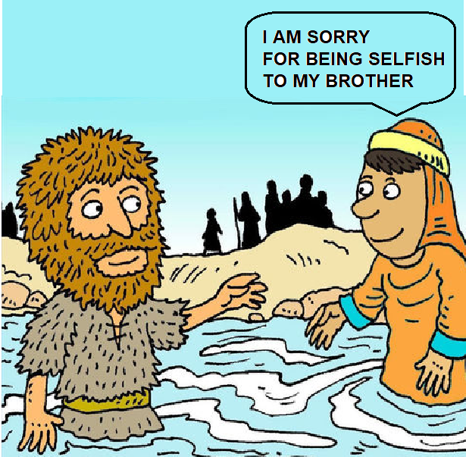
TO PREPARE THE WAY FOR JESUS, John baptized the people in the Jordan river as they said sorry for their sins.
People of the whole Judean countryside and all the inhabitants of Jerusalem were coming to him.

Slide 6
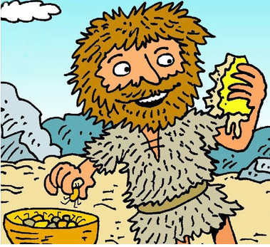
JOHN’S DRESS WAS SPECIAL.
John was clothed in camel’s hair, with a leather belt around his waist. He fed on locusts and wild honey.

Slide 7
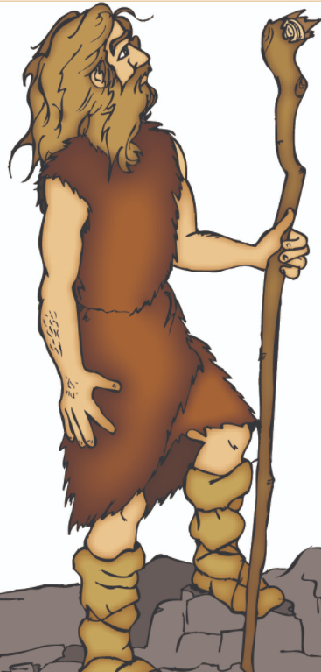
THIS IS WHAT HE PROCLAIMED,
“One mightier than I is coming after me. I am not worthy to stoop and loosen the thongs of his sandals. I have baptised you with water; He will baptise you with the Holy Spirit.”
JOHN THE BAPTIST IS SPEAKING ABOUT JESUS.
HE SAYS THAT JESUS IS THE ONE WHO IS POWERFUL AND HE IS NOT WORTHY EVEN TO UNTIE HIS SANDALS.
SEE HOW HUMBLE HE IS?
John’s baptism of Repentance will prepare people to receive Jesus who is more powerful and who will baptize all the repented ones with Holy Spirit.

Slide 8
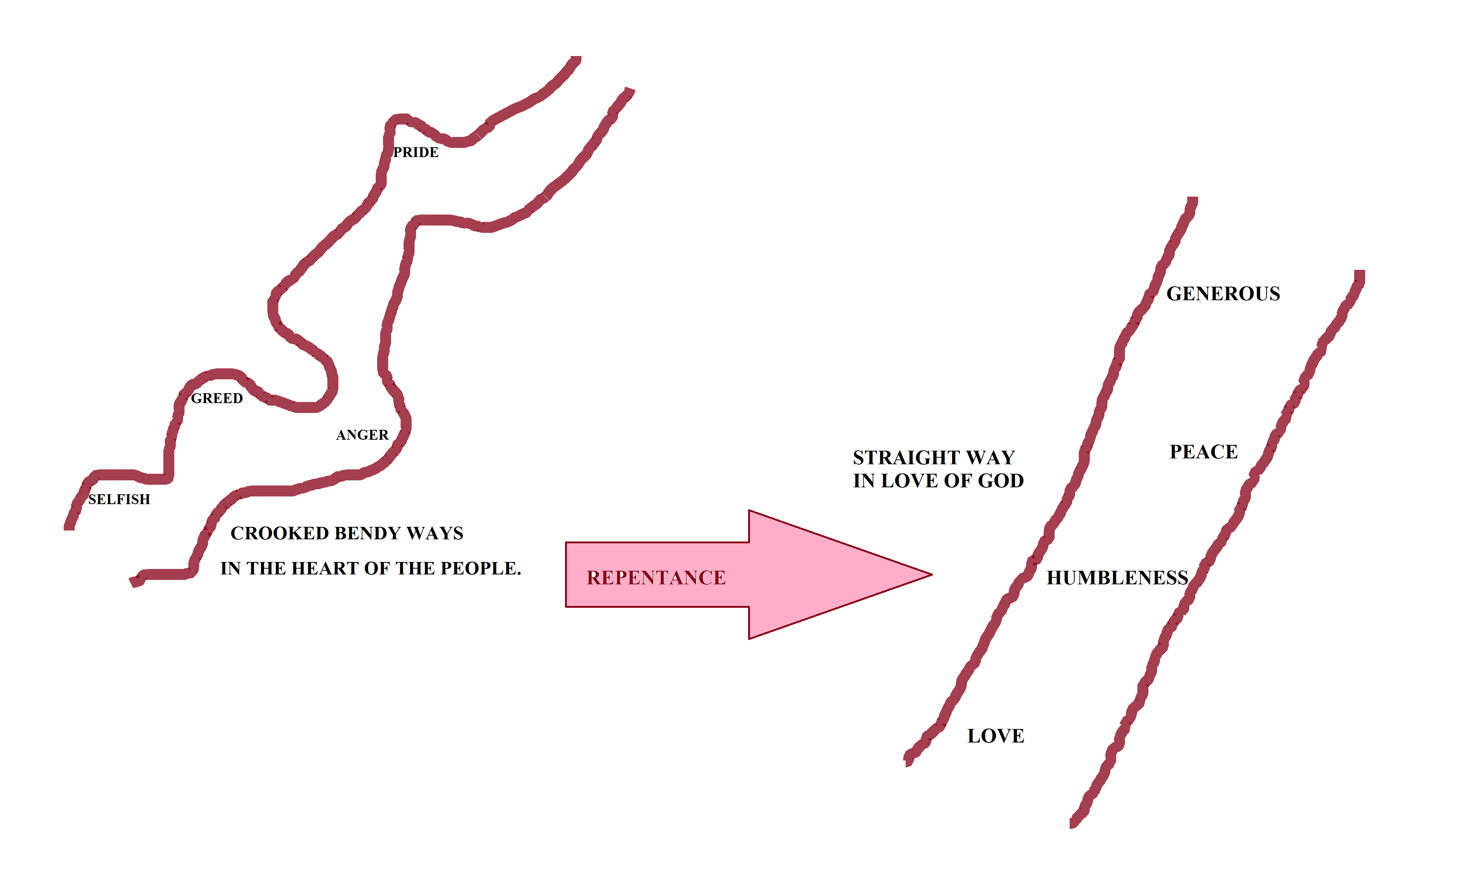
WHAT IS TODAY’S GOSPEL TELLING US?
‘PREPARE THE WAY FOR JESUS, MAKE IT STRAIGHT’
HOW DID JOHN PREPARE THE WAY FOR JESUS?
BY PREPARING THE HEARTS OF THE PEOPLE THROUGH REPENTANCE.
ARE WE PREPARING FOR JESUS?
As we are getting ready to celebrate the birth of Jesus Christ,
let us prepare our hearts for Him, anticipating His second coming.

Slide 9
REPENTANCE
REPENTANCE IS A GIFT FROM GOD
REPENTACE ALLOWS GOD TO WIPE OUT OUR SINS
REMOVES ALL THE BLOCKS IN US TO ALLOW THE LOVE OF GOD TO FLOW TO US
REPENTANCE UNITES US TO CHRIST, MAKING US A NEW CREATION
REPENTANCE ALLOWS HOLY SPIRIT TO FLOW INTO US
IT BRINGS THE KINGDOM OF GOD IN US

Slide 10
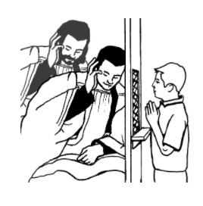
SACRAMENT OF RECONCILIATION
PREPARES OUR HEARTS TO RECEIVE JESUS.
It celebrates God’s forgiveness and mercy
Confessing sins brings us closer to the healing mercy of our forgiving God.
We confess our sins to God
through the Priest.
DID I HURT MY JESUS?
Each time before we go for Holy Mass,
Prepare our hearts to receive Jesus
who waits to come into us.
EXAMINE OUR MIND DAILY BEFORE GOING TO BED.
Find out whether we have hurt Jesus through our actions that day.
If so, say sorry and pray for grace not to repeat it anymore.
Try to correct it next time, if possible.

Slide 11
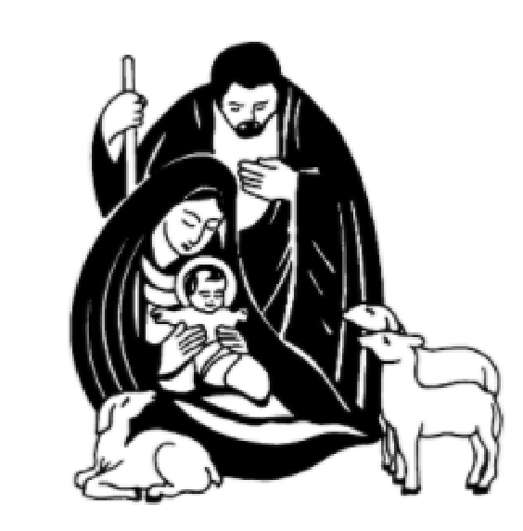
TODAY IS THE SECOND SUNDAY OF ADVENT
When we turn to God in true repentance,
He fills us with His peace.
‘JESUS’ is our Prince of Peace.
DO YOU THINK THAT WE TOO HAVE A MISSION LIKE JOHN THE BAPTIST?
LET US LIGHT THE CANDLE OF PEACE,
reminding us that Jesus brings peace to all who turn to Him in Faith.
This week let us think: What we can do at home,
in school, and with friends to prepare the way for Jesus?

Slide 12
LET US PRAY,
Dear Loving Father in Heaven, we thank you for the peace You are giving us through Jesus Christ. Help us, by Your grace to prepare our hearts in true repentance to receive Jesus.
We make this prayer through
Jesus Christ our Lord. Amen.

Slide 13
VERSE FOR THE WEEK

Slide 14
THANK YOU
GOD BLESS YOU
REMEMBER
LITTLE EVANGELISTS
IN YOUR SPECIAL PRAYERS.
FOR MORE IDEAS PLEASE VISIT:
WEBSITE:
http://littleevangelist.com/childrens_liturgy.php
YOUTUBE CHANNEL:
https://www.youtube.com/channel/UCndM2GK0dnpWg5ECUscdDcA

