Slide 1
BE WATCHFUL ! BE ALERT !
FIRST SUNDAY OF ADVENT
CHILDREN’S LITURGY NOVEMBER 29TH , 2020
GOSPEL:MARK 13:33-37

Slide 2
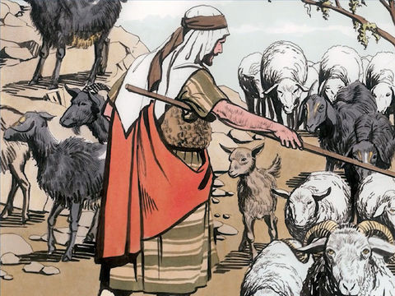
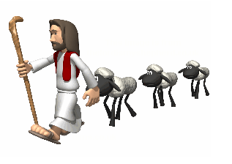
LAST WEEK IN THE GOSPEL,
JESUS WAS REVEALING TO HIS DISCIPLES,
HOW HE IS GOING TO JUDGE EACH OF US IN HIS SECOND COMING.
GOATS OR SHEEPS??
QUALIFY ‘TO BE THE SHEEP ON THE RIGHT’?
BY FOLLOWING THE SHEPHERD-JESUS ,CLOSELY.
GOATS
(THE UNRIGHTEOUS)
ON LEFT
SHEEPS
(THE RIGHTEOUS)
ON RIGHT
BY SEEING JESUS IN THE LEAST OF HIS OWN.
BY SERVING THE ONE,
WHOM HE WISHES
TO BE SERVED
'WHATEVER YOU DO FOR ONE OF THE LEAST BROTHERS OF MINE, YOU DID FOR ME.'
Notes:
May require more than one slide

Slide 3
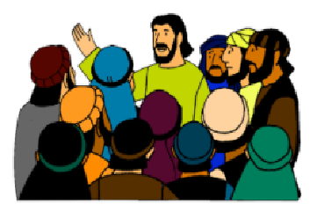
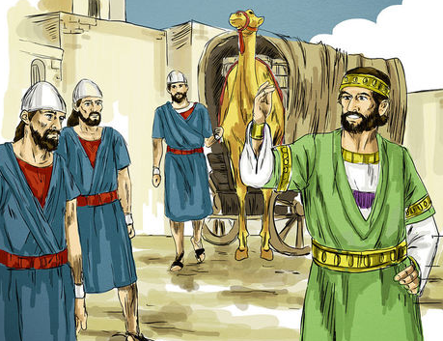
Today in the gospel,
Jesus is telling his disciples about the time of the second coming and the Necessity for Watchfulness.
Jesus compares this to a man who is traveling abroad.
He,
-> entrusts his home and places to his servants,
-> assigns each with his own work,
-> ordered the gatekeeper to be on the watch.

Slide 4
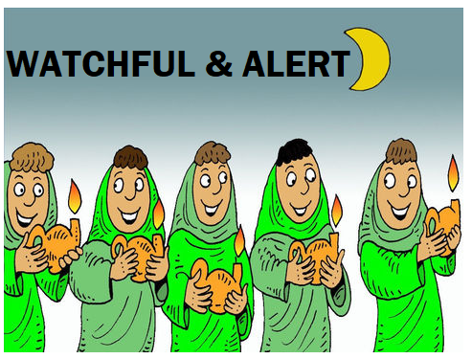
Jesus warns!
WE DON’T KNOW WHEN HE WILL RETURN?
The servants do not know the time when their master is returning.
So, They must be watchful and alert.
Fulfilling their assigned missions.
So that if he returns suddenly, he will not find them sleeping or lazy, but faithful.

Slide 5
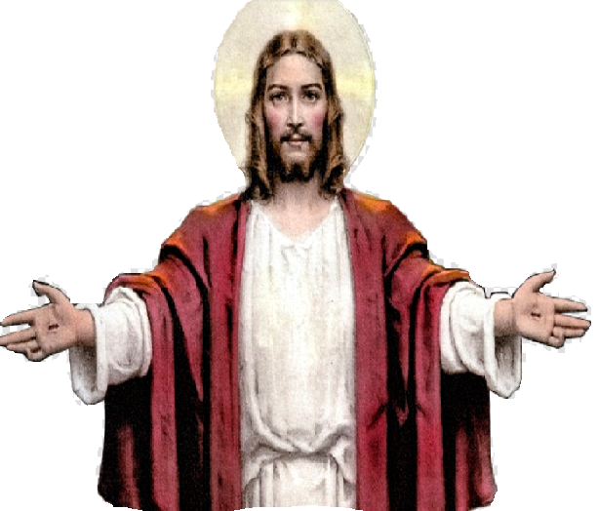
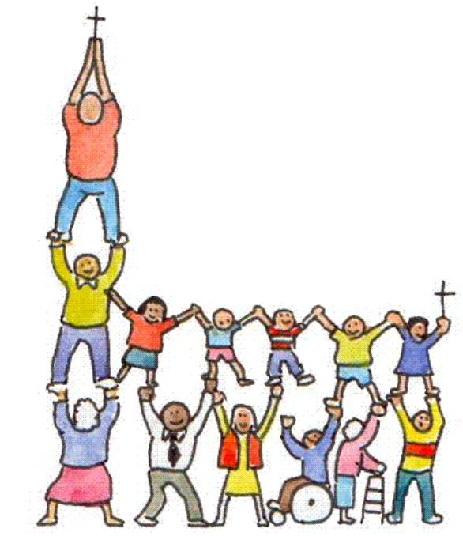
In this parable,
We are the servants,
and Jesus is the master of
the house.
Jesus our lord has entrusted each of us with his missions to be accomplished before he comes the second time.
The time of his second coming is not known for us.
Nor it is known for Jesus. Only Father in Heaven knows about it.
So, let us be ,
For we do not know
when the time will come.

Slide 6
HOW CAN WE STAY ALERT AND AWAKE?
LET US SEE WHAT THE BIBLE SAYS?
PRAY IN THE SPIRIT AT ALL TIMES IN EVERY PRAYER AND SUPPLICATION. TO THAT END KEEP ALERT
EPHESIANS 6:18
DEVOTE YOURSELVES TO PRAYER,
KEEPING ALERT IN IT WITH THANKSGIVING.
- COLOSSIANS 4:2
BE VIGILANT AT ALL TIMES AND PRAY THAT YOU HAVE THE STRENGTH TO ESCAPE THE TRIBULATIONS THAT ARE IMMINENT AND TO STAND BEFORE THE SON OF MAN.”
-LUKE 21:36
PRAYER
PRAYER HELPS US TO STAY ALERT AND AWAKE IN SPIRIT ALWAYS.
PRAYER IS THE WAY OF HELPING US TO BE IN THE PRESENCE OF GOD ALWAYS.
BE SPIRITUALLY ALERT!

Slide 7
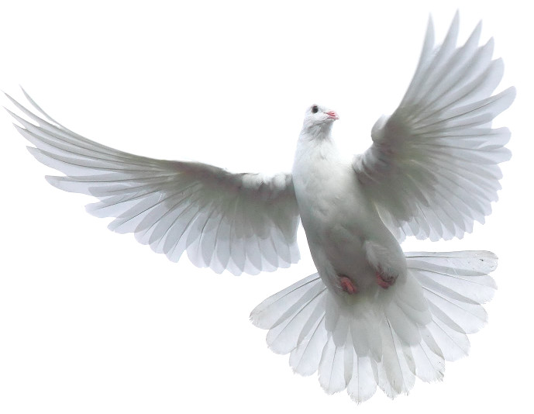
HOLY SPIRIT IS OUR HELPER
HOW CAN WE KNOW OUR MISSIONS?
Holy Spirit intercedes for
Gods children according to the will of God. - Romans 8:26-27
Holy Spirit reveals us lords wish.
He gives us strength to accomplish FAITHFULLY what is entrusted to us by our lord.
He fills us in God’s love to live lives of love, compassion, forgiveness, and honesty.

Slide 8
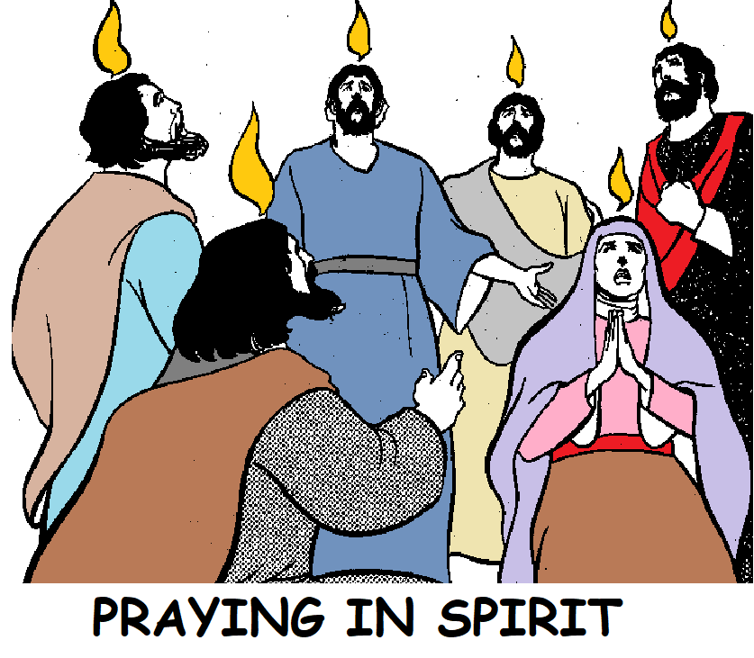
Let us, therefore always be ,
REMOVING EVERYTHING FROM OUR HEART THAT COULD MAKE US SLEEPY.
And VIGILANTLY FULFILING WHAT GOD IS ENTRUSTING US BY REVEALING THROUGH HOLY SPIRIT.
SO THAT WHEN HE COMES WE ARE FOUND READY FOR HIM ALWAYS.
SPIRITUALLY SLEEPY ONE WILL EASILY BE TRAPPED AND MISLEAD BY THE ENEMY.

Slide 9
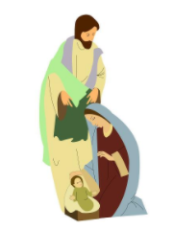
TODAY BEGINS THE SEASON OF ADVENT
It is the time of EXPECTANT WAITING and PREPARATION for ,
* the celebration of the Nativity of Christ at Christmas and
* the return of Christ at the Second Coming
There are four weeks in Advent before Christmas.

Slide 10
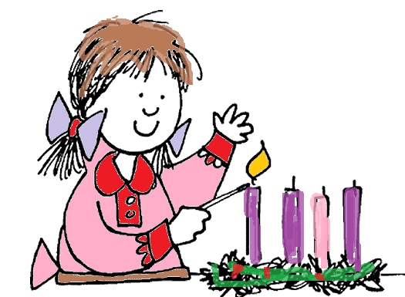
THE ADVENT WREATH
TODAY WE LIGHT
THE PURPLE CANDLE
OF HOPE

Slide 11
LET US PRAY,
DEAR FATHER IN HEAVEN , WE THANK YOU FOR GIVING US THE GREAT HELPER ,HOLY SPIRIT THROUGH OUR LORD JESUS .
HELP US TO STAY ALERT BY PRAYING IN HOLY SPIRIT , LIGHTING UP OUR SOULS IN HOPE FOR THE SECOND COMING OF JESUS AND PREPARING US TO WELCOME HIM BY ACCOMPLISHING ALL YOUR WISHES ENTRUSTED TO US THROUGH JESUS .
IN JESUS’ NAME WE PRAY, AMEN.

Slide 12
VERSE OF THE WEEK
LET US PREPARE OUR HEART TO RECEIVE JESUS.
Notes:
May require more than one slide

Slide 13
THANK YOU AND GOD BLESS
KEEP LITTLE EVANGELIST IN YOU SPECIAL PRAYERS.
FOR MORE IDEAS PLEASE VISIT:
WEBSITE: http://littleevangelist.com/childrens_liturgy.php
YOUTUBE CHANNEL: https://www.youtube.com/channel/UCndM2GK0dnpWg5ECUscdDcA

