Slide 1
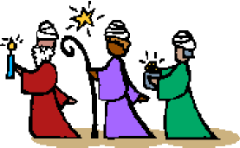
Children’s Liturgy January 3rd 2021
THE EPIPHANY OF THE LORD
(MOVED SOLEMNITY)
Gospel: Matthew 2:1-12

Slide 2
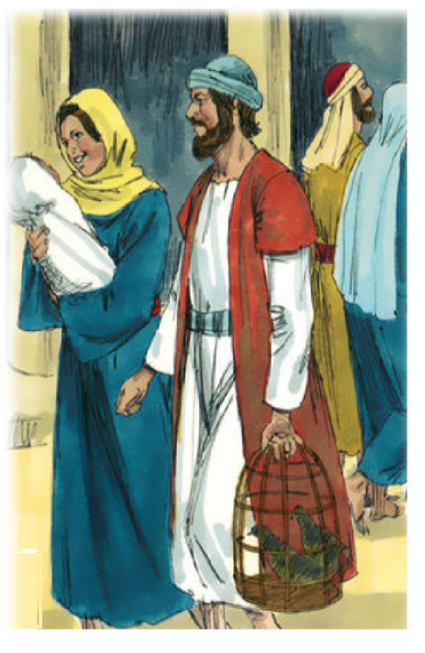
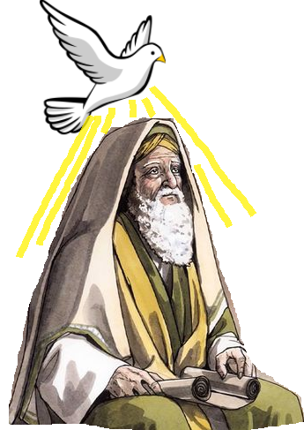
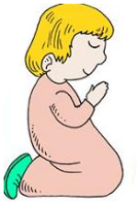
Last week in the Gospel,
The Holy Family, being obedient to the lord, presented Jesus to the lord.
They thanked lord who fulfilled His promise.
OUR GOD IS ALWAYS FAITHFUL IN HIS PROMISES
SIMEON AND ANNA WAITED FAITHFULLY; TRUSTING IN LORDS PROMISE
Simeon offered himself to be led by the holy spirit as he put trust in the promise of the lord.
Walk in the Spirit of the Lord.

Slide 3
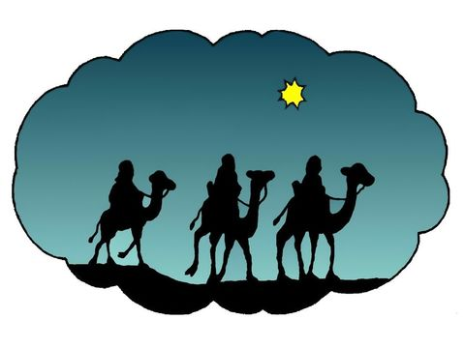
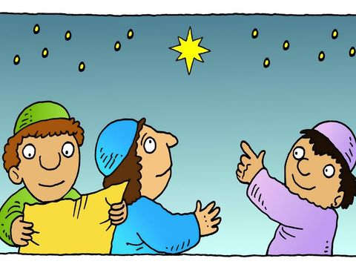
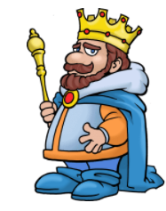
Today in the Gospel,
We see the Magi from the east arriving in Jerusalem seeking the new-born king.
"Where is the newborn king of the Jews? We saw his star at its rising and have come to do him homage."
When King Herod heard this, he was greatly troubled, and all Jerusalem with him.

Slide 4
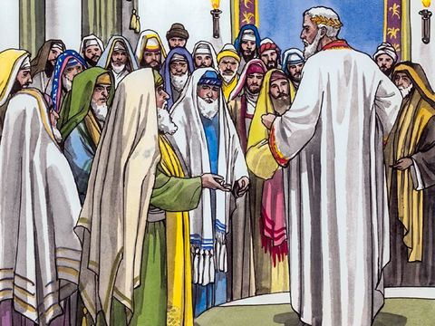
King Herod, Assembled all the chief priests and the scribes of the people and inquired;
Where the Christ was to be born?
"In Bethlehem of Judea, for thus it has been written through the prophet: And you, Bethlehem, land of Judah, are by no means least among the rulers of Judah; since from you shall come a ruler, who is to shepherd my people Israel."

Slide 5
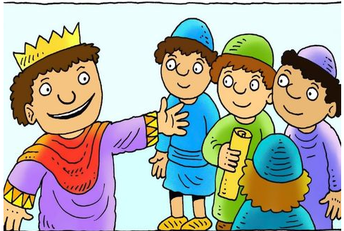
Then Herod called the Magi secretly .
He ascertained from them the time of the star's appearance.
He sent them to Bethlehem and said,
"Go and search diligently for the child. When you have found him, bring me word, that I too may go and do him homage."
When they had heard the king, they set out back on their journey.

Slide 6
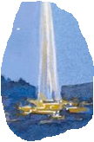
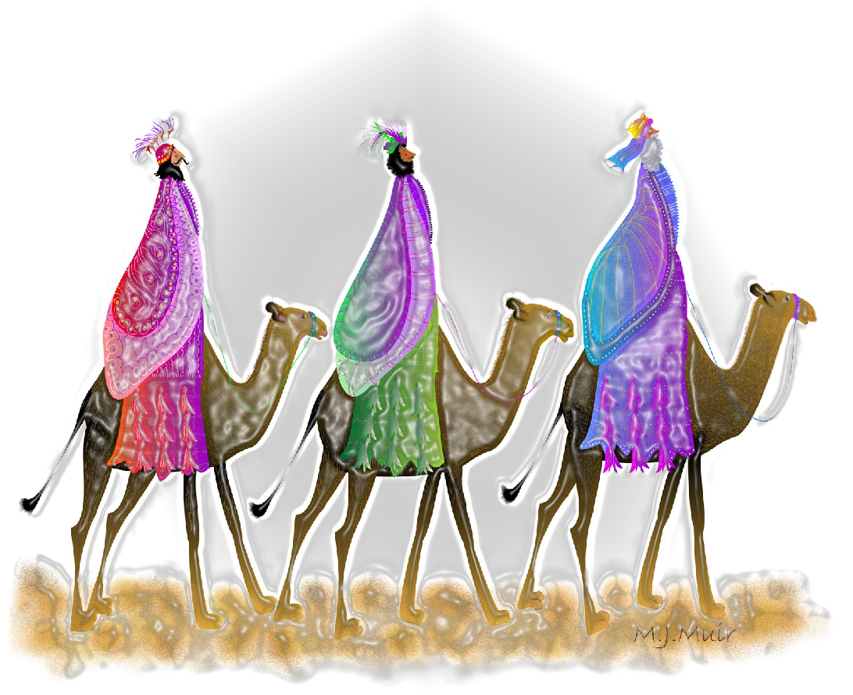
There, ahead of them, went the STAR that they had seen at its rising,
until it stopped over the
place where the child was.
WHEN THEY SAW THAT THE STAR HAD STOPPED,
THEY WERE OVERWHELMED WITH JOY.

Slide 7
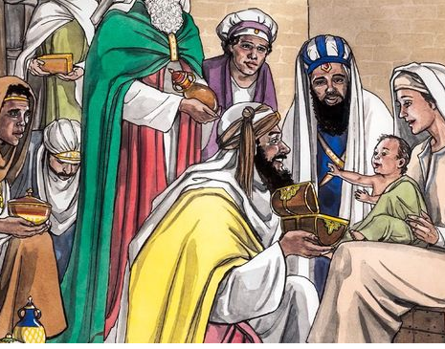
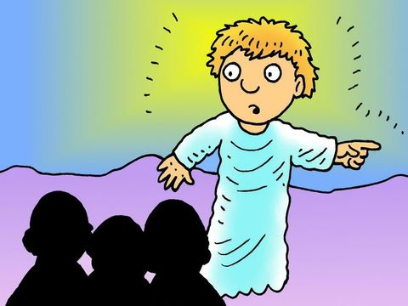
On entering the house, they saw the child with Mary his mother.
and they knelt down and
paid him homage.
Then, opening their treasure chests, they offered Him gifts,
GOLD
MYRRH
FRANKINCENSE
Having been warned in a dream not to return to Herod,
they left for their own country by another road.

Slide 8
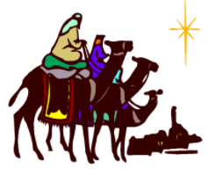
TODAY WE CELEBRATE THE SOLEMNITY OF EPIPHANY OF THE LORD.
Marks the event of the Revelation of God incarnate as Jesus Christ.
IT REMEMBERS THE MAGI WHO WERE LED BY THE STAR TO JESUS.
Magi were wise men who studied about stars.
They knew the prophecies regarding the birth of the saviour and trusted in it.
They used their
knowledge and wisdom
to seek and find the Saviour.
They adored and worshiped him and paid homage to Jesus.
They offered their precious treasures to Jesus.
MYRRH
GOLD
AS A SYMBOL OF KINGSHIP.
FRANKINCENSE
Incense
AS A SYMBOL
OF DEITY.
AS SYMBOL OF
JESUS DEATH AND BURIAL

Slide 9
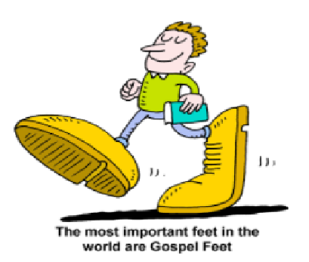
JOURNEYING TOWARDS JESUS
Like the Magi, each of us are in the journey to KNOW Jesus and REACH Jesus.
The lord has provided us with a great helper
in this journey.
THE HOLY SPIRIT
WHO LEADS US TO JESUS
THE STAR OF OUR LIFE
Let everything that we are being provided in this world be like the STAR REVEALING AND LEADING US TO JESUS through Holy Spirit.
LET US USE THE WISDOM, KNOWLEDGE AND BLESSINGS TO SEEK AND FIND OUR SAVIOUR JESUS.
Let our ways of living proclaim the truth of Jesus to others and lead them to Jesus, the only way of salvation.

Slide 10
THE HOLY SPIRIT LIGHTS UP THE WAY THAT LEADS TO
JESUS-THE TRUE LIGHT
HOLY SPIRIT REVEALS JESUS IN OUR LIVES THROUGH DIFFERENT WAYS:
THE LIVING WORD
THE LIFE OF SAINTS
With all that we have,
let us pay homage and honour, adore and worship our lord proclaiming his kingship, divinity and his passion for the salvation of souls.

Slide 11
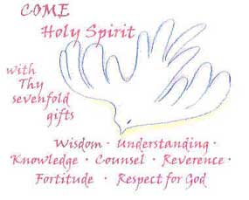
THE HERODS are waiting to trap and misguide us in our journey to Jesus, intending to destroy Jesus in us.
BAD COMPANY
JUDGING
BEING TREACHEROUS
THE WISDOM AND HOLY SPIRIT OF THE LORD HELPS US TO IDENTIFY THE HERODS OF OUR LIVES.
Let our life be led by Holy spirit to reach Jesus escaping the Herod.

Slide 12
LET US PRAY
Dear Lord, thank you for giving us Jesus our savior. Fill us with the Holy Spirit to guide us to Jesus, to proclaim Jesus by our life and lead others to Jesus, the salvation and eternal life. Fill us with your wisdom and deliver us from the Herod’s of this world waiting to trap and destroy Jesus in us. In all things, help us to glorify and give thanks to you lord, as we await in hope for His second coming to adore and worship Him in fullness.
In Jesus’ name we pray, Amen.

Slide 13
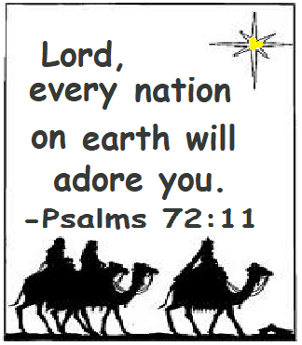
VERSE FOR
THE WEEK

Slide 14
THANK YOU AND GOD BLESS YOU ALL
KEEP LITTLE EVANGELISTS IN YOUR SPECIAL PRAYERS
FOR MORE IDEAS PLEASE VISIT:
WEBSITE:
http://littleevangelist.com/childrens_liturgy.php
YOUTUBE CHANNEL:
https://www.youtube.com/channel/UCndM2GK0dnpWg5ECUscdDcA

