Slide 1
FOLLOW ME!
GOSPEL: MARK 1:14-20
CHILDRENS LITURGY 24TH JANUARY 2021

Slide 2
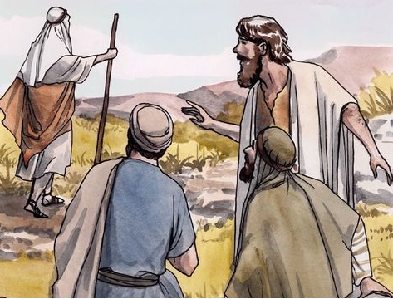
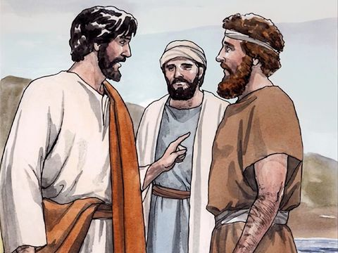
IN THE GOSPEL LAST WEEK,
John was testifying and pointing Jesus to his disciples
BEHOLD !
THE LAMB OF GOD.
Andrew and the other disciple Followed Jesus and
sought Jesus about His place of Stay.
Jesus said,
COME AND YOU WILL SEE.
They stayed with him and remained with him, to understand more about Him.
Andrew went to his brother and shared about Jesus.
He brought his brother to Jesus,
who changed his life.
Let us ,HEAR, FOLLOW, SEEK, ABIDE IN JESUS AND SHARE JESUS TO ALL
THROUGH OUR LIFE.

Slide 3
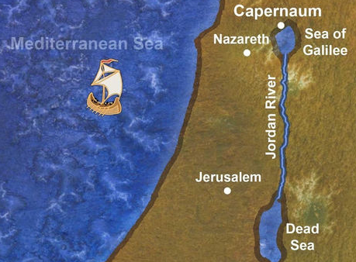
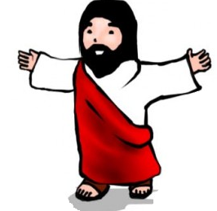
This week we see,
After John had been arrested,
Jesus went into Galilee
There he proclaimed the Good News from God,
‘The time has come’ he said ‘and the kingdom of God is close at hand. Repent, and believe the Good News.’

Slide 4
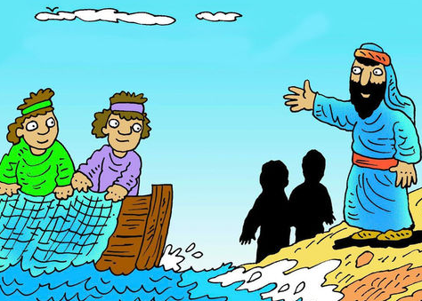
Jesus was walking along by the Sea of Galilee.
He saw Simon and his brother Andrew casting a net in the lake .
They were fishermen.
He said to them,
‘Follow me and I will make you into fishers of men.’
At once they left their nets and followed him.

Slide 5
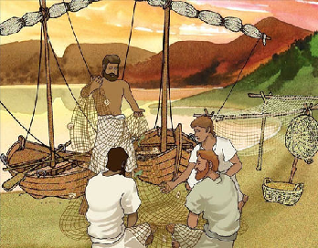
Going on a little further
Jesus saw James, son of Zebedee and his brother John;
They were in their boat, mending their nets.
Jesus called them at once.
They went after him, leaving their father Zebedee in the boat with the men they employed.

Slide 6
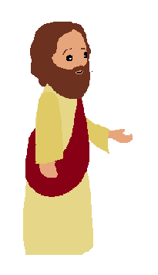
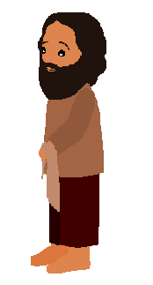
Jesus proclaimed,
‘The time has come. The kingdom of God is close at hand. Repent, and believe the Good News.’
Jesus opened the way of salvation.
HOW COULD THEY DO THIS?
With faith
JESUS SAID,
FOLLOW ME!
THEY LEFT EVERYTHING AND FOLLOWED HIM.
* THEY BELIEVED IN WHAT JESUS WAS PROCLAIMING AND THEY FOLLOWED HIM.
* THEY ENTRUSTED THEIR LIFE AND EVERYTHING TO JESUS AND HIS PROVIDENCE.
* THEY LEFT WHAT THEY CONSIDERED TO BE IMPORTANT IN THEIR LIFE FOR FOLLOWING JESUS.

Slide 7
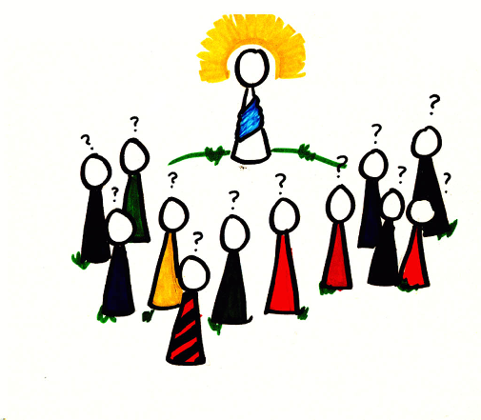
The Good News of God is being proclaimed to all.
LISTEN AND BELIEVE IN THE GOOD NEWS
THE GOSPEL
The gospel is the power of God to salvation
for everyone who believes.
IT IS THE MESSAGE FROM GOD THROUGH HIS SON JESUS,
WHO SAVED US BY HIS LIFE, DEATH AND RESURRECTION.
Are we listening to the Good News?
Are we believing in it?
Is it bringing us closer to Jesus, our salvation?

Slide 8
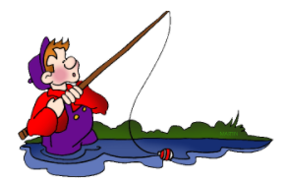
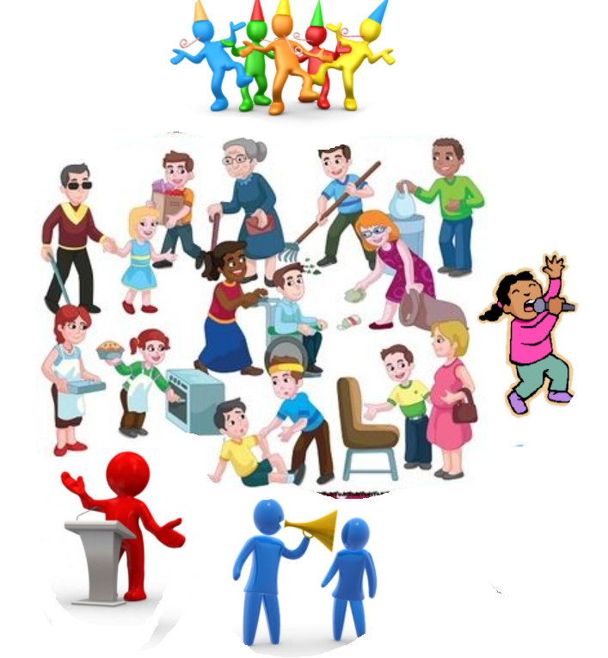
‘I WILL MAKE YOU FISHERS OF MEN.’
Jesus uses their skills IN FISHING for the GOD’S PURPOSE.
To gather children of God and
To build the kingdom of heaven.
Do we offer ourselves and our life to the Lord and
allow him to use us for his purpose?
Jesus is calling us too.
Through our baptism.
Our skills
LET US OFFER:
Our weaknesses
And everything
in complete trust to God,
to use it for his purpose.
Family
Our talents,
Our time.

Slide 9
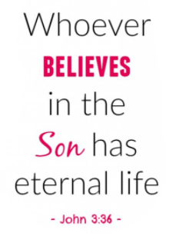
‘Fishing men 'means gaining souls for the kingdom of god.
THE MISSION
Jesus entrusts us the mission of gaining the souls of the children of God,
by spreading the good news of forgiveness and salvation in Jesus name.
Everyone must come to know Jesus to bring faith in him.
Knowing Jesus and believing in Jesus,
secures a soul to eternity.
TO BE FISHERS OF MAN
Let us spend time with him
listen to him ,follow him and
learn from him how to be
fishers of men.
We must FOLLOW JESUS
Reflect on: What all can we entrusting our lord who is calling us to follow him?

Slide 10
Do you know the story of Jonah?
Read the Book of Jonah from the Bible
Jonah was called by God.
He entrusted to him a mission in Nineveh. But he ran away to Tarshish without taking it, due to fear and love of his life .
But God passed him through an experience in his journey and in the whales stomach, that brought him back to God's mission.
He went to Nineveh and spread the word that God asked him.
People of Nineveh believed in Jonah and acted accordingly in faith. They were saved from destruction through their faith in god's message through Jonah.
SO, LET US
BE ATTENTIVE TO THE MESSAGES OF THE LORD
REPENT, BELIEVE AND FOLLOW HIM
ENTRUST OUR SELF TO JESUS AND
OFFER ALL THAT WE HAVE FOR THE PURPOSE OF GOD
SPREAD THE GOSPEL
GAIN SOULS FOR THE KINGDOM OF HEAVEN.

Slide 11
LET US PRAY,
Dear Lord, thank you for saving each of us by the Good News ‘Jesus’. We offer our life unto you. Teach us your ways and guide us in your truth. Help us to discern your calling and mission . Increase our faith in Jesus by filling us with your love and knowledge in the power of holy spirit. So that, we fully entrust all skills, talents and everything you blessed us ,to gain souls for eternal life, to your kingdom, by spreading your love to all through Jesus ‘the good news’.
In Jesus name we pray amen.

Slide 12
VERSE FOR THE DAY

Slide 13
THANK YOU
GOD BLESS YOU ALL
KEEP LITTLE EVANGELIST IN YOUR SPECIAL PRAYERS.
FOR MORE IDEAS PLEASE VISIT:
WEBSITE:
http://littleevangelist.com/childrens_liturgy.php
YOUTUBE CHANNEL:
https://www.youtube.com/channel/UCndM2GK0dnpWg5ECUscdDcA

