Slide 1
BEAR FRUITS THAT THE LORD DESIRES
CHILDREN’S LITURGY OCTOBER 4th 2020
MATTHEW 21:33-43

Slide 2
LAST WEEK IN THE GOSPEL
WE HEARD ABOUT ‘DOING THE FATHER’S WILL’ THROUGH THE PARABLE OF THE TWO SONS WHO WERE CALLED BY THEIR FATHER TO WORK IN HIS VINEYARD.
THROUGH THE PARABLE JESUS MADE US UNDERSTAND THAT IT IS NOT THE ONE WHO HEARS, BUT THE ONE WHO DOES THE FATHER’S WISH THAT WILL ENTER THE KINGDOM OF GOD FIRST.

Slide 3
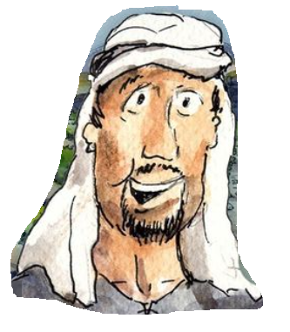
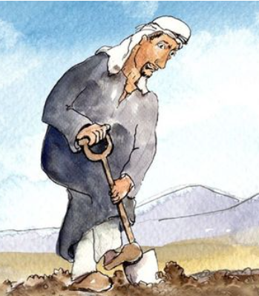
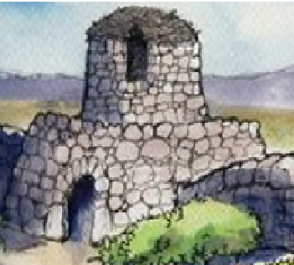
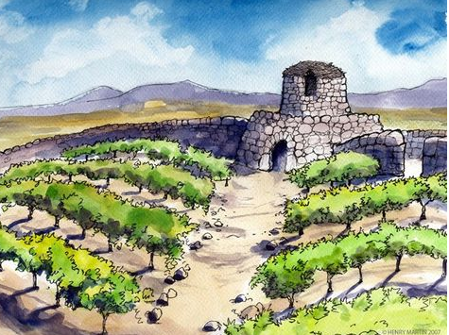
IN THE GOSPEL TODAY
There was a landowner
who planted a vineyard
JESUS TELLS US ANOTHER PARABLE ABOUT
He put a fence around it,
dug a wine press in it,
THE WICKED TENANTS
OF THE VINEYARD.
and built a watchtower.

Slide 4
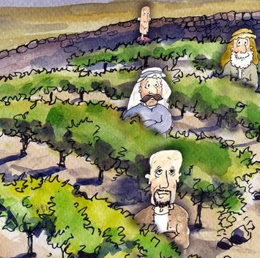
Then he leased it to tenants and went to another country.
When the harvest time had come, he sent his servants to the tenants to collect his produce from the vineyard.

Slide 5
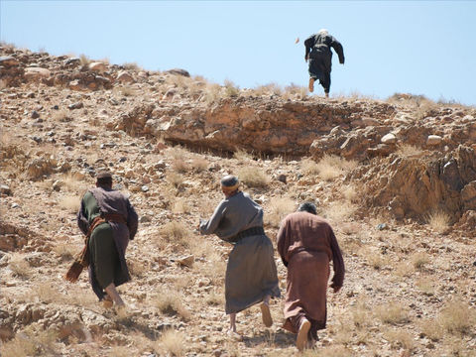
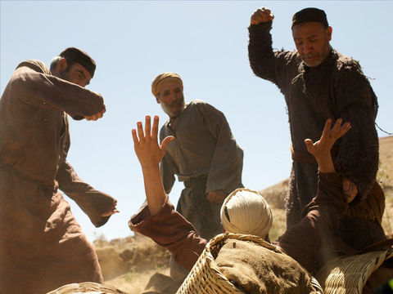
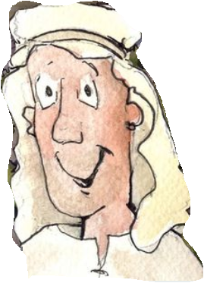
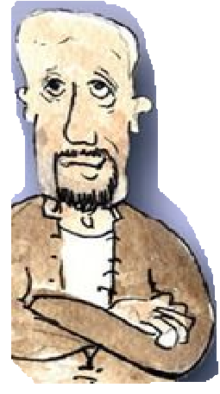
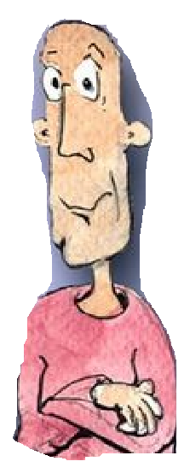
Do you know what the tenants did?
The tenants seized his slaves and beat one, killed another, and stoned another.
Again he sent other slaves, more than the first; and they treated them in the same way.
Finally, he sent his son to them, saying, ‘They will respect my son’
‘This is the heir; come, let us kill him and get his inheritance.’
So they seized him, threw him out of the vineyard, and killed him.

Slide 6
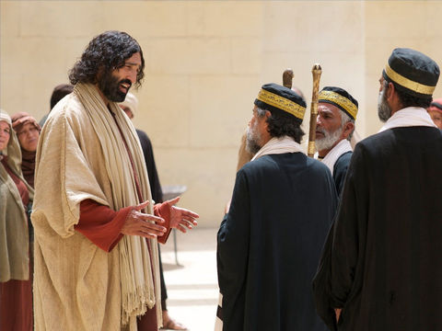
JESUS ASKED THE CHIEF PRIESTS AND ELDERS,
Now when the owner of the vineyard comes, what will he do to those tenants?
He will put those wicked tenants to a miserable death and lease the vineyard to other tenants who will give him the produce at the harvest time.
Have you never read in the scriptures: ‘The stone that the builders rejected has become the cornerstone; this was the Lord’s doing, and it is amazing in our eyes’?
Therefore I tell you, the kingdom of God will be taken away from you and given to a people that produces the fruits of the kingdom.

Slide 7
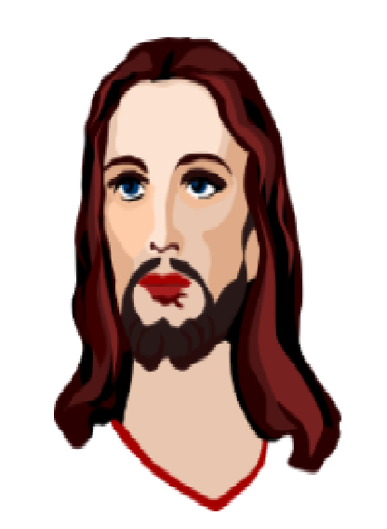
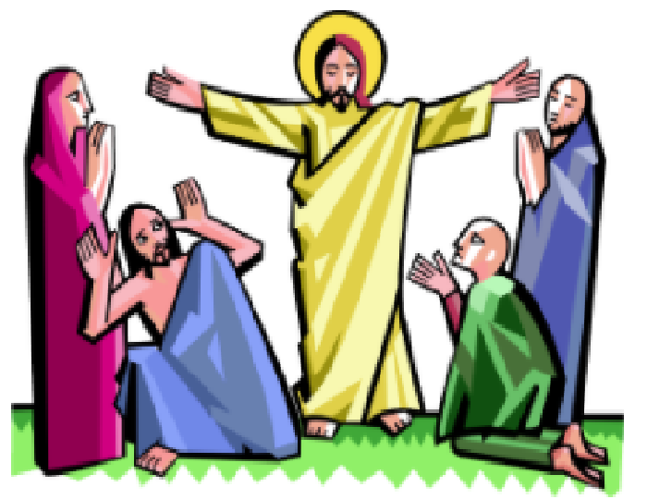
WHAT IS JESUS TELLING US THROUGH THIS PARABLE?
IN THE OLD TESTAMENT OF THE BIBLE, WE SEE THE LORD SENDING MANY PROPHETS TO WARN PEOPLE NOT TO SIN AGAINST GOD.
BUT MANY DIDN’T HEAR. THEY CONTINUED TO SIN AND DISOBEY GOD.
FINALLY HE SENT HIS ONLY SON JESUS.
MANY BELIEVED, BUT OTHERS DIDN’T.
PEOPLE WHO DIDN’T BELIEVE HIM, CRUCIFIED HIM.
BUT HE WAS RESURRECTED!
THOSE WHO BELIEVE IN HIM ARE FREED FROM SIN,
HAVE ENTERED THE KINGDOM OF GOD AND WILL HAVE ETERNAL LIFE.
JESUS GAVE US HOLY SPIRIT FROM FATHER IN HEAVEN TO GUIDE US AND TO BEAR FRUITS FOR THE LORD,
BY MAKING US MORE LIKE JESUS AND TO HELP US REACH HEAVEN.

Slide 8
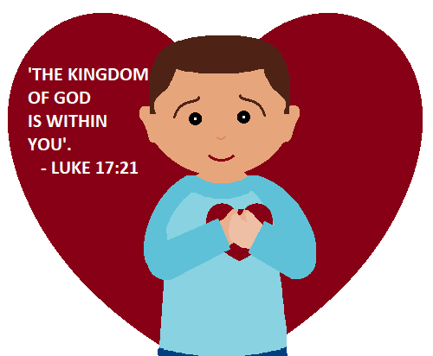
THROUGH JESUS, HOLY SPIRIT SEEDED THE KINGDOM OF GOD INSIDE US.
THE LORD IS COMING TO HARVEST OUR FRUITS.
THE LORD VISITS US IN DIFFERENT WAYS. THROUGH OUR FRIENDS, THROUGH OUR EXPERIENCES, THROUGH SOMEONE WHO NEEDS HELP ETC.
ARE WE BEARING FRUITS FOR THE LORD?
OR ARE WE BEING LIKE THE WICKED TENANTS?
WHAT IS OUR RESPONSE?
LET US BEAR FRUITS THAT THE LORD DESIRES.
The fruits of the spirit that reflect the character of Jesus through us.
Be people OF LOVE, JOY, PEACE, PATIENCE, KINDNESS, GOODNESS, GENTLENESS, FAITHFULNESS AND SELF-CONTROL

Slide 9
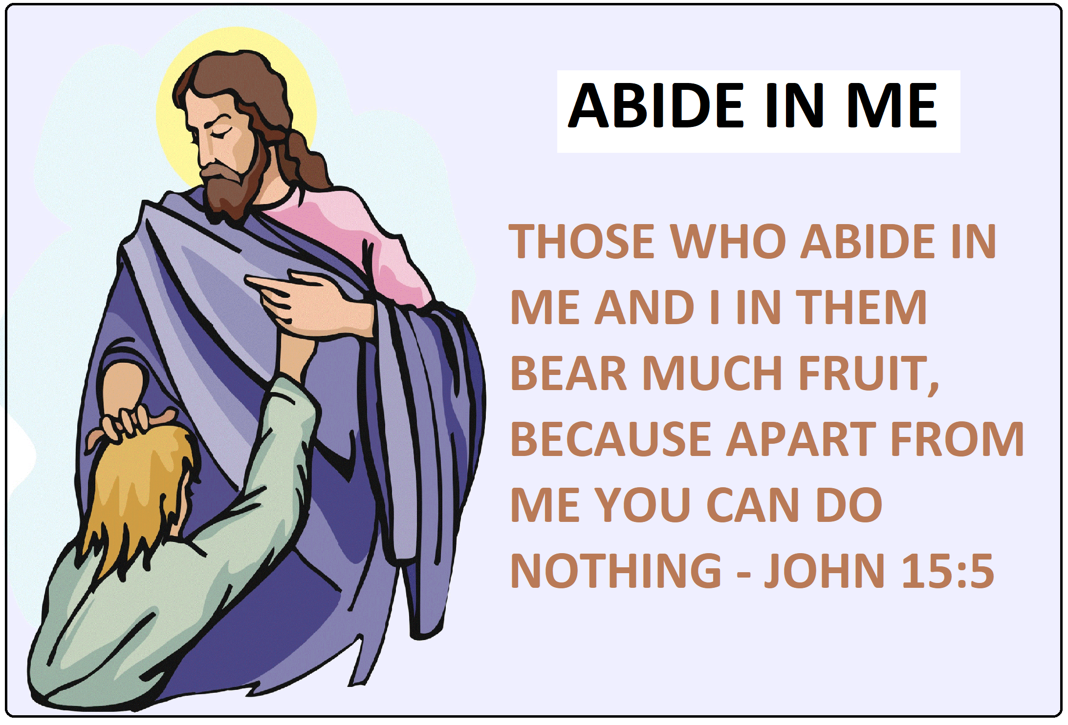
HOW CAN WE BEAR FRUITS THAT THE LORD DESIRES?
LET US ABIDE IN JESUS AND BEAR FRUITS FOR THE LORD.

Slide 10
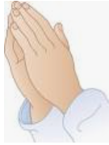
LET US PRAY
DEAR LORD JESUS,
THANK YOU FOR CHOOSING US FOR THE KINGDOM OF GOD TO BEAR FRUITS FOR YOU. GIVE US YOUR GRACE TO ABIDE IN YOU ALWAYS AND PRUNE US TO BEAR FRUITS THAT YOU DESIRE, SO THAT WHEN YOU VISIT US, WE ARE SEEN MOULDED LIKE YOU IN LOVE.
IN JESUS’ NAME WE PRAY,
AMEN.

Slide 11
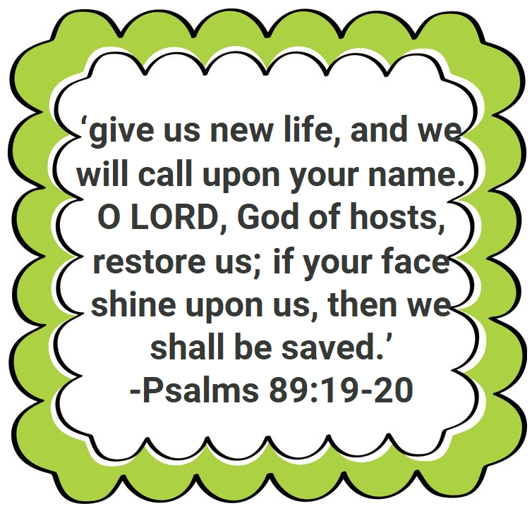
VERSE FOR THE WEEK

Slide 12
THANK YOU
GOD BLESS
FOR MORE IDEAS , PLEASE VISIT:
WEBSITE: http://littleevangelist.com/childrens_liturgy.php
YOUTUBE CHANNEL:
https://www.youtube.com/channel/UCndM2GK0dnpWg5ECUscdDcA

