Slide 1
STAY AWAKE AND BE READY!
CHILDREN’S LITURGY NOVEMBER 8TH ,2020
GOSPEL:MATTHEW 25:1-13

Slide 2
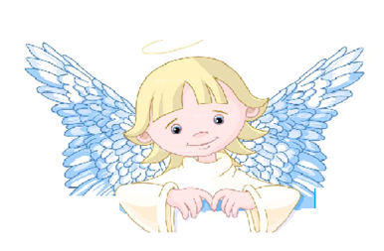
DO YOU REMEMBER WHAT WAS THE GOSPEL LAST WEEK?
THE BEATITUDES
JESUS REVEALED ABOUT THE GREAT BLESSINGS FROM HEAVEN AND ABOUT THE BLESSED ONES.
THROUGH THE BEATITUDES, JESUS MOTIVATE HIS DISCIPLES AND EACH OF US TO BECOME WHAT THE LORD TRULY DESIRES US TO BECOME - THE TRUE CHILDREN OF GOD

Slide 3
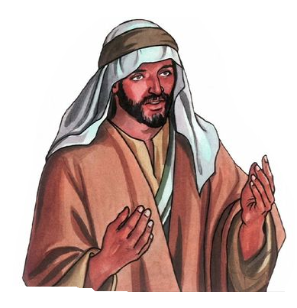
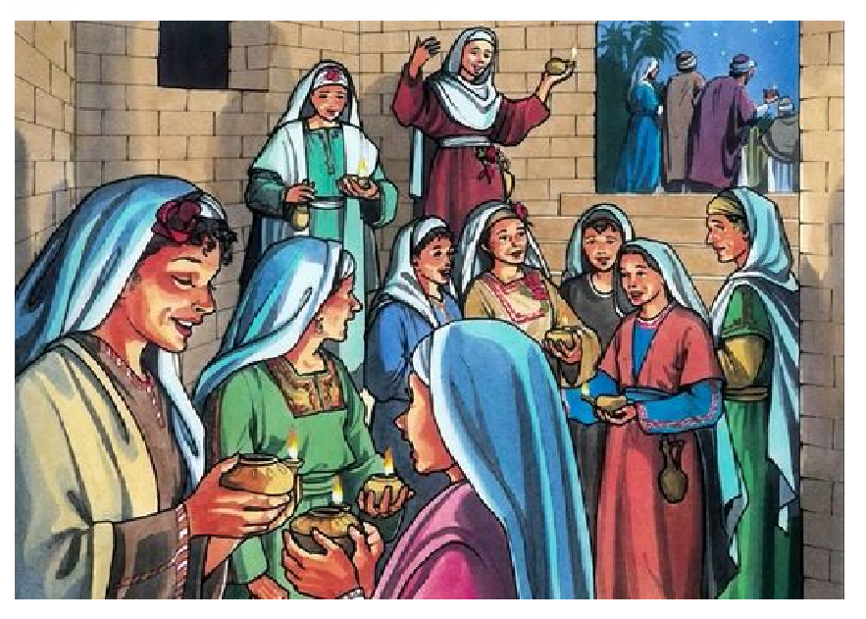
IN THE GOSPEL TODAY,
JESUS TELLS ABOUT
THE KINGDOM OF HEAVEN and
THE TIME OF HIS SECOND COMING.
"The kingdom of heaven will be like ten virgins who took their lamps and went out to meet the bridegroom.
FIVE WERE WISE
FIVE WERE FOOLISH

Slide 4
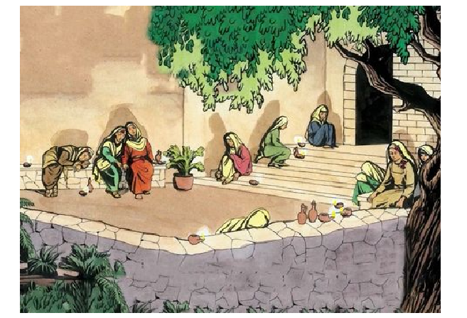
Brought flasks of oil with their lamps.
Brought no oil with their lamps.
The bridegroom was long delayed, they all became drowsy
and fell asleep.
HAVE YOU FELT SLEEPY AFTER A LONG WAIT?

Slide 5
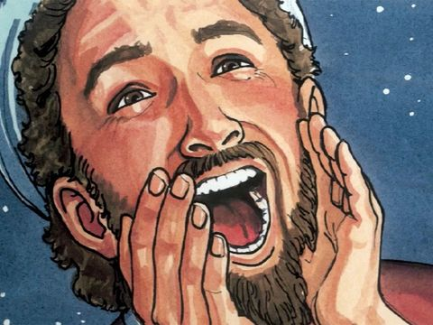
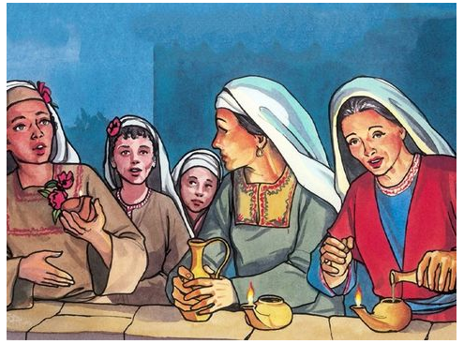
At midnight, there was a cry,
‘Behold, the bridegroom!
Come out to meet him!’
All the virgins got up and trimmed their lamps.
The foolish ones asked the wise ones,
Give us some of your oil, for our lamps are going out.’
'No, for there may not be enough for us and you. Go instead to the merchants and buy some for yourselves.’

Slide 6
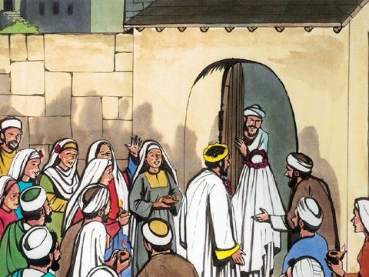
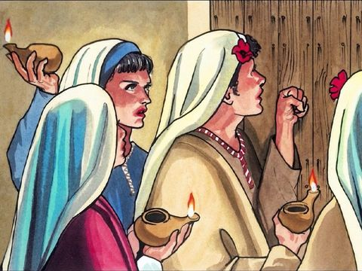
WHILE THE FOOLISH ONES WENT OFF TO BUY OIL, THE BRIDEGROOM CAME.
Those who were ready went into the wedding feast with him.
‘Lord, Lord, open the door for us!’
Then the door was locked.
The other virgins came and said,
But he said in reply, ‘AMEN, I SAY TO YOU, I DO NOT KNOW YOU.’
“THEREFORE, STAY AWAKE, FOR YOU KNOW NEITHER THE DAY NOR THE HOUR."

Slide 7
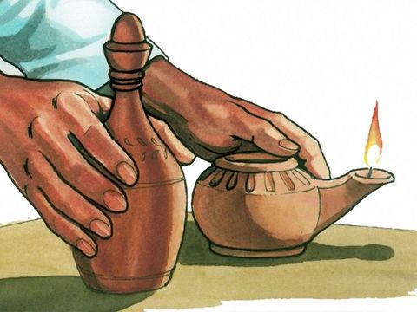
WHAT IS JESUS ASKING US THROUGH THE GOSPEL?
ALL THE TEN VIRGINS PREPARED AND WAS WAITING FOR
THE COMING OF THE BRIDEGROOM.
WHAT WAS THE DIFFERENCE IN THEIR PREPARATIONS?
THE FOOLISH ONES HAD
NO EXTRA OIL
TO LIGHT UP THE LAMP.
THE LACK OF OIL PUT OFF THEIR LAMPS. IT LED THE FOOLISH ONES TO MISS THE BRIDEGROOM AND TO LOOSE THEIR ENTRY TO THE BANQUET.

Slide 8
STAY AWAKE ,PREPARE AND BE READY!
Through our Baptism we received
the light of Christ,
the LIGHTED LAMP OF NEW LIFE in Christ
and THE OIL OF HOLY SPIRIT
to keep it burning.
RECEIVE THE LIGHT OF CHRIST
HAVE OUR OIL DIRED OUT? OR
IS IT FILLING UP TO KEEP THE LIGHT BURNING?
THE BAPTISIMAL CANDLE
LET US KEEP AWAKE AND BE SOBER;
TO KEEP UP OUR OIL.

Slide 9
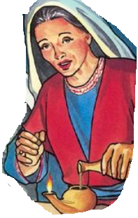
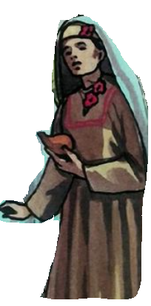
REFILL THE OIL BY LIVING IN HOLY SPIRIT.
The Wise virgins are the ones who lived in spirit according to the word of god.
But the foolish ones are those who listens to the word of God but does not act on them.
As we prepare for coming of Jesus and before we all fall asleep, now is the time to fill in oil.
Let us live in holy spirit
living according to the word of God.

Slide 10
HOLY SPIRIT FILLS US WITH WISDOM;
TO LIVE PLEASING GOD.
JESUS SAID:
WE ARE THE LIGHT
OF THE WORLD
BEING FILLED IN THE OIL OF HOLY SPIRIT,
LET OUR SOULS SHINE OUT OUR DEEDS DONE IN HOLY SPIRIT.

Slide 11
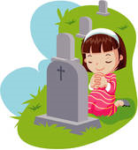
NOVEMBER- THE MONTH TO PRAY FOR
ALL DEPARTED SOULS.
THE DEAD ARE SLEEPING IN CHRIST
AWAITING HIS SECOND COMING.
THEY WILL RISE
IN THE DAY OF LORD’S COMING.
LET US PRAY FOR THEM,
Eternal rest grant unto them, O Lord, and let perpetual light shine upon them.
May the souls of all the faithful departed, through
the mercy of God, rest in peace. Amen
Our prayers can help them lot as they cannot pray for themselves.
SEEK HELP TO READ
1THESSALONIANS 4:13-18

Slide 12
VERSE OF THE WEEK

Slide 13
Let us pray,
Dear Lord, thank you for creating us new in Jesus through Holy Spirit. Give us your grace to stay awake, always shining and spreading your light living and filling in holy spirit .So that, when you arrive, we are seen lighted up to receive you and enter with you to the kingdom of heaven to remain with you forever. In Jesus’ name we pray, amen.

Slide 14
THANK YOU AND GOD BLESS YOU ALL
KEEP LITTLE EVANGELIST IN YOUR SPECIAL PRAYERS.
FOR MORE IDEAS PLEASE VISIT:
WEBSITE: http://littleevangelist.com/childrens_liturgy.php
YOUTUBE CHANNEL:
https://www.youtube.com/channel/UCndM2GK0dnpWg5ECUscdDcA

