Slide 1
‘Whoever Believes in Jesus have Eternal Life’
Gospel: John 3:14-21
Children’s Liturgy March 14th ,2021

Slide 2
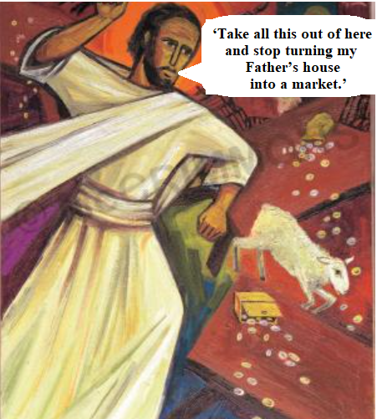
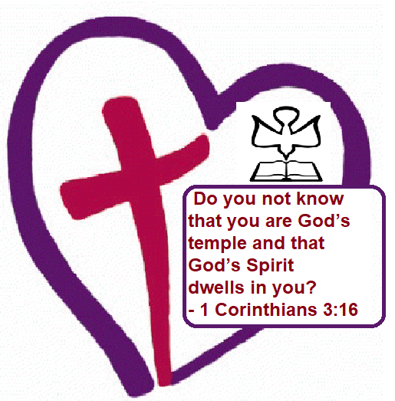
The Gospel last week:
Jesus found people selling
in the Temple of Jerusalem.
The Zeal of His Father’s house consumed Him, and He cleansed the temple of Jerusalem.
Jesus was saying about the body
as temple of god.
Jesus transformed Our Body as the Temple of God
by sending down the holy spirit upon us.
LET US HAVE THE ZEAL OF JESUS BE HOLY.

Slide 3
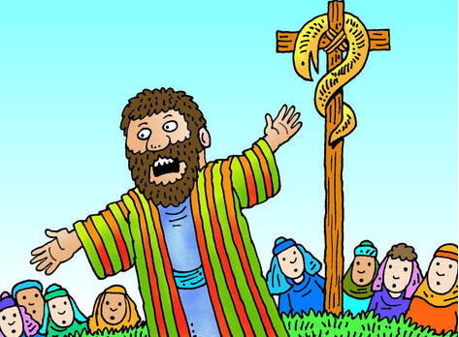
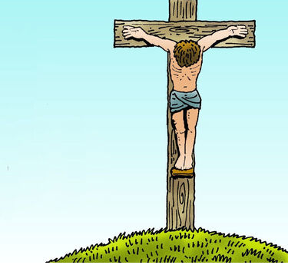
In Gospel Today,
Jesus is talking to Nicodemus, a pharisee,
who came to see him in the night.
‘The Son of Man must be lifted up
as Moses lifted up the serpent in the desert,
so that everyone who believes may have
eternal life in him.
Yes, God loved the world so much that he gave his only Son, so that everyone who believes in him may not be lost but may have eternal life.

Slide 4
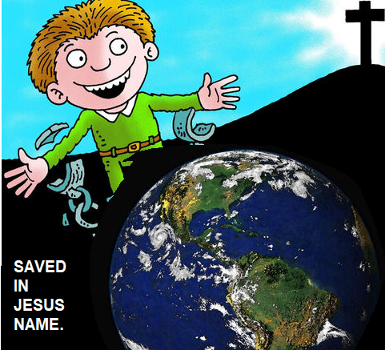
For God sent his Son into the world not to condemn the world,
but so that through him the world might be saved.
No one who believes in him
will be condemned.

Slide 5
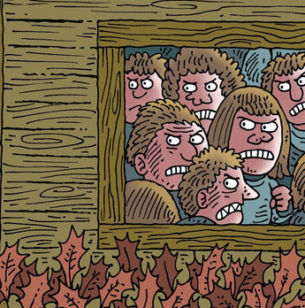
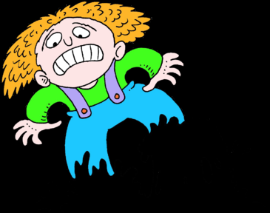
But whoever refuses to believe is condemned already,
because he has refused to believe
in the name of God’s only Son.
We don’t believe in Jesus!
On these grounds is sentence pronounced:
* that though the light has come into the world
men have shown they prefer darkness to the light
* because their deeds were evil.

Slide 6
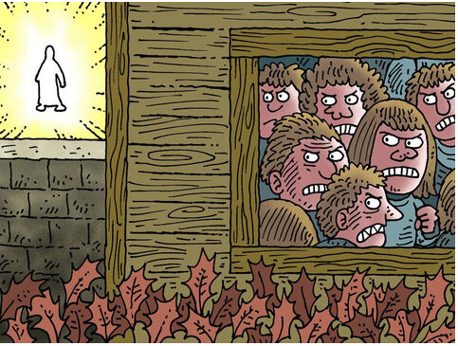
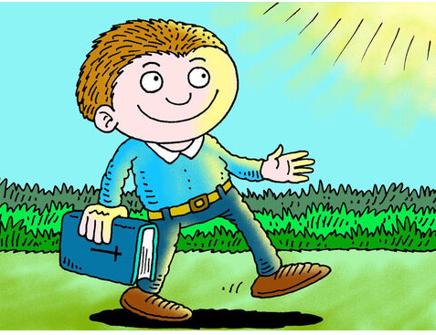
And indeed,
everybody who does wrong
hates the light and avoids it,
for fear his actions should be exposed;
but the man who lives by the truth
comes out into the light,
so that it may be plainly seen that
what he does is done in God.’
This is the Gospel of the Lord.
Praise to you Lord Jesus Christ.

Slide 7
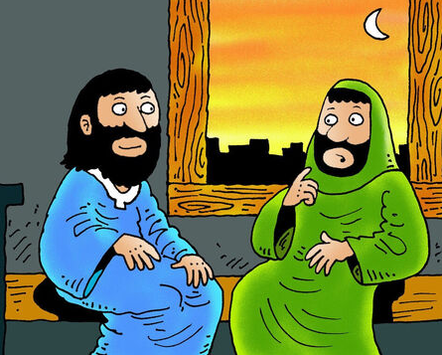
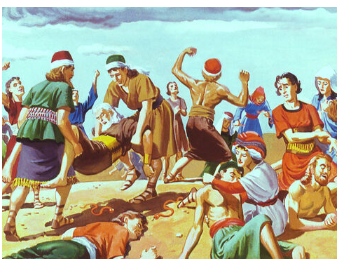
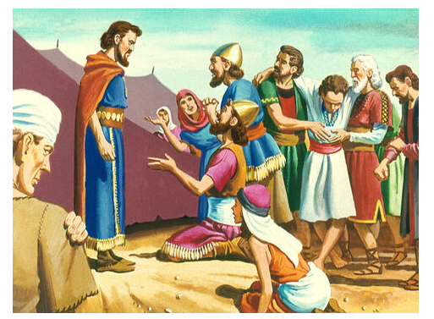
Nicodemus ,the pharisee was curious to know about way of salvation. He came to Jesus. He believed in Jesus.
Jesus reminds Nicodemus about what happened in days of Moses.
Jesus is referring to Book of Numbers 21:4–9
DISOBEDIENCE
LED TO
TROUBLES
The people of Israel were attacked by
poisonous snakes, as a result of
their own disobedience.
People went to Moses for help

Slide 8
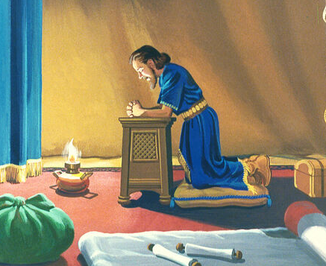
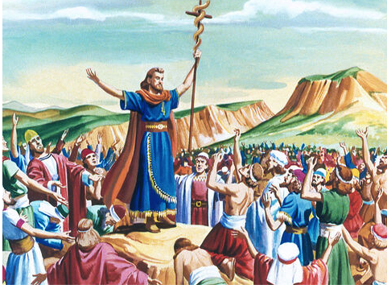
Moses prayed to God.
God instructed Moses to make a bronze serpent and raise it on a pole
Everyone who looked at the snake was cured from their bite and lived.
The faith in God’s words and obedience to God ,cured them.

Slide 9
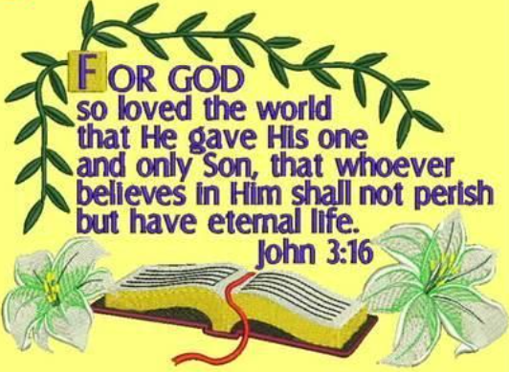
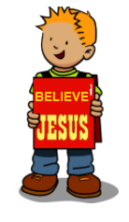
The same way as Moses lifted up the serpent, Christ has to be lifted up on the cross
So that all who by their disobedience to God got bitten by evil, and got poisoned by sin ,
will be delivered from sins
and gain eternal life.
Jesus was telling about his passion and crucifixion
for our redemption and salvation.
Father God who loves each of us , send his own son to deliver us from sins.
Those who BELIEVE in him will not perish
but will have eternal life.

Slide 10
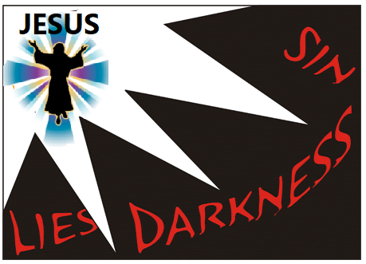
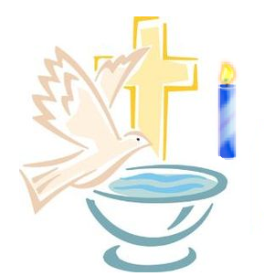
Jesus came down giving light to the world
darkened by evil through sin.
By his life death resurrection and ascension,
Jesus gave the eternal light,
revealing the way of eternal life for all.
Through our baptism, we too received this light of Christ
and are made the children of light.
Jesus asks us to live as children of light.

Slide 11
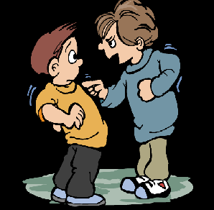
But some do not like light.
They love darkness because they do wrong.
They do not like to be found out wrong, they don't like to be corrected
They wish to live in their own ways.
So, They do not believe in Jesus.
What do we feel sometimes if we do some wrong?
Do we sometimes tend to hide ?
Do we like to be corrected?
Being made the Children of Light,
Jesus asks us to come to light.
To do what he has shown us by his life.
to tell sorry and accept our wrong.
To forgive… to love…to care..

Slide 12
BELIEVE IN JESUS, FOLLOW JESUS, GAIN ETERNAL LIFE
ALWAYS BE CLOSE TO JESUS AND LIVE IN HIS LIGHT
Let us allow Jesus’ light to shine in us and
allow him to reveal the areas we need to change.
Let the light of Christ expel darkness in us .
Word of God helps us to follow the Jesus way to eternal life.
Let us be his light to give light to others.
Jesus is the Light of the world, those who follow Jesus will never walk in darkness but will have the light of life. (John 8:12)

Slide 13
Let us Pray,
Dear Loving Jesus, we believe in your passion for us; out of the unconditional love of God. Help us to stay close to you always and be in your light. Let your light shine in us and expel all our darkness. Give us grace to walk in your light and to be the light for the world.
In Jesus name we pray, amen.

Slide 14
VERSE FOR THE DAY

Slide 15
God Bless you
KEEP LITTLE EVANGELIST IN YOUR SPECIAL PRAYERS
FOR MORE IDEAS PLEASE VISIT:
WEBSITE:
http://littleevangelist.com/childrens_liturgy.php
YOUTUBE CHANNEL:
https://www.youtube.com/channel/UCndM2GK0dnpWg5ECUscdDcA

