Slide 1
REPENT, AND BELIEVE IN THE GOOD NEWS
GOSPEL: MARK 1:12-15
CHILDREN’S LITURGY FEBRUARY 21ST 2021

Slide 2
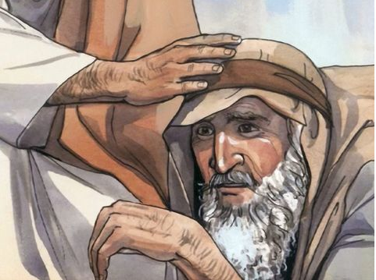
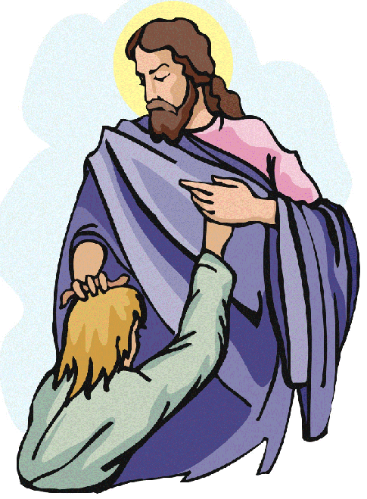
IN THE GOSPEL LAST WEEK,
We see Jesus healing a leper.
He touched him in compassion.
WE ARE CHOSEN TO BE CLEAN BY HIS LOVE.
Let us approach Jesus with FAITH and HUMILITY.
Let us have compassion and love for each other
Let us be thankful and
always be vigilant to FOLLOW his directions.

Slide 3
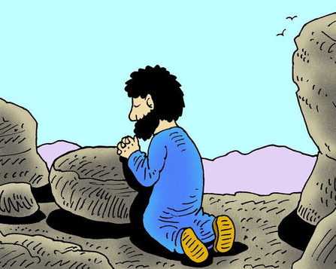
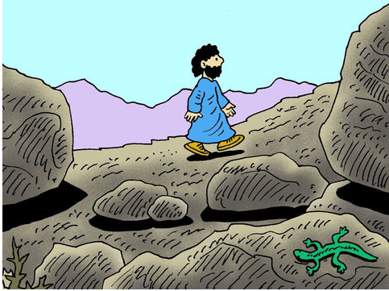
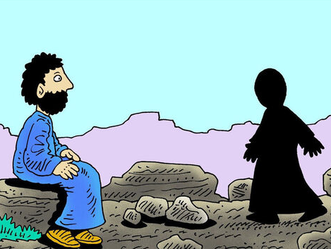
In the gospel today gospel: mark 1:12-15
The Spirit drove Jesus out into the wilderness
He remained there for forty days,
and was tempted by Satan

Slide 4
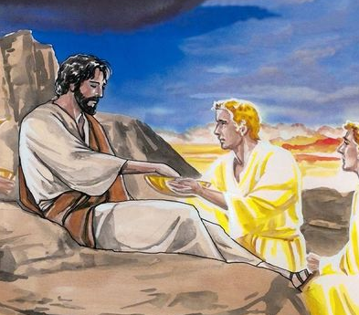
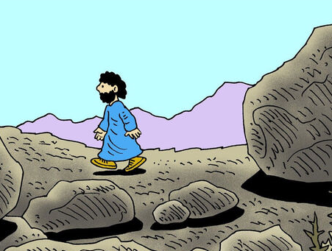
He was with the wild beasts, and the angels looked after him.
After John had been arrested, Jesus went into Galilee.
‘The time has come’ ‘and the kingdom of God is close at hand. Repent, and believe the Good News.’
THIS IS THE GOSPEL OF THE LORD.
RESPONSE: PRAISE TO YOU LORD JESUS CHRIST

Slide 5
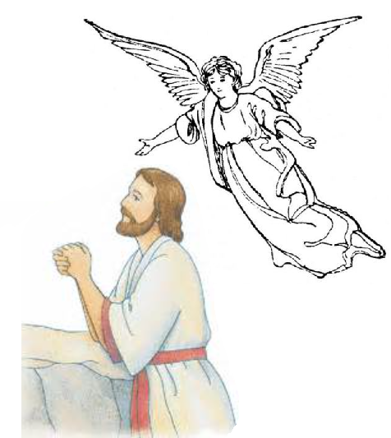
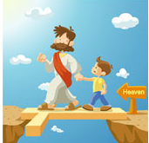
GOSPEL REFLECTION
After baptism, Jesus was led to desert by the Holy Spirit.
He prayed and fasted and increased in strength of Spirit.
He overcame the temptations in heavenly help , through word of God.
He began His mission proclaiming the good news.
THROUGH OUR BAPTISM WE ARE CALLED TO A LIFE IN JESUS, LED BY THE HOLY SPIRIT.
We are called out from this world to God’s Kingdom.
To reject satan and sin and …
To turn to God, REPENT and BELEIVE in Good News.
To live by following Jesus, who conquered the world through His passion, death on Cross and His resurrection.
To overcome the world through Jesus .

Slide 6
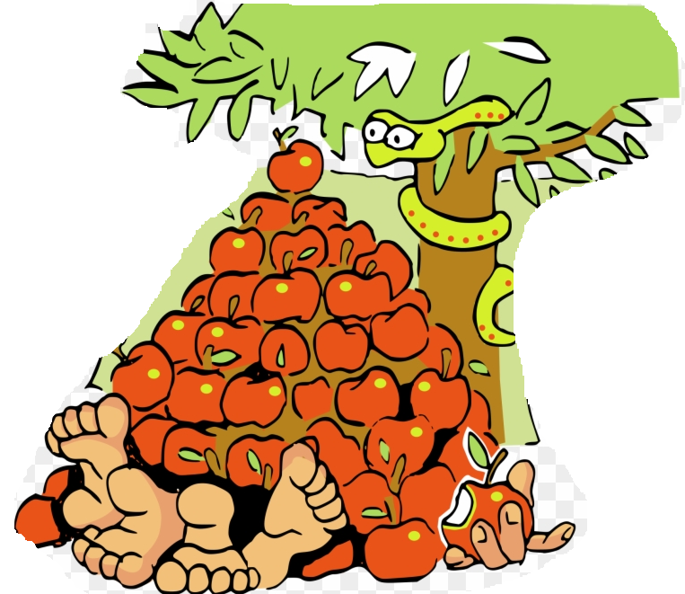
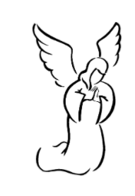
TEMPTATIONS
* THERE ARE LOT OF TEMPTATIONS AROUND US.
* TEMPTATIONS ARE BROUGHT BY SATAN TO TRAP US AND TAKE US AWAY FROM GOD.
* TEMPTATIONS ATTRACT US TO LOVE WORLDLY THINGS MORE THAN GOD.
THE GOSPEL TODAY ASSURES US THAT WE HAVE HEAVENLY HELP TO OVERCOME IT.
THE HEAVENLY HELP
JESUS (WHO CONQUERED THE WORLD) IS WITH US FOREVER TO HELP US.
THE HOLY EUCHARIST
-ETERNAL NOURISHMENT
THE WORD OF GOD
-THE SWORD OF SPIRIT
THE HOLY SPIRIT
-OUR HELPER AND GUIDE
THE ANGELS
-THE HEAVENLY HELPERS
FAITH IN JESUS HELP US TO CONQUER THE TEMPTATIONS

Slide 7
Conquering temptations strengthens us in spirit and faith
Each time we offer ourselves to heavenly help and overcome temptations; We get strengthened in spirit.
It strengthen us in faith.
It empower us through grace and built us to proclaim Good news.
And prepares us for Heaven.
SO LET US REPENT, BELIEVE IN GOOD NEWS – SALVATION THROUGH CHRIST

Slide 8
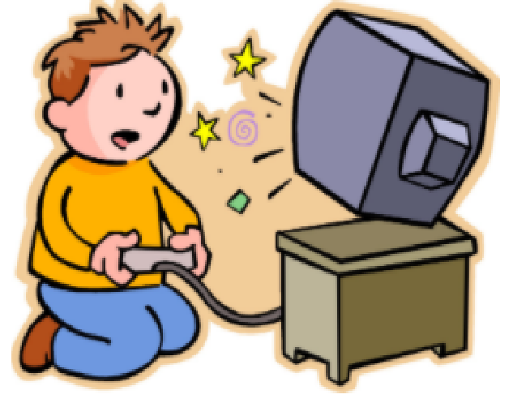
Now we are in
Lent is our journey with Jesus,
Who has shown us the way
to attain eternal life.
LENT TRAINS US TO BECOME STRONG IN SPIRIT AGAINST SATAN WHO COMES TO TEMPT US
BY SEEKING REFUGE IN JESUS, WHO HAS CONQUERED THE WORLD.
To be led by holy spirit and to draw closer to God.
Let us offer ourselves and all our weaknesses in true desire for THE HEAVENLY HELP.
not to mourn
not to be bossy
Not to be
selfish
not to be angry
to control the
screen time, games
to control our tongue and
speak more of the word of God.
to obey more
to help and care,
TAKE Word of god , the sword of spirit to fight temptations.

Slide 9
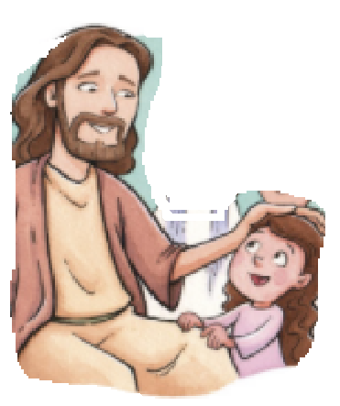
THE THREE PILLARS OF LENT
Spend time with God.
Read word of God.
Works in love of God

Slide 10
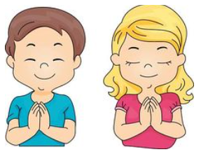
LET US PRAY,
Dear Lord Jesus, we thank you for delivering us and setting us free from sin. Give us the grace to stay closer to you and depend on the power of Holy Spirit and word of God to resist the temptations that drags us away from your presence.
In Jesus name we pray, Amen

Slide 12
GOD BLESS YOU ALL
KEEP LITTLE EVANGELIST IN YOUR SPECIAL PRAYERS
FOR MORE IDEAS PLEASE VISIT:
WEBSITE:
http://littleevangelist.com/childrens_liturgy.php
YOUTUBE CHANNEL:
https://www.youtube.com/channel/UCndM2GK0dnpWg5ECUscdDcA

