Slide 1
THE FEEDING OF THE FIVE THOUSAND
CHILDREN’S LITURGY AUGUST 2ND , 2020
GOSPEL: MATTHEW 14:13-21

Slide 2
Last Sunday Jesus told us about The Greatest Treasure ‘The Kingdom of Heaven’
In today’s Gospel, Jesus asks us:
-> to OFFER unto the LORD (who is the only source of blessing), all that we have, no matter how LITTLE,
-> to MULTIPLY it and
-> to USE it for the GOOD of many.

Slide 3
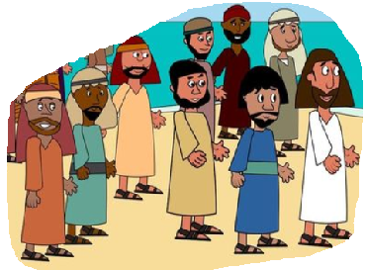
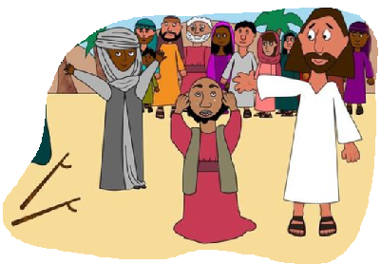
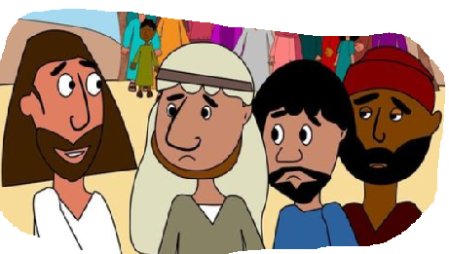
A LARGE CROWD OF ABOUT 5000 PEOPLE CAME TO LISTEN JESUS.
JESUS FELT COMPASSION FOR THEM
AND HEALED THEIR SICKNESS.
JESUS, IT IS GETTING LATE. SEND THE CROWDS AWAY TO BUY SOME FOOD
“THEY DO NOT NEED TO GO AWAY. YOU GIVE THEM SOMETHING TO EAT.”
“WE HAVE HERE ONLY FIVE LOAVES OF BREAD AND TWO FISH”

Slide 4
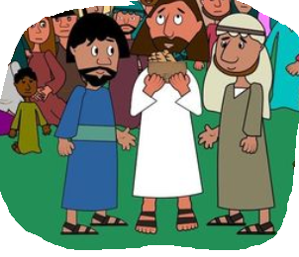
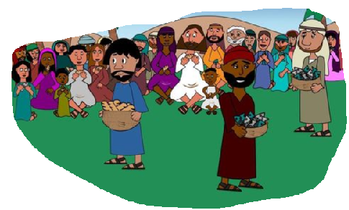
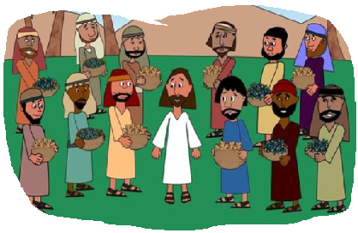
GIVE TO ME WHAT YOU HAVE. I WILL BLESS IT FOR THE GOOD OF MANY.
TAKING THE FIVE LOAVES AND THE TWO FISH AND LOOKING UP TO HEAVEN, HE GAVE THANKS AND BROKE THE LOAVES AND GAVE IT TO THE DISCIPLES
THE DISCIPLES GAVE THEM TO THE PEOPLE
THEY ALL ATE AND WERE SATISFIED
THE DISCIPLES PICKED UP TWELVE BASKETFULS OF BROKEN PIECES THAT WERE LEFT OVER

Slide 5
GOD CAN USE OUR SMALL OFFERINGS TO DO GREAT THINGS
.
* WHAT DO WE FEEL WE ARE TOO WEAK IN? OR THAT WE HAVE ONLY TOO LITTLE OF?
* WHAT DID JESUS SHOW US THROUGH THE GOSPEL TODAY?
* DO NOT LIMIT YOURSELF . NO MATTER HOW LITTLE YOU FEEL;
OFFER IT TO OUR LORD,
HE WILL TRANSFORM IT TO AN ABUNDANCE.

Slide 6
JESUS GAVE HIMSELF FOR US
LET US OFFER OURSELVES TO OUR LORD.
LET NO CHALLENGES SEPARATE US FROM THE LOVE OF CHRIST.
IN TIMES OF CHALLENGES LET US HAVE A MIND TO LISTEN TO HIM ,
TO TRUST IN HIS MERCY AND TO DO WHATEVER HE TELLS US.
LET US APPROACH THE ETERNAL SPRING OF LIFE- JESUS

Slide 7
VERSES FOR TODAY
“You open wide your hand and satisfy the desire of every living thing. The LORD is near to all who call upon him, to all who call upon him in truth
(Psalms 145:16,18)

Slide 8
PRAYER
LORD JESUS, WE OFFER OURSELVES AND ALL THAT WE HAVE, UNTO YOU.
BLESS US AND USE IT FOR THE GOODNESS OF ALL IN YOUR GLORY,
IN JESUS NAME WE PRAY, AMEN.

Slide 9
THANK YOU GOD BLESS
FOR MORE IDEAS , PLEASE VISIT:
WEBSITE: http://littleevangelist.com/childrens_liturgy.php
YOUTUBE CHANNEL:
https://www.youtube.com/channel/UCndM2GK0dnpWg5ECUscdDcA

