Slide 1
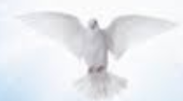
The Feast of Pentecost
CHILDREN’S LITURGY MAY 31ST ,2020
HAPPY BIRTHDAY TO CHURCH!
“RECEIVE THE HOLY SPIRIT.”
- JOHN 20:22
Notes:
Note:
This certificate is designed to be printed. You should test print on regular paper to ensure proper positioning before printing on card stock.
You may need to uncheck Scale to Fit Paper in the Print dialog (in the Full Page Slides dropdown).

Slide 2
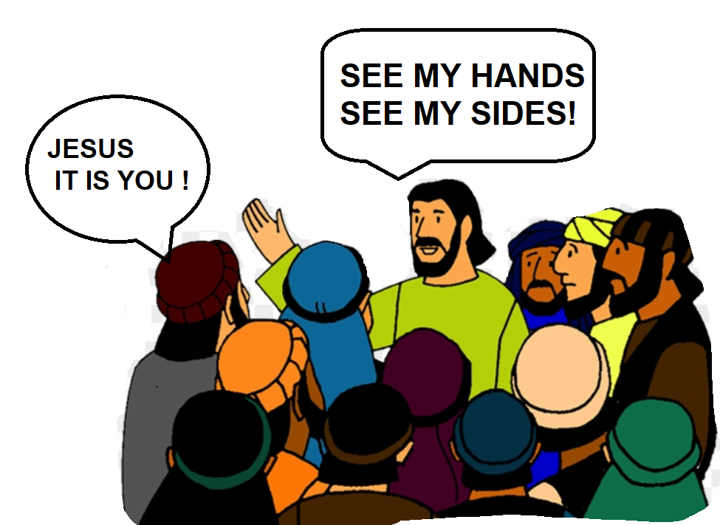
PEACE BE WITH YOU
JESUS CAME THROUGH THE LOCKED DOORS, AMIDST THE DISCIPLES WHO WERE TROUBLED AND SCARED. HE GAVE PEACE TO THEM.
THE DISCIPLES REJOICED
WHEN THEY SAW HIM
JESUS SAID TO THEM,’As the Father has sent me, so I send you.”

Slide 3
JESUS BREATHED ON THEM SAYING; ‘RECEIVE THE HOLY SPIRIT’
Breathing on them the Holy Spirit, Jesus asked them to forgive each others sins.
'whose sins you forgive are forgiven them, and whose sins you retain are retained.”
HE ASKED HIS FOLLOWERS TO SPREAD HIS PEACE
BY FORGIVING SINS.

Slide 4
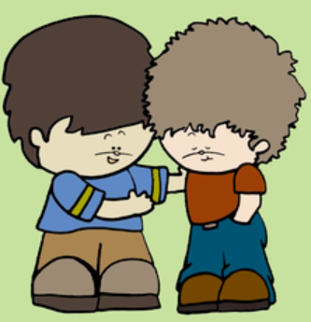
ARE WE ABLE TO FORGIVE?
WE ARE FORGIVEN. LET US FORGIVE EACHOTHER
LET US THINK OF TIMES THAT WE WERE NOT ABLE TO FORGIVE
LET US THINK OF THINGS THAT WE ARE NOT ABLE TO FORGIVE
HOLY SPIRIT FILL IN ME WITH GODS LOVE. HELP ME TO FORGIVE

Slide 5
JESUS CRACKS OPEN THROUGH OUR WEAKNESSES AND BLOCKS TO COME INTO US
*HE GIVES US PEACE*
*HE REVEALS HIMSELF AS LIVING *
*HE BREATHES HOLY SPIRIT*
LET US OFFER ALL OUR WEAKNESSES AND CONCERNS TO JESUS
LET HIS PEACE FILL IN US
LET THE HOLY SPIRIT STRENGTHEN US

Slide 6
THE DAY OF WAIT IS OVER
THE GIFT FROM ABOVE UNWRAPPED AND ENKINDLED WITH PRAYER
JESUS ORDERED HIS FRIENDS TO WAIT AND PRAY FOR THE PRECIOUS GIFT FROM ABOVE BEFORE HE ASCENDED TO HEAVEN
THEY GATHERED FOR 10 DAYS AND PRAYED FERVENTLY
ON THE TENTH DAY- THE DAY OF PENTECOST-AS THEY WERE PRAYING,
TONGUES AS OF FIRE ,
PARTED AND
CAME TO REST ON EACH ONE OF THEM
ALL WERE FILLED WITH
HOLY SPIRIT
THE SPIRIT ENABLED THEM TO PROCLAIM AND
SPEAK IN DIFFERENT TONGUE

Slide 7
HOLY SPIRIT ENKINDLED
ooo...that is a great experience of getting FILLED WITH HOLY SPIRIT
LET US WATCH IT !

Slide 8
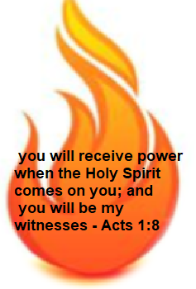
APOSTLES WERE REBORN IN HOLY SPIRIT TO NEW PERSONS IN CHRIST
Holy Spirit came with DIVINE GIFTS. The disciples were no longer scared, they came out boldly in power and Peter began to preach loudly about Jesus together with others. They were filled in love of God that transformed them to give their life for Jesus.

Slide 9
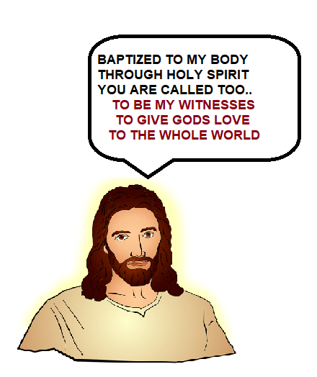
“In one Spirit we were all baptized into one body of JESUS” - 1 Corinthians 12:13
THE CHURCH
IT IS THE BIRTHDAY OF CHURCH

Slide 10
UNWRAP THE GIFTS GOD GAVE US THROUGH HOLY SPIRIT AND BEAR FRUITS FOR THE LORD LET’S GO AND ANNOUNCE THE GOSPEL TO THE WORLD
GIFTS OF
THE HOLY SPIRIT

Slide 11
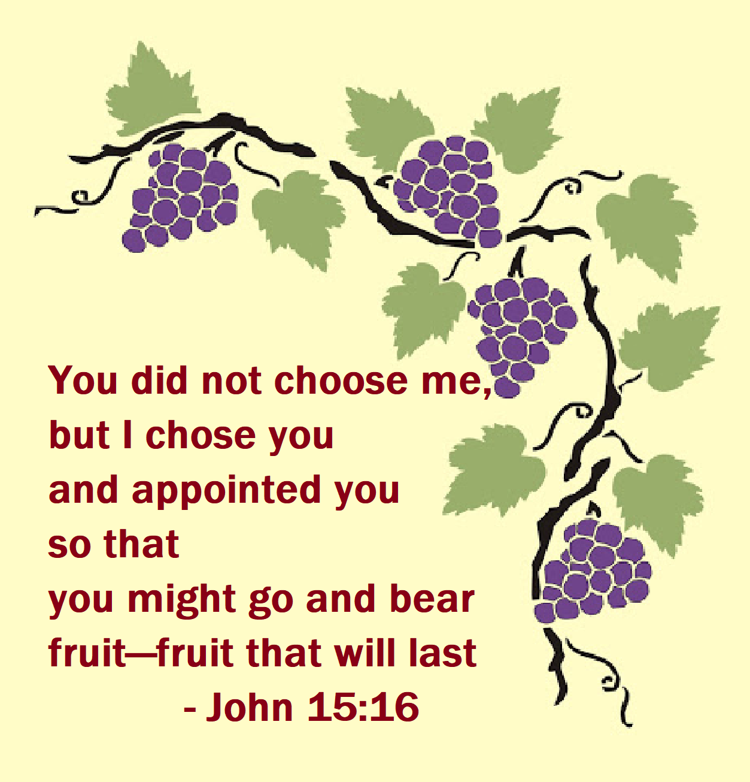
PRAYER
COME HOLY SPIRIT, FILL THE HEARTS OF YOUR FAITHFUL AND KINDLE IN THEM THE FIRE OF YOUR LOVE. SEND FORTH YOUR SPIRIT AND THEY SHALL BE CREATED. AND YOU SHALL RENEW THE FACE OF THE EARTH.
TRANSFORM US MORE LIKE JESUS EACH DAY , BEARING FRUITS FOR THE LORD AND GIVING JESUS TO THE WHOLE WORLD.

Slide 12
Verses for today
Jesus said to them again, “Peace be with you. As the Father has sent me, so I send you.” When he had said this, he breathed on them and said to them, “Receive the Holy Spirit. If you forgive the sins of any, they are forgiven them; if you retain the sins of any, they are retained.”
- John 20:21-23
FOR MORE ACTIVITIES AND IDEAS PLEASE VISIT
http://littleevangelist.com/childrens_liturgy.php

Slide 13
Thank you
LET US GO AND LIVE THE GOSPEL WITNESSING JESUS BY OUR LIFE

