Slide 1
CHILDREN’S LITURGY NOVEMBER 1ST, 2020
BLESSED ARE YOU !
GOSPEL: MATTHEW 5:1-12

Slide 2
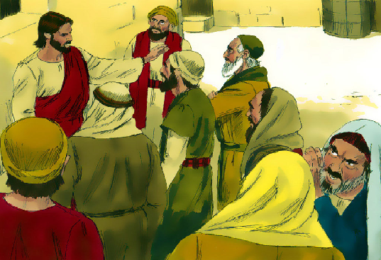
DO YOU REMEMBER LAST WEEK’S GOSPEL?
LOVE ONE ANOTHER AS I HAVE LOVED YOU
JESUS WAS TESTED BY A SCHOLAR OF THE LAW BY ASKING
‘WHICH COMMANDMENT OF THE LAW IS GREATEST?’
"You shall love the Lord, your God, with all your heart, with all your soul, and with all your mind. THIS IS THE GREATEST AND THE FIRST COMMANDMENT.
“THE SECOND IS LIKE THIS: You shall love your neighbor
as yourself. ”
“THE WHOLE LAW AND THE PROPHETS DEPEND ON THESE TWO COMMANDMENTS."
JESUS
ANSWERED
IN
WISDOM
LOVE FULFILLS
ALL THE LAWS

Slide 3
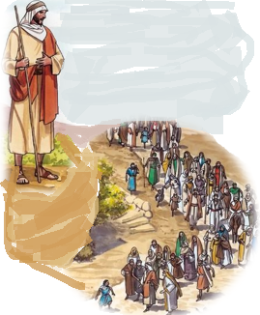
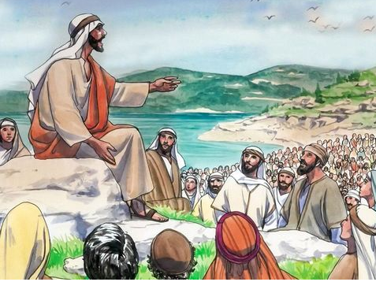
IN THE GOSPEL TODAY,
JESUS SAW THE CROWDS.
HE WENT UP THE MOUNTAIN.
HE SAT DOWN AND
HIS DISCIPLES CAME TO HIM.
HE BEGAN TO TEACH THEM,

Slide 4
THE BLESSED
THE BEATITUDES
“Blessed are the poor in spirit,
for theirs is the Kingdom of heaven
Blessed are they who mourn,
for they will be comforted.
for they will inherit the land.
Blessed are the meek,
Blessed are they who hunger and thirst for righteousness,
for they will be satisfied.
for they will be shown mercy.
Blessed are the merciful,
Blessed are the clean of heart,
for they will see God.
Blessed are the peacemakers,
for they will be called children of God.
Blessed are they who are persecuted for the sake of righteousness,
for theirs is the Kingdom of heaven.
Blessed are you when they insult you and persecute you and utter every kind of evil against you falsely because of me.
Rejoice and be glad, for your reward will be great in heaven.”

Slide 5
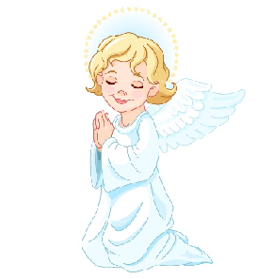
THROUGH TODAY’S GOSPEL JESUS TELLS US WHO ARE THE BLESSED?
THIS TEACHING OF JESUS IS KNOWN AS,
THE BEATITUDES
BEATITUDE MEANS ‘BLESSED’:
THE GREAT BLESSINGS
IN THE BEATITUDES, JESUS EXPLAINS TO US ABOUT
THE BLESSINGS FROM HEAVEN SHOWERED FOR
CERTAIN VIRTUES OR EXPERIENCES.

Slide 6
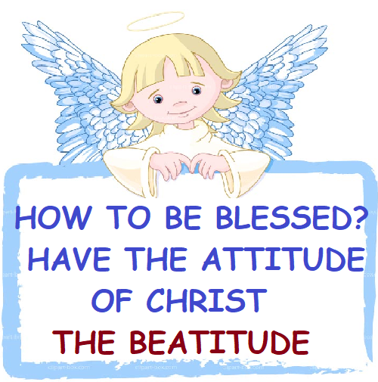
THROUGH THE BEATITUDES JESUS REVEALS TO US
THE GREAT BLESSINGS FROM HEAVEN AND WHO WILL RECEIVE THEM.
1. THE POOR IN SPIRIT
MEANING: DEPENDING ON GOD AT ALL TIMES.
UNDERSTANDING THAT
ALL YOUR BLESSINGS ORIGINATE
FROM GOD.
BLESSING: KINGDOM OF HEAVEN
MEANING: FEELING SAD ABOUT OUR SINFUL NATURE AND THE SINS OF THE WORLD. REALISING THAT WE SHOULD REPENT AND RENEW AND WE NEED TO PRAY FOR THE REPENTANCE OF ALL.
2.THOSE WHO MOURN
BLESSING: COMFORT FROM HEAVEN
3. THE MEEK
MEANING: HUMILITY ,OBEDIENCE AND SUBMISSION TO THE WILL OF GOD.
BLESSING: INHERIT THE EARTH
4. THEY WHO HUNGER AND THIRST FOR RIGHTEOUSNESS
MEANING: REAL DESIRE FOR RIGHTEOUNESS. TO BE CHRIST-LIKE.
BLESSING: FULL SATISFACTION OF SOUL

Slide 7
5. THE MERCIFUL
MEANING: BEING MERCIFUL TO ALL AS OUR LORD IS MERCIFUL TO US.
TO FORGIVE AND TO BE KIND TO ALL.
BLESSING: MERCY FROM HEAVEN
6. THE CLEAN OF HEART
MEANING: HAVE A TRUE HEART FREE OF ALL SELFISH PURPOSES
AND SELF-SEEKING MOTIVES.
BLESSING: WILL SEE GOD
7. THE PEACEMAKERS
MEANING:TO BE IN PEACE OF CHRIST AND SHARE PEACE TO ALL
EVEN AMIDST ALL TROUBLES OR CHALLENGES.
BLESSING: WILL BE THE CHILDREN OF GOD
8. THEY WHO ARE PERSECUTED FOR THE SAKE OF RIGHTEOUSNESS AND ARE INSULTED AND PERSECUTED, UTTERING EVERY KIND OF EVIL AGAINST THEM FALSELY BECAUSE OF CHRIST.
MEANING:GIVING YOUR LIFE TO PROCLAIM JESUS. READY TO SUFFER PERSECUTION AND HARDSHIPS FOR CHRIST.
BLESSING: KINGDOM OF GOD WITH A GREAT REWARD

Slide 8
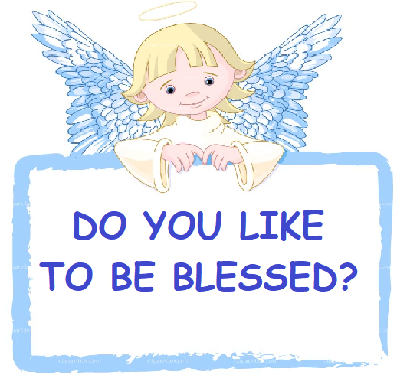
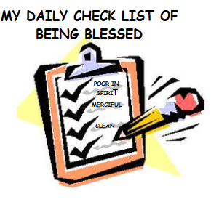
WE ARE SO HAPPY TO DO SOMETHING IF WE KNOW THE BLESSINGS THAT WE GET BY DOING SO.
SO, WHY DO YOU THINK JESUS REVEALED THE BEATITUDES ?
TO MOTIVATE HIS DISCIPLES AND EACH OF US TO BECOME WHAT THE LORD TRULY DESIRES US TO BECOME -
THE TRUE CHILDREN OF GOD
EACH MOMENT WE LIVE IN THIS WORLD, LET US TICK THE CHECK LIST OF THE BEATITUDES, TO ACCOMPLISH GOD’S WILL IN OUR LIVES.

Slide 9
CAN WE BECOME SO?
YES,WE CAN!
SAINTS ARE SIMPLE PEOPLE LIKE US
WHO SHOWED US THAT
WE TOO ARE ABLE TO LIVE FOLLOWING THE JESUS WAY AND BE BLESSED.
BECAUSE THEY THEMSELVES RECEIVED THE GRACE TO LIVE AND ARE BLESSED TO BE IN HEAVEN.
THIS IS WHAT WE CELEBRATE TODAY
WHEN WE READ THEIR STORIES, THEY TELL US,
-> TO DESIRE JESUS IN TRUTH.
-> OFFER OURSELVES TO GOD’S WILL,
FOLLOW JESUS’ WAY.
-> PRAY FOR GOD’S GRACE AND MERCY.
YOU ARE SURE TO REACH WHERE HE IS.

Slide 10
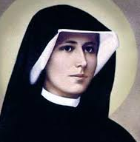
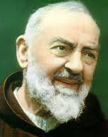
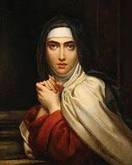
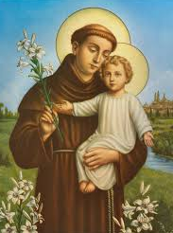
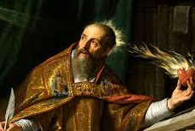
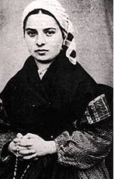
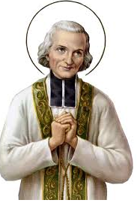
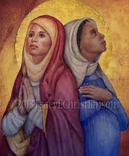
SAINTS
“Who are these wearing white robes, and
where did they come from?
”He said to me, “These are the ones who have survived the time of great distress; they have washed their robes and made them white in the Blood of the Lamb.”
– Revelations 7:13-14
AND MANY MORE…..
PICK ONE OF YOUR FAVORITE SAINT AND
TRY TO UNDERSTAND THEIR LIFE.

Slide 11
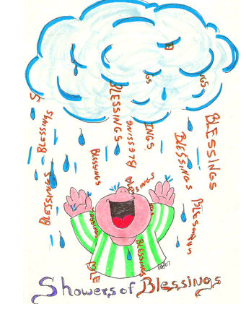
ARE WE READY FOR THE SHOWERS OF BLESSINGS?
LET US PRAY,
DEAR LORD JESUS, WE THANK YOU FOR YOUR LOVE THAT REVEALS TO US THE WAY TO HEAVEN. WE PRAY TO YOU TO HELP US TO RECEIVE YOUR GRACE THAT TRANSFORMS US EACH MOMENT TO BE THE CHILDREN OF GOD BY BEING POOR IN SPIRIT, MERCIFUL, PURE IN HEART, MEEK, PEACEMAKERS, THIRSTING FOR YOUR RIGHTEOUSNESS TO FILL US AND TO GIVE OUR LIFE FOR YOU OUT OF YOUR LOVE FOR US.
IN JESUS’ NAME WE PRAY, AMEN
WE ARE A HOLY NATION,
GOD’S OWN PEOPLE
-1 PETER 2:9
WE ARE CALLED TO BE SAINTS.

Slide 12
VERSE FOR THE WEEK

Slide 13
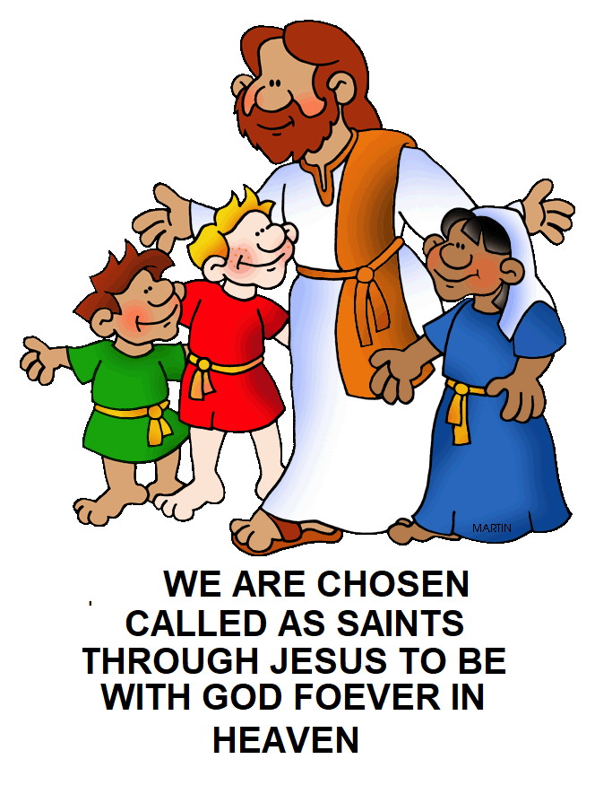
THANK YOU AND GOD BLESS YOU ALL
KEEP LITTLE EVANGELIST IN YOUR SPECIAL PRAYERS.
FOR MORE IDEAS PLEASE VISIT:
WEBSITE: http://littleevangelist.com/childrens_liturgy.php
YOUTUBE CHANNEL:
https://www.youtube.com/channel/UCndM2GK0dnpWg5ECUscdDcA

