Slide 1
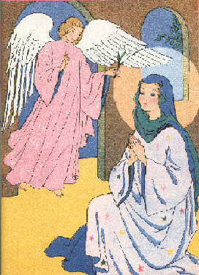
FOURTH SUNDAY OF ADVENT
OBEDIENCE OF FAITH
GOSPEL: LUKE 1:26-38
CHILDREN’S LITURGY DECEMBER 20TH, 2020

Slide 2
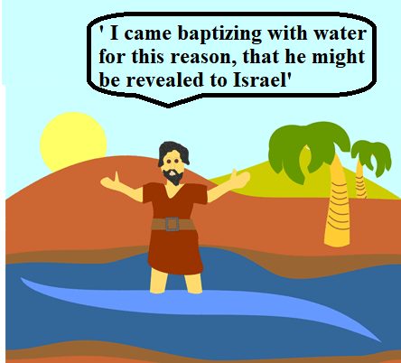
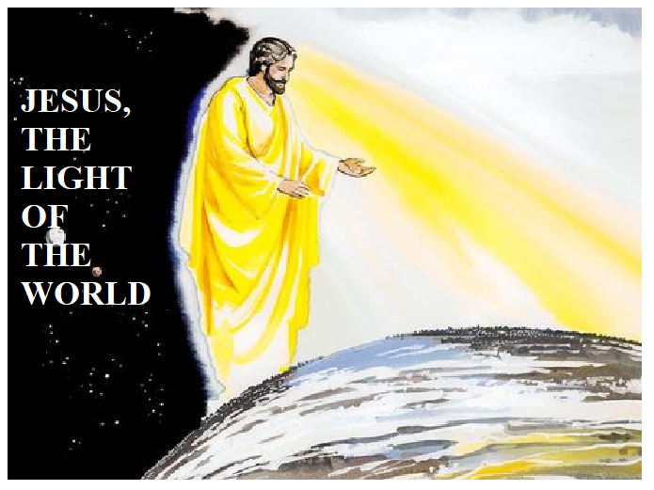
LAST WEEK IN THE GOSPEL
WE SAW THE MISSION OF JOHN THE BAPTIST
John was sent from God.
TO TESTIFY TO THE LIGHT.
SO THAT,
ALL MIGHT BELIEVE.
JESUS, THE LIGHT OF THE WORLD

Slide 3
IN THE GOSPEL TODAY WE SEE, GOD REVEALING HIS GREAT MISSION TO A SPECIAL PERSON.
The angel Gabriel was sent from God to a town of Galilee called Nazareth
Angel Gabriel was sent to a virgin betrothed to a man named Joseph, of the house of David, and the virgin’s name was Mary.

Slide 4
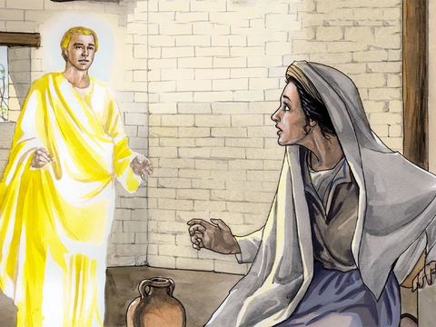
Coming to her, the angel said,
“Hail, full of grace! The Lord is with you.”
Mary was greatly troubled at what was said and pondered what sort of greeting this might be.

Slide 5
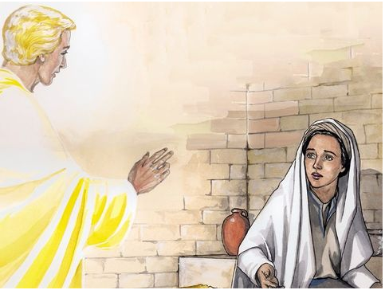
Then the angel said to her,
MARY ASKS THE ANGEL
He will be great and will be called Son of the Most High, and the Lord God will give him the throne of David his father, and he will rule over the house of Jacob forever, and of his kingdom there will be no end.”
“Do not be afraid, Mary, for you have found favor with God.
“Behold, you will conceive in your womb and bear a son, and you shall name him Jesus.
“How can this be, since I have no relations with a man?”

Slide 6
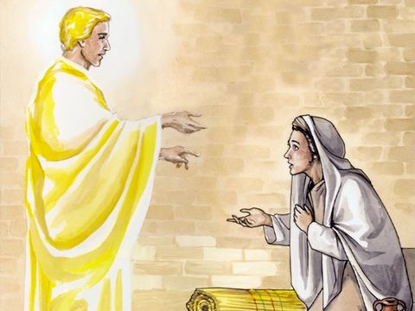
The angel said to her in reply,
AND MARY SAID,
“The Holy Spirit will come upon you, and the power of the Most High will overshadow you. Therefore, the child to be born will be called holy, the Son of God.
“And behold, Elizabeth, your relative, has also conceived a son in her old age, and this is the sixth month for her who was called barren; for nothing will be impossible for God.”
“Behold, I am the handmaid of the Lord. May it be done to me according to your word.”
THE ANGEL GAVE HER A SIGN TOO….
Then the angel departed from her.

Slide 7
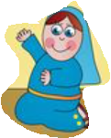
MARY SAID YES IN FAITH FOR HER MISSION
MARY’S MISSION WAS REVEALED THROUGH THE WORD: To conceive in womb and bear a son and
name him Jesus.
HOW WILL IT HAPPEN?
MARY WAS HAVING DOUBTS:
But Mary offered her doubts to the lord..
ANGEL ASSURED HER GOD’S HELP:
The Holy Spirit-
THE POWER OF MOST HIGH

Slide 8
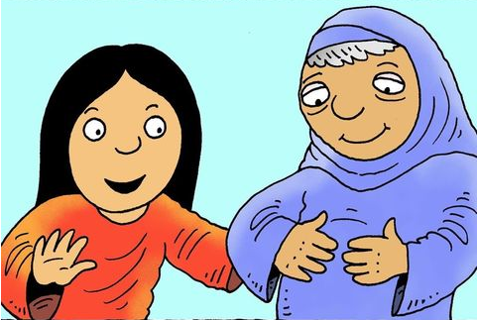
MARY GAVE HERSELF IN TRUST FOR THE WORD OF GOD TO ACCOMPLISH IN HER BY THE POWER OF HOLY SPIRIT.
MOTHER MARY WAS GIVEN A SIGN TOO FOR ASSURANCE
HER AUNTY ELIZABETH WHO HAD NO CHILDREN IS HAVING A BABY IN HER WOMB IN HER OLDAGE.
‘FOR NOTHING WILL BE IMPOSSIBLE FOR GOD.’
“BEHOLD, I AM THE HANDMAID OF THE LORD. MAY IT BE DONE TO ME ACCORDING TO YOUR WORD.”
MOTHER MARY OBEYED IN FAITH

Slide 9
THE LIVING WORD ‘JESUS’ HAS COME TO US TOO….
THROUGH ,
* THE HOLY SCRIPTURES
* THE HOLY EUCHARIST
THE WORD COMES TO US TO BE MADE FLESH IN US JUST LIKE IT CAME TO MARY
HOW ARE WE RESPONDING?
ARE WE DOUBTFUL?
ARE WE OFFERING OUR DOUBTS AND WEAKNESSES TO GOD LIKE MARY?
ARE WE TRUSTING IN THE HEAVENLY HELP THROUGH HOLY SPIRIT?
OR ARE WE IGNORING THE LIVING WORD?

Slide 10
OBEDIENCE OF FAITH
THE WORD
When Lord’s living word come to us, let us say ‘yes’ and ‘amen’ ,
Trusting in the power of the heavenly help – the Holy Spirit.
LET US SEEK OUR MISSION DAILY-
Surrender ourselves in faith
TO TRANSFORM US LIKE JESUS
AND TO DELIVER JESUS TO ALL
‘Nothing is impossible for God’

Slide 11
TODAY IS THE FOURTH SUNDAY OF ADVENT
LET US REMEMBER THE LOVE OF GOD ‘JESUS’ WHO CAME DOWN FOR US AND INTO US TO MAKE EACH OF US LIKE HIM ,
FILLING US WITH HIS PEACE.
LET US LIGHT
THE FOURTH CANDLE
OF PEACE.
THE ANGLE CANDLE

Slide 12
LET US PRAY
Dear Lord Jesus, the living word, we thank you for giving yourself for us. Help us in your mercy to say ‘Yes’ to the living word. Give us grace for the obedience of faith like Mother Mary .Fill us with your power of Holy spirit and accomplish your word in us as we pray, ‘Let it be done in me according to thy word.’
In Jesus name we pray, Amen.

Slide 13
VERSE OF THE WEEK

Slide 14
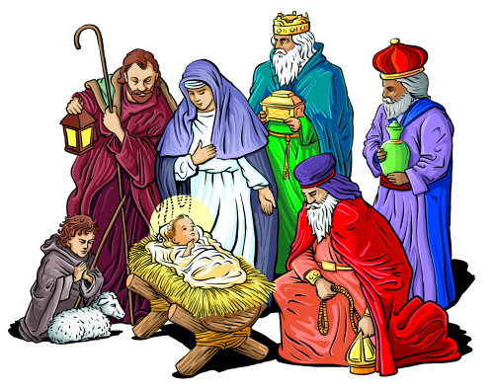
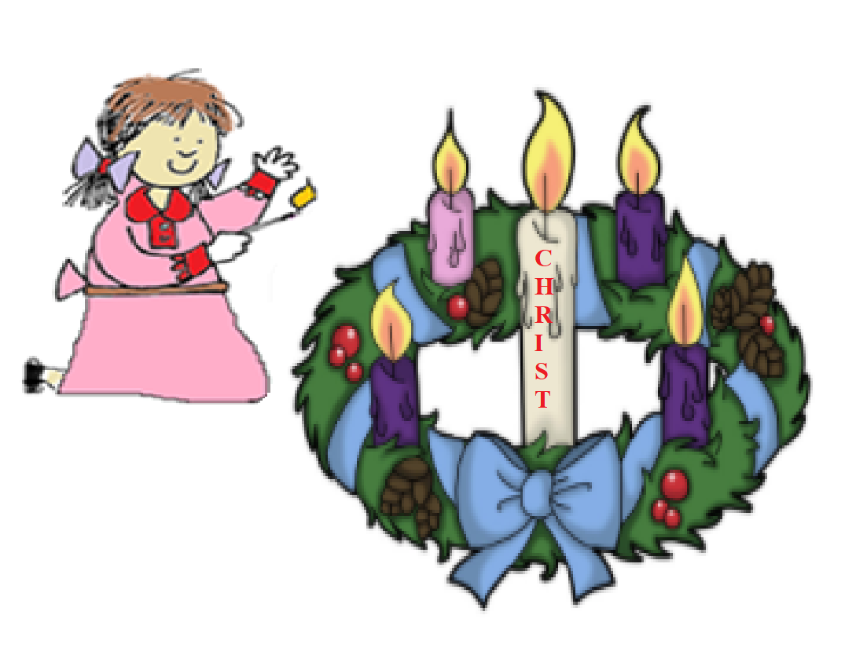
BLESSED CHRISTMAS TO YOU ALL
CELEBRATE JESUS.
WE LIGHT
THE CHRIST CANDLE
ON CHRISTMAS
CELEBRATE GOD’S LOVE.

Slide 15
THANK YOU
GOD BLESS YOU ALL
KEEP LITTLE EVANGELIST IN YOUR SPECIAL PRAYERS
FOR MORE IDEAS PLEASE VISIT:
WEBSITE:
http://littleevangelist.com/childrens_liturgy.php
YOUTUBE CHANNEL:
https://www.youtube.com/channel/UCndM2GK0dnpWg5ECUscdDcA

