Slide 1
The promise received in faith.
THE HOLY FAMILY
CHILDREN’S LITURGY DECEMBER 27TH , 2020
GOSPEL: LUKE 2:22-40

Slide 2
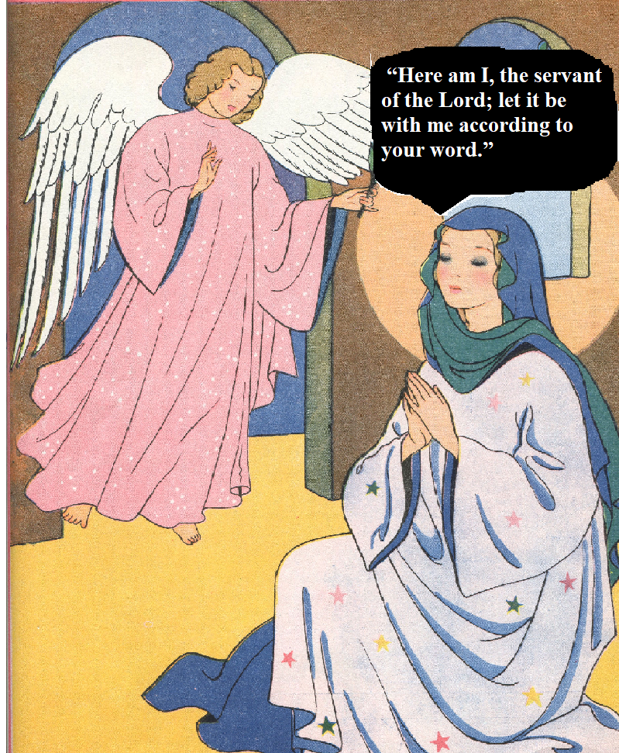
Last week in the Gospel we saw,
Angel Gabriel appearing to Mother Mary with a very important mission from the Lord.
TO CONCEIVE AND BEAR A SON
MARY HAD DOUBTS.
THE ANGEL ASSURED HER THE HEAVENLY HELP;
PROMISED THROUGH THE POWER OF HOLY SPIRIT.
MARY GAVE HERSELF IN TRUST FOR THE WORD OF GOD TO BE ACCOMPLISHED IN HER .
OBEDIENCE
OF FAITH

Slide 3
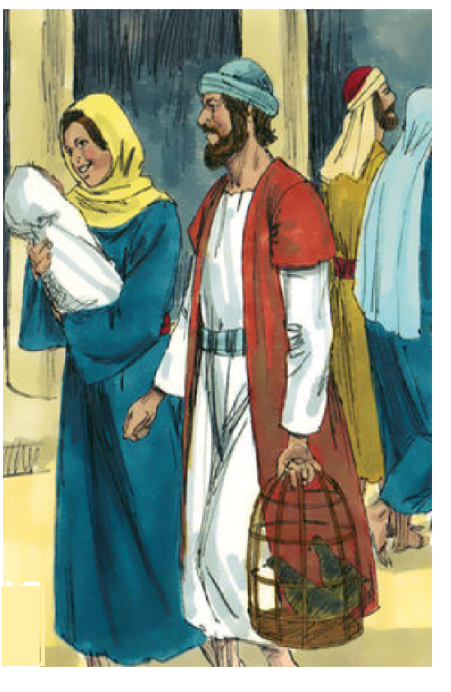
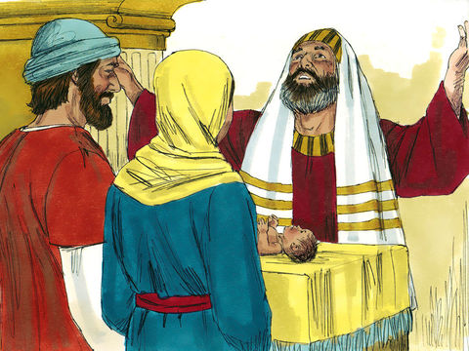
Today in the Gospel,
Jesus’ parents is taking Jesus to Jerusalem
to present him to the lord,
just as it is written in the law of the lord.
THE LAW OF LORD GIVEN THROUGH MOSES
‘Every male that opens the womb shall be consecrated to the Lord, TO OFFER THE SACRIFICE OF a pair of turtledoves or two young pigeons.

Slide 4
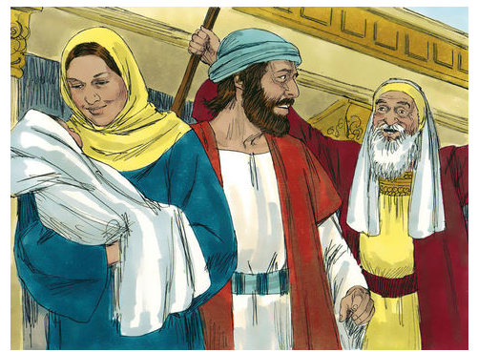
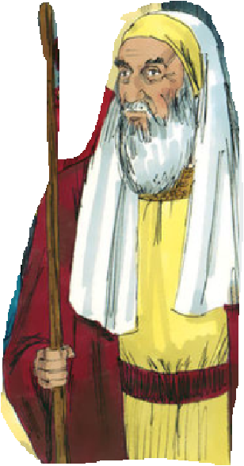
There was a man in Jerusalem whose name was Simeon.
This man was righteous and devout, awaiting the consolation of Israel, and the Holy Spirit was upon him.
It had been revealed to him by the Holy Spirit that
he should not see death before
he had seen the Christ of the Lord.
He came in the Spirit into the temple; and when the parents brought in the child Jesus.

Slide 5
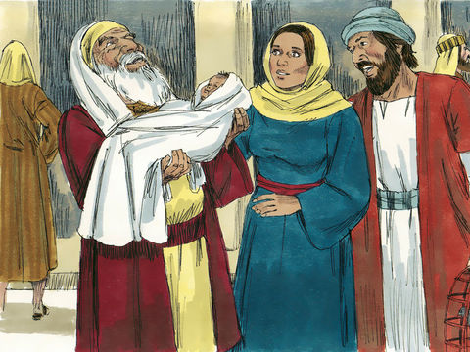
He took him into his arms and blessed God, saying:
“Now, Master, you may let your servant go in peace, according to your word, for my eyes have seen your salvation, which you prepared in sight of all the peoples, a light for revelation to the Gentiles, and glory for your people Israel.”
The child’s father and mother were amazed at what was said about him.

Slide 6
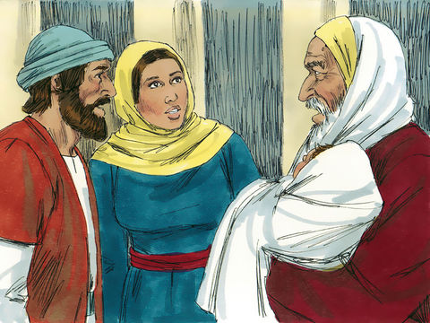
Simeon blessed them and said to Mary his mother,
“Behold, this child
is destined for the fall and rise of many in Israel, and to be a sign that will be contradicted —and you yourself a sword will pierce— so that the thoughts of many hearts may be revealed.”

Slide 7
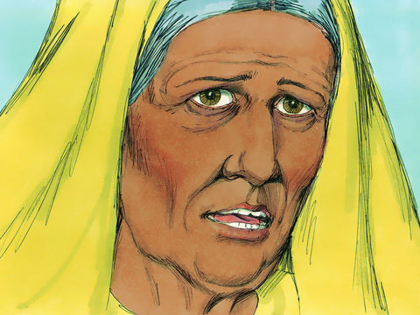
There was also a prophetess, Anna,
She is the daughter of Phanuel (the tribe of Asher).
She was very old.
She lived seven years with her husband after her marriage. She became a widow .
She went to live in the temple of Jerusalem.
She was eighty-four. She never left the temple, but worshiped night and day with fasting and prayer.

Slide 8
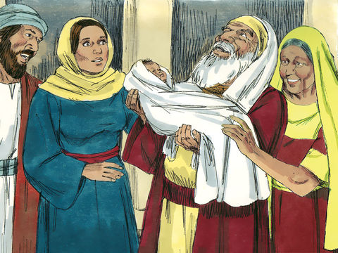
On seeing Jesus, she came forward and gave thanks to god and spoke about the child to all who were awaiting the redemption of Jerusalem.

Slide 9
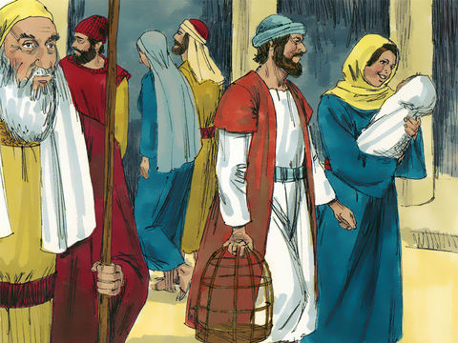
Jesus grew and became strong, filled with wisdom; and the favor of God was upon him.
When the HOLY FAMILY had fulfilled everything in the law of the Lord, they returned to Galilee, to their own town of Nazareth.

Slide 10
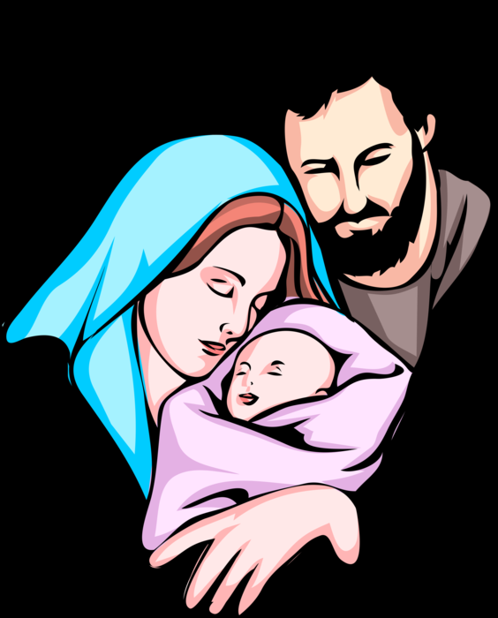
The Holy Family was obedient to the Lord.
THE GREATEST PROMISE FULFILLED- JESUS
By presenting Jesus to the lord, they thanked lord who fulfilled His promise.
Jesus’ parents dedicated Him in God’s hands,
to be filled in wisdom and God’s favour.
Are we offering our families for the grace like the Holy Family to be obedient to Lords words?
Are we thankful to our Lord for Jesus and for all His blessings?
LET US BE THANKFUL TO THE LORD
WHO FULFILLED HIS PROMISE FOR EACH OF US

Slide 11
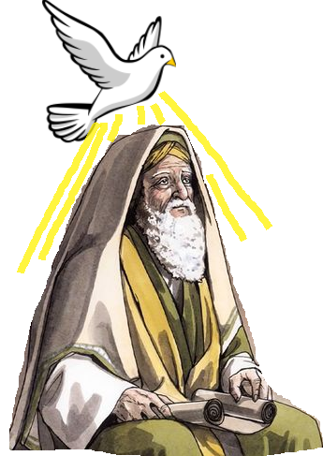
WAITING FAITHFULLY; TRUSTING IN LORDS PROMISE
Simeon offered himself to be led by the holy spirit as he put trust in the promise of the lord.
People living in God’s Spirit will be led to God and are able to see God’s plans and His promises revealed.
Prophetess Anna too dedicated herself for the lord..
PRAYED
FASTED
SERVED GOD
She
as she waited patiently in faith on the Lords promised Saviour.
As she RECOGNIZED Jesus, she began to PRAISE God and began to make Jesus KNOWN to all.

Slide 12
OUR GOD IS ALWAYS FAITHFUL IN HIS PROMISES
Are we allowing ourselves to be led by Holy Spirit ?
Holy Spirit helps us to recognize Jesus and
leads us to the everlasting happiness and salvation in Jesus.
Are we making known about- Jesus- the greatest gift of the Lord
for the world to all ?
God fulfilled His greatest promise by sending His son, Jesus for us so that anyone who believes in him will have eternal life in heaven.
ARE WE FAITHFUL TO GOD?

Slide 13
WALK IN HOLY SPIRIT, FILLING IN WISDOM AND FAVOUR OF GOD
BE
FAITHFUL
BE LOYAL
Let us OFFER our Families to be like the Holy family
Let us be THANKFUL for everything Lord is doing for us.
Let us be FAITHFUL and LOYAL to God, living by TRUSTING in Jesus.
Let us live in spirit FOLLOWING Jesus, WAITING PATIENTLY in FAITH and PREPARING in hope for the promise of His Second coming.

Slide 14
LET US PRAY
Dear Lord, we thank you for Jesus, the greatest gift of your love . We thank you for the Holy spirit that you gave us through Jesus to live a life that leads us to You in Heaven. We thank you for our families. Give us grace to live in the Holy spirit, filling in wisdom by knowing Jesus and being like Him more and more. Help us to always be thankful , loyal, patient, and faithful to you as we wait in hope, putting our trust in the second coming of Jesus. Let Your favor be upon each one of us. Make our families like the Holy Family.
In Jesus name we pray, Amen.

Slide 15
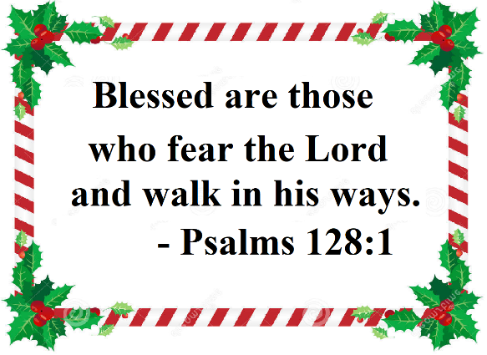
VERSE OF THE WEEK

Slide 16
THANK YOU
FOR MORE IDEAS PLEASE VISIT:
WEBSITE:
http://littleevangelist.com/childrens_liturgy.php
YOUTUBE CHANNEL:
https://www.youtube.com/channel/UCndM2GK0dnpWg5ECUscdDcA
GOD BLESS YOU ALL

