Slide 1
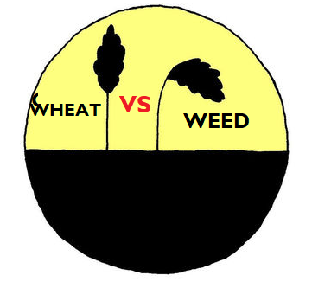
Gospel: matthew 13:24-30,36-43
The parable of the weeds
AMONG THE WHEAT
Children’s liturgy July 19th, 2020

Slide 2
In the liturgy last Sunday, WE HEARD ‘THE PARABLE OF THE SOWER’
JESUS TAUGHT US TO BE THE RICH SOIL
Our heart is God’s field.
He is sowing good seeds of word in us.
But each of us receive the word differently.
For the word to be fruitful, and to yield manifold, we must be a rich soil
But if in our hearts (the soil), there are rocks or thorns or if we are indifferent without getting deep rooted in God’s love, the seed of word will be crushed by thorns, rocks and the scorching sun and will be rendered fruitless.

Slide 3
TODAY WE HEAR ANOTHER PARABLE. THIS PARABLE IS ABOUT THE KINGDOM OF GOD.
The parable of the weeds
AMONG THE WHEAT

Slide 4
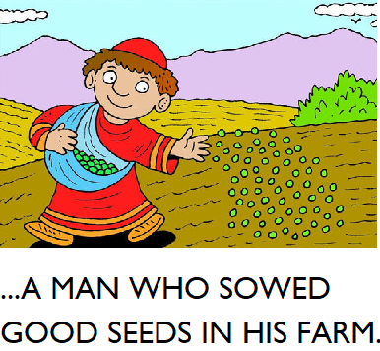
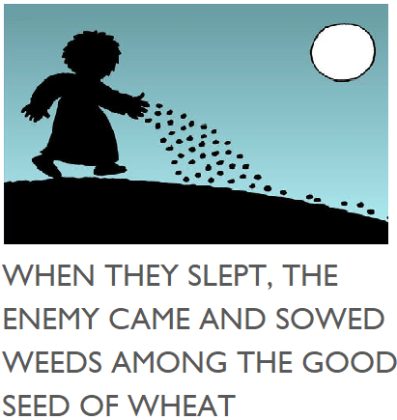
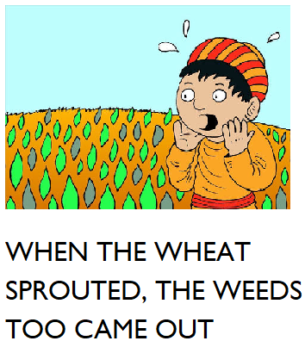
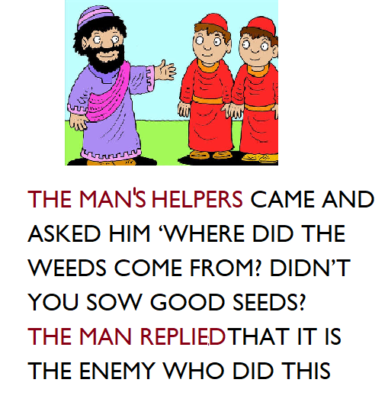
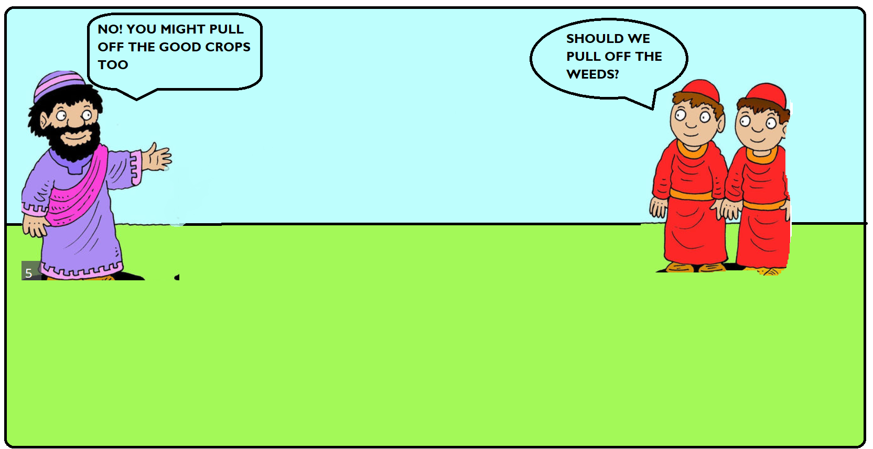
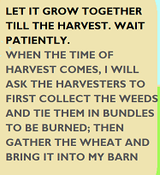
JESUS SAYS THAT THE KINGDOM OF HEAVEN IS LIKE:

Slide 5
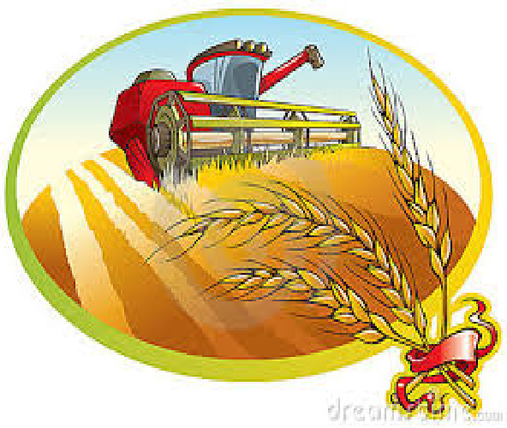
JESUS EXPLAINS THE PARABLE TO THE DISCIPLES
THE SOWER OF GOOD SEED - IS THE SON OF MAN
THE FIELD – IS THE WORLD
THE GOOD SEEDS – ARE THE PEOPLE OF THE KINGDOM
THE SOWER OF THE WEEDS – IS THE DEVIL
THE WEEDS – ARE THE PEOPLE OF EVIL ONE
THE HARVEST – IS THE END OF THE AGE
THE HARVESTER - ARE THE ANGELS

Slide 6
JESUS MAKES IT CLEAR OF HOW THE END OF THE AGES WILL BE…
IN THE END OF THE AGES, JUST AS THE WEEDS ARE PULLED OUT .
THE SON OF MAN WILL SEND OUT HIS ANGELS,WHO WILL WEED OUT EVERYTHING THAT CAUSES SIN AND ALL WHO DO EVIL FROM THE KINGDOM.THEY WILL THROW THEM INTO THE BLAZING FURNACE, WHERE THERE WILL BE WEEPING AND GNASHING OF TEETH.
THEN THE RIGHTEOUS , (THE GOOD CROPS) WILL SHINE LIKE THE SUN IN THE KINGDOM OF THEIR FATHER.

Slide 7
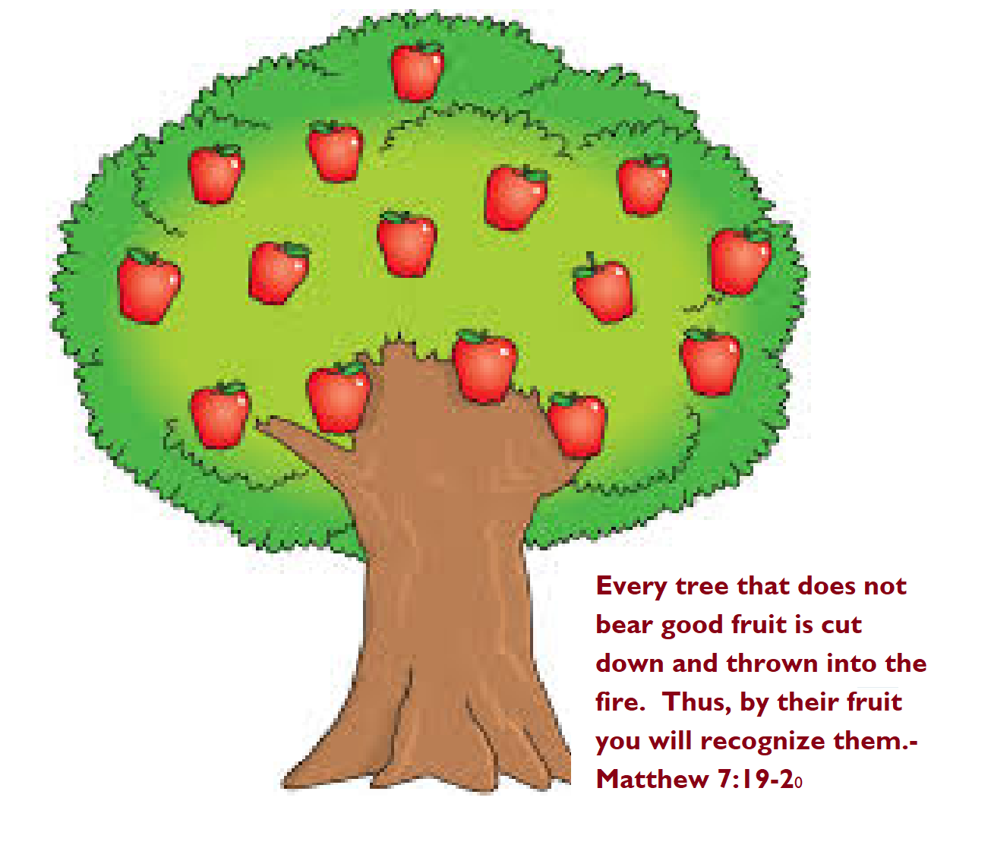
GOD ALLOWS GOOD AND EVIL TO GROW TOGETHER TILL HARVEST
THE EVIL MIMICS THE GOOD. IT IS HARD TO FIND WHO IS TRUE
THE HARVEST TIME REVEALS THE FRUITS OF THE CROPS. THE ONE WITH GOOD FRUITS ARE THE GOOD ONES
THE GOOD PERSON CAN BE KNOW FROM HIS FRUITS- HIS ACTIONS

Slide 8
GOD IS MERCIFUL AND PATIENT
GOD IS PATIENT AND KIND TO ALL
GOD GIVES TIME AND CHANCES FOR THE EVIL ONES TO CHANGE
WE TOO MUST BE PATIENT, KIND AND FORGIVING.
WE MUST NOT JUDGE
WE MUST OUTGROW THE WEEDS , BY LIVING IN THE HOLY SPIRIT
WE MUST GAIN STRENGTH FROM LORD TO BE GOOD CROPS.

Slide 9
NEVER BOTHER THE WEEDS. GOD WILL TAKE CARE OF THEM
ONLY BOTHER ;
HOW TO OUTGROW THE WEEDS BY BEING GOOD CROPS?
BE GOOD CROPS
BEARING GOOD FRUITS FOR LORD
NEVER BE LAZY
STAY AWAKE AND PRAY
RECEIVE THE WORD OF GOD, ALLOW IT TO CHANGE US
LIVE IN THE POWER OF HOLY SPIRIT, OUTGROW THE WEEDS
BE PATIENT MERCIFUL AND KIND JUST AS OUR LORD IS
PRAY FOR THE CONVERSION OF ALL TOWARDS JESUS
DO NOT JUDGE
BEWARE NOT TO BE A WEED!!

Slide 10
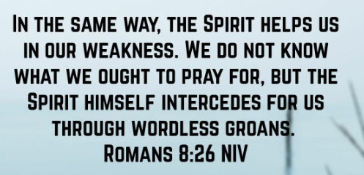
PRAYER
DEAR LORD WE THANK YOU FOR BEING MERCIFUL, KIND AND FORGIVING TOWARDS US. BY THE POWER OF YOUR HOLY SPIRIT AND THE LIVING WORD, HELP US TO GROW AS GOOD CROPS BEARING GOOD FRUITS FOR YOU. GIVE US GRACE TO BE KIND AND MERCIFUL LIKE YOU AND NOT TO JUDGE ANYONE BUT TO OVERCOME EVIL BY DOING GOOD AND TO PRAY FOR ALL TO REACH TO YOU, THE ETERNAL ABODE OF LOVE. IN JESUS NAME WE PRAY ,AMEN

Slide 11
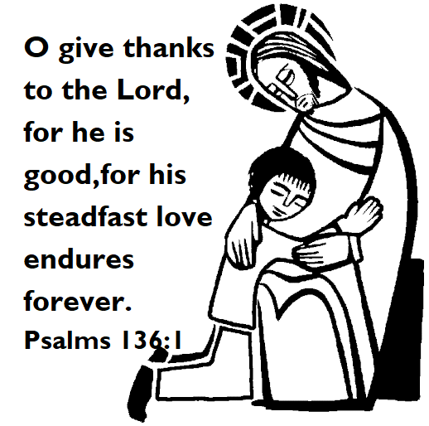
VERSE FOR THE DAY
LORD, YOU ARE GOOD AND FORGIVING, MOST MERCIFUL TO ALL WHO CALL ON YOU. -PSALMS 86:5

Slide 12
THANK YOU GOD BLESS YOU
FOR MORE IDEAS , PLEASE VISIT:
WEBSITE: http://littleevangelist.com/childrens_liturgy.php
YOUTUBE CHANNEL: https://www.youtube.com/channel/UCndM2GK0dnpWg5ECUscdDcA

